Slide 1
Betty Vergheese.P
Medical Surgical Department

Slide 2
FISSURES

Slide 3
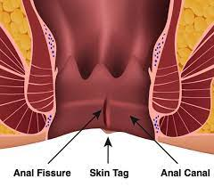

Slide 4
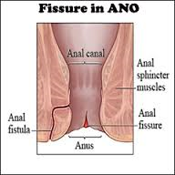

Slide 5
Definition
An anal fissure is a tear or cut in the skin that lines the anus causing a painful linear ulcer at the margin of the anus.
The anal fissure can cause pain,bleeding and or itching.
Most anal fissures occur along the mid-line ,the top or bottom-of the anus. .

Slide 6
TYPES
Acute anal fissure –recent onset
Chronic anal fissure-
present for a long time or occuring frequently.
Chronic fissures often have a small external lump associated with the tear

Slide 7
CAUSES & RISK FACTORS
Large or hard stools passing through the anal canal
Constipation
Straining during bowel movements
Diarrhea
Anal sex

Slide 8
f.Child birth
g. Anorectal surgery
h. Proctitis:inflammation of the lining of the rectum.
I. A low fiber diet

Slide 9
Health conditions-cause
Vitamin B6 deficiency
Abdominal pain
Fever
Weight loss
Chrons disease
Inflammatory bowel disease

Slide 10
7.Syphilis
8. Suppressed immune system
9.Tuberculosis
10.HIV infection
11.cancer

Slide 11
CLINICAL FEATURES
Pain during or after defecation and bleeding.
Sharp, stinging or burning pain during and following a bowel movement
Spots of bright red blood on toilet tissue
Itching and malodorous discharge may also occur
A visible crack in the skin around the anus
A small lump or skin tag on the skin near the anal fissure

Slide 12
Diagnostic measures
Physical examination
Anal manometry
Flexible sigmoidoscopy
colonoscopy

Slide 13
Anal Manometry
Non invasive test that measures the pressure and function of the anal and rectal muscles

Slide 14
Medical treatment
High fiber diet,bulking agents,plenty of fluids
Warm bath for 10-20 mts
sitz bath with salt water
3.Pain killers-paracetamol
4.Local anesthetic ointments
5.Nitroglycerin applied locally twice daily every dya for 6 weeks
6.Botox injection- paralyzes the muscle of anal spincture

Slide 15
Surgical management
1. Internal spincterotomy
Cutting small portion of the inner muscle around the anus
IP procedure
Under general or spinal anesthesia
2. Anal dilation
3.Fissurectomy: is the first line surgical treatment of fissure.It is done with local advancement flap where after fissure excision the defect in the anal canal is closed by a small advancement flap.
4.Lord’s dilatation : also known as blunt spincterotomy

Slide 16
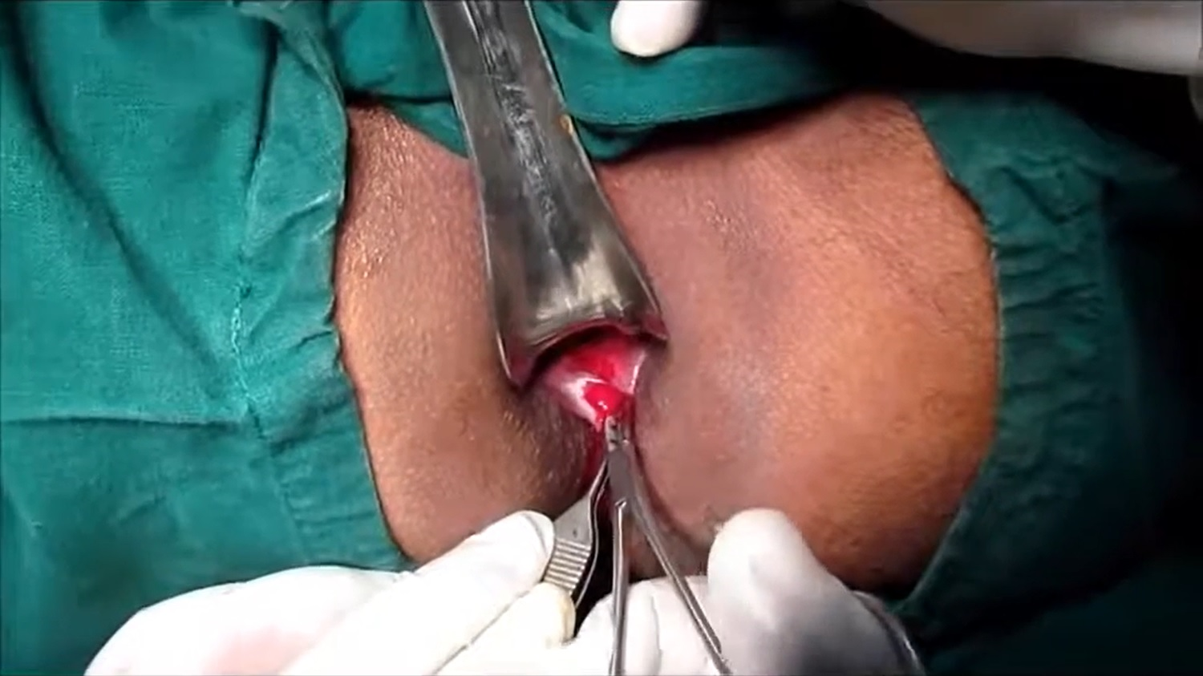
Spincterotomy

Slide 17
Life style and home remedies
1. Add fiber to diet: Getting enough fiber in diet-about 25 to 30 grams a day-improves fissure healing and helps keep stools soft. Increase fiber intake by eating more fruits,vegetables, nuts and whole grains.
2. Drink adequate fluids: Fluids help prevent constipation, so it's important to get enough fluids up to eight glasses a day.
3. Avoid too much tea and coffee as these can make
constipation worse.

Slide 18
3. Exercise regularly: Engage in 30 minutes or more of moderate physical activity
Exercise promotes regular bowel movements and increases
blood flow to all parts of body, which may promote healing of an anal fissure
4. Avoid straining during bowel movements: Straining creates pressure, which can open a healing tear or cause a new tear.

Slide 19
GODS LOVE IS SO
WONDERFUL

