Slide 1
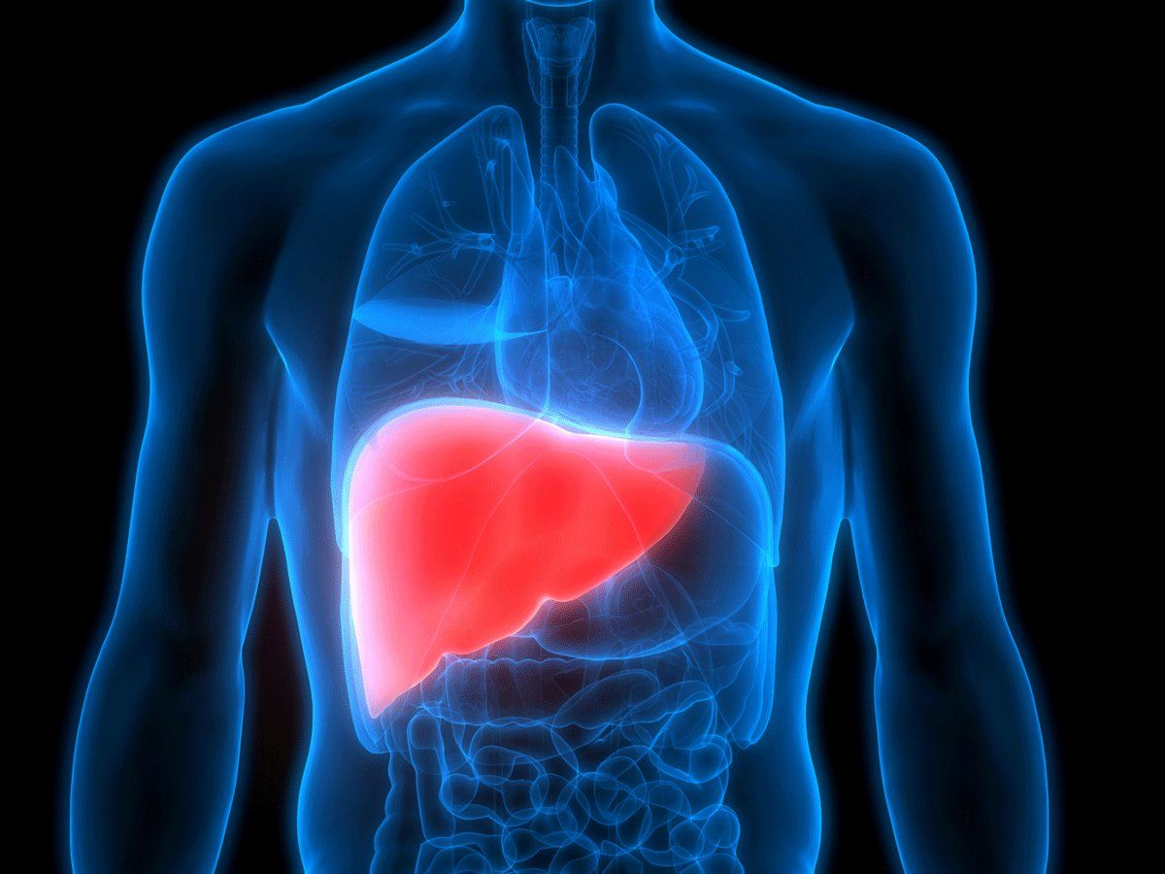
VIRAL HEPATITIS AND ITS PREVENTION
Betsy Varghese
Lecturer
Medical Surgical Department
JMCON

Slide 2
OBJCTIVES
CENTRAL OBJECTIVE: at the end of the class students will acquire in depth knowledge about viral hepatitis, appreciate its management and utilize this knowledge in taking care of patient with viral hepatitis with positive attitude.
SPECIFIC OBJECTIVES
Define hepatitis
Enlist types of viral hepatitis
Explain stages of viral hepatitis
Differentiate types of hepatitis and its prevention
Explain nurses role in prevention of viral hepatitis

Slide 3
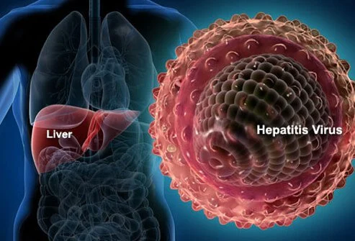
INTRODUCTION
Several viruses are known to cause hepatitis, which refers to inflammation of the liver.

Slide 4
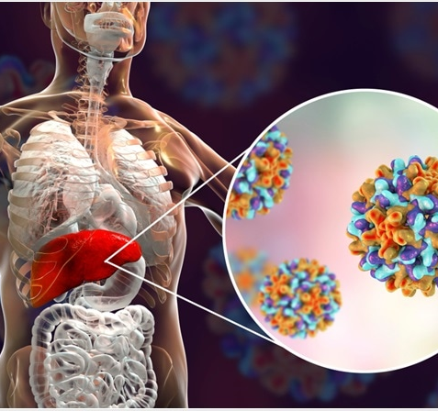
HEPATITIS
Inflammation of the liver caused by a virus, bacteria, or exposure to medications or hepatotoxins
Notes:
May require more than one slide

Slide 5
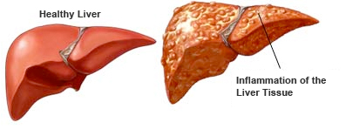
TYPES OF VIRAL HEPATITIS
Hepatitis A virus (HAV)
Hepatitis B virus (HBV)
Hepatitis C virus (HCV)
HepatitisD virus (HDV)
Hepatitis E virus (HEV)
Notes:
May require more than one slide

Slide 6
STAGES OF VIRAL HEPATITIS
Preicteric Stage
The first stage of hepatitis, preceding the appearance of jaundice;
Includes flu-like symptoms, malaise, fatigue
GI symptoms: anorexia, nausea, vomiting, diarrhea
Headache, muscle aches, polyarthritis
Elevated serum bilirubin and enzyme levels
Notes:
May require more than one slide

Slide 7
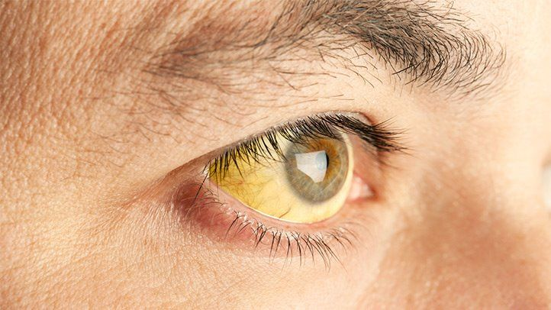
STAGES OF VIRAL HEPATITIS
Icteric Stage
The second stage of hepatitis includes the appearance of jaundice and associated symptoms
such as elevated bilirubin levels,
dark or tea-colored urine, and
Clay colored stools
Pruritus
decrease in preicteric-phase symptoms.
Notes:
May require more than one slide

Slide 8
STAGES OF VIRAL HEPATITIS
Posticteric Stage
The convalescent stage of hepatitis includes;
Jaundice decreases
Color of the urine and stool returns to normal
Energy increases
Pain subsides,
There is minimal to absent gastrointestinal symptoms
Bilirubin and enzyme levels return to normal.
Notes:
May require more than one slide

Slide 9
HEPATITIS A
Formerly known as infectious hepatitis
Caused by RNA virus of enterovirus family
Individuals at increased risk
1. Crowded conditions (e.g., day care, nursing home)
2. Exposure to poor sanitation
Notes:
May require more than one slide

Slide 10
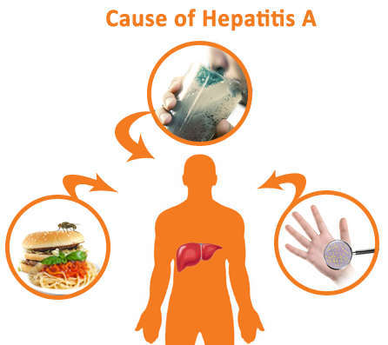
HEPATITIS A
Transmission
Fecal-oral route
Person-to-person contact
Parenteral
Contaminated fruits or vegetables, or uncooked Shellfish
Contaminated water or milk
Poorly washed utensils
Notes:
May require more than one slide

Slide 11

HEPATITIS A
Incubation and infectious period
1. Incubation period is 2 to 6 weeks.
2. Infectious period is 2 to 3 weeks before and 1 week after development of jaundice
Testing
1. Present soon after symptoms appear - HAV antibodies (anti-HAV) in the blood.
2..Recent infection - elevated levels of IgM antibodies, which persist in the blood for 4 to 6 weeks.
3. Previous infection is indicated by the presence of elevated levels of IgG antibodies.
Notes:
May require more than one slide

Slide 12

HEPATITIS A
Prevention
1. Strict hand washing
2. Stool and needle precautions
3. Treatment of municipal water supplies
4. Serological screening of food handlers
5. Hepatitis A vaccine:
6. Immune globulin: For individuals exposed to HAV who have never received the hepatitis A vaccine; administer immune globulin during the period of incubation and within 2 weeks of exposure.
Notes:
May require more than one slide

Slide 13
HEPATITIS A
Prevention
7. Immune globulin and hepatitis A vaccine are recommended for household members and sexual contacts of individuals with hepatitis A.
8. Preexposure prophylaxis with immune globulin is recommended to individuals traveling to countries with poor or uncertain sanitation conditions..
Notes:
May require more than one slide

Slide 14
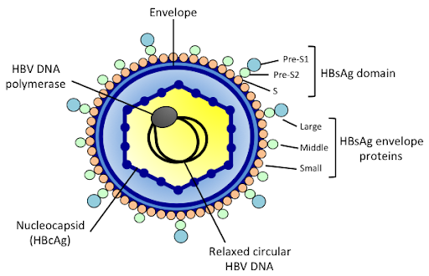
HEPATITIS B
Hepatitis B is nonseasonal.
All age groups can be affected
It is known as serum hepatitis
HBV is found in blood and all body fluids except stool
Notes:
May require more than one slide

Slide 15
HEPATITIS B
Individuals at increased risk
1. IV drug users
2. Clients undergoing long-term hemodialysis
3. Health care personnel
4. Multiple sexual partners
5. Blood transfusion

Slide 16
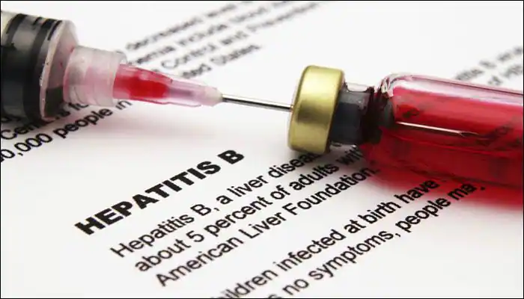
HEPATITIS B
Transmission
1. Blood or body fluid contact
2. Infected blood products
3. Infected saliva or semen
4. Contaminated needles
5. Sexual contact
6. Parenteral
7. Perinatal period
8. Blood or body fluid contact at birth

Slide 17
HEPATITIS B
Incubation period: 6 to 24 weeks
Testing
1. Infection is established by the presence of hepatitis B antigen– antibody systems in the blood.
2. The presence of hepatitis B surface antigen (HBsAg) is the serological marker establishing the diagnosis of hepatitis B.
3. If the serological marker (HBsAg) is present after 6months, it indicates a carrier state or chronic hepatitis. Normally, the serological marker (HBsAg) level declines and disappears after the acute hepatitis B episode.
Notes:
May require more than one slide

Slide 18
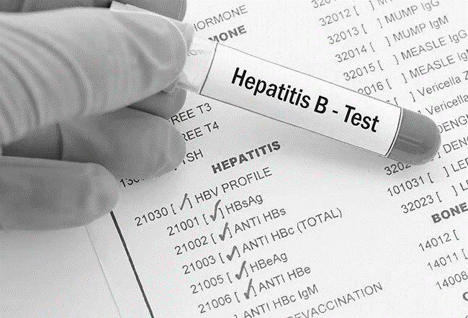
HEPATITIS B
6. The presence of antibodies to HBsAg (anti-HBs) indicates recovery and immunity to hepatitis B.
7. Hepatitis B early antigen (HBeAg) is detected in the blood about 1 week after the appearance of HBsAg, and its presence determines the infective state of the client.
Notes:
May require more than one slide

Slide 19
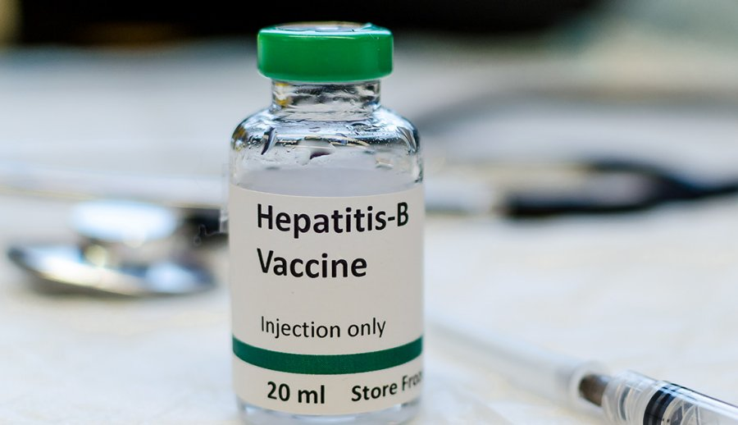
HEPATITIS B
Prevention
1. Strict hand washing
2. Screening blood donors
3. Testing of all pregnant women
4. Needle precautions
5. Avoiding intimate sexual contact and contact with body fluids if test for HBsAg is positive.
6. Hepatitis B vaccine
Notes:
May require more than one slide

Slide 20
HEPATITIS B
Prevention
7. Hepatitis B immune globulin is for individuals exposed to HBV through sexual contact or through the percutaneous or transmucosal routes who have never had hepatitis B and have never received hepatitis B vaccine.
Notes:
May require more than one slide

Slide 21
HEPATITIS C
HCV infection occurs year-round.
Infection can occur in any age group.
Infection with HCV is common among IV drug users and is the major cause of posttransfusion hepatitis.
Risk factors and transmission are similar to those for HBV, because hepatitis C is also transmitted parenterally.
Notes:
May require more than one slide

Slide 22
HEPATITIS C
Incubation period:
5 to 10 weeks
Testing:
Anti-HCV is the antibody to HCV and is measured to detect chronic states of hepatitis C
Prevention
1. Strict hand washing
2. Needle precautions
3. Screening of blood donors
Notes:
May require more than one slide

Slide 23
HEPATITIS D
Hepatitis D is common in the Mediterranean and Middle Eastern areas.
Hepatitis D occurs with hepatitis B and causes infection only in the presence of active HBV infection.
Coinfection with the delta agent (HDV) intensifies the acute symptoms of hepatitis B.
Transmission and risk of infection are the same as for HBV, via contact with blood and blood products.
Prevention of HBV infection with vaccine also prevents HDV infection, because HDV depends on HBV for replication.
Notes:
May require more than one slide

Slide 24
HEPATITIS D
Incubation period: 7 to 8 weeks
Testing:
Serological HDV determination is made by detection of the hepatitis D antigen (HDAg) early in the course of the infection and by detection of anti-HDV antibody in the later disease stages
Prevention:
The precautions that help prevent hepatitis B are also useful in preventing delta hepatitis.
Notes:
May require more than one slide

Slide 25
HEPATITIS E
Hepatitis E is a waterborne virus.
Hepatitis E is prevalent in areas where sewage disposal is inadequate or where communal bathing in contaminated rivers is practiced.
Risk of infection and transmission is the same as for HAV.
Infection with HEV presents as a mild disease except in infected women in the third trimester of pregnancy, who have a high mortality rate
Notes:
May require more than one slide

Slide 26
HEPATITIS E
Individuals with increased risk
1. Travelers to countries that have a high incidence of hepatitis E, such as India, Burma (Myanmar), Afghanistan, Algeria, and Mexico
2. Eating or drinking of food or water contaminated with the virus
Notes:
May require more than one slide

Slide 27
HEPATITIS E
Incubation period: 2 to 9 weeks
Testing:
Specific serological tests for HEV include detection of IgM and IgG antibodies to hepatitis E (anti-HEV).
Prevention:
1. Strict hand washing
2. Treatment of water supplies and sanitation measures
Notes:
May require more than one slide

Slide 28
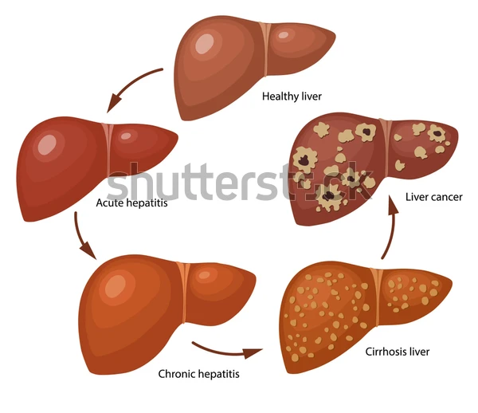
COMPLICATIONS
Fulminant hepatitis
Chronic liver disease
Cirrhosis
Primary hepatocellular carcinoma
Notes:
May require more than one slide

Slide 29
HOME CARE INSTRUCTIONS FOR THE CLIENT WITH HEPATITIS
Hand washing must be strict and frequent.
Do not share bathrooms unless the client strictly adheres to personal hygiene measures.
Individual washcloths, towels, drinking and eating utensils, and toothbrushes and razors must be labeled and used only by the client.
The client must not prepare food for other family members.
Notes:
May require more than one slide

Slide 30
HOME CARE INSTRUCTIONS FOR THE CLIENT WITH HEPATITIS
The client should avoid alcohol and over-the-counter medications, particularly acetaminophen and sedatives, because these medications are hepatotoxic
The client should increase activity gradually to prevent fatigue.
The client should consume small, frequent meals consisting of high carbohydrate, low-fat foods.
The client is not to donate blood.
The client may maintain normal contact with persons as long as proper personal hygiene is maintained.
Notes:
May require more than one slide

Slide 31
HOME CARE INSTRUCTIONS FOR THE CLIENT WITH HEPATITIS
Close personal contact such as kissing and sexual activity should be discouraged with hepatitis B until surface antigen test results are negative.
The client needs to carry a MedicAlert card noting the date of hepatitis onset.
The client needs to inform other health professionals, such as medical or dental personnel, of the onset of hepatitis.
The client needs to keep follow-up appointments with the primary health care provider.
Notes:
May require more than one slide

Slide 32
REFERENCE
Brunner & suddarth’s text book of Medical- Surgical Nursing.volume-3. By Janice L. Hinkle & Kerry H. Cheever. Edition-13th.
Lewis S,Heitkemper M,Dirken S. Medical –surgical nursing .St Louis:mosby;2018
Notes:
May require more than one slide

Slide 33
CONCLUSION
Hepatitis A and E usually only cause short-term (acute) infections that the body can overcome. The others (B, C and D) can also cause acute infections, but might also cause chronic (long-term) infections. The chronic forms are more dangerous. Hepatitis non-E is usually acute, but can become chronic.

Slide 34


