Slide 1
Triage
Presented by,
Ms. Anila Arun
Asst.Professor

Slide 2
Objectives:
Defines triage
Lists aims of triage
Explains types of triage
Describes the principles of triage
Enumerates the basic components of triage

Slide 3
Meaning of triage
Triage comes from the French word, ‘to sort out or choose”.
It is the art of sorting patients according to the severity of their injury.
It is the key for successful management of the disaster affected victims of which is performed in the field and in the emergency department.

Slide 4
Definition of triage
It’s the process by which patients classified according to the type and urgency of their conditions to get the . Right patient to the Right place at the Right time with the Right care provider

Slide 5
Aims of triage
1. To sort patients based on needs for immediate care
2. To recognize futility
3. Medical needs will outstrip the immediately available resources
4. Additional resources will become available given enough time.

Slide 6
PRINCIPLES OF TRIAGE
The main principles of triage are as follows: –
1. Every patient should receive and triaged by appropriate skilled health-care professionals.
2. Triage is a clinic-managerial decision and must involve collaborative planning.
3. The triage process should not cause a delay in the delivery of effective clinical care.

Slide 7
Advantages of Triage
1. Helps to bring order and organization to a chaotic scene.
2. It identifies and provides care to those who are in greatest need
3. Helps make the difficult decisions easier
4. Assure that resources are used in the most effective manner
5. May take some of the emotional burden away from those doing triage

Slide 8
Types of triage
There are two types of triage:
1. Simple triage
2. Advanced triage

Slide 9
Simple triage
Simple triage is used in a scene of mass casualty, in order to sort patients into those who need critical attention and immediate transport to the hospital and those with less serious injuries.
S.T.A.R.T. (Simple Triage and Rapid Treatment) is a simple triage system that can be performed by lightly trained lay and emergency personnel in emergencies.
Triage separates the injured into four groups:
0 – The deceased who are beyond help
1 – The injured who can be helped by immediate transportation
2 – The injured whose transport can be delayed
3 – Those with minor injuries, who need help less urgently

Slide 10
Advanced triage
In advanced triage, doctors may decide that some seriously injured people should not receive advanced care because they are unlikely to survive.
Advanced care will be used on patients with less severe injuries. Because treatment is intentionally withheld from patients with certain injuries, advanced triage has an ethical implication.
Principles of advanced triage is
“Do the greatest good for the greatest number”
Preservation of life takes precedence over preservation of limbs.
Immediate threats to life: HEMORRHAGE

Slide 11
Triage Categories
The North Atlantic Treaty Organization (NATO) triage system is one that is widely used and presented here. It consists of four colours, Red, Yellow, Green and Black. Each colour signifies a different level of priority.

Slide 12
Triage Categories CONTD
Class I (emergent) Red IMMEDIATE
– Victims with serious injuries that are life threatening but has a high probability of survival if they received immediate care.
– They require immediate surgery or other life-saving intervention, and have first priority for surgical teams or transport to advanced facilities; they “cannot wait” but are likely to survive with immediate treatment.
“Critical; life threatening—compromised airway, shock, hemorrhage”

Slide 13
Triage Categories CONTD
Class II (urgent) Yellow DELAYED
– Victims who are seriously injured and whose life is not immediately threatened; and can delay transport and treatment for 2 hours.
– Their condition is stable for the moment but requires watching by trained persons and frequent re-triage, will need hospital care (and would receive immediate priority care under “normal” circumstances).
“Major illness or injury;—open fracture, chest wound”

Slide 14
Triage Categories CONTD
Class III (non- urgent) Green MINIMAL
– “Walking wounded,” the casualty requires medical attention when all higher priority patients have been evacuated, and may not require monitoring.
– Patients/victims whose care and transport may be delayed 2 hours or more.
“minor injuries; walking wounded—closed fracture, sprain, strain”

Slide 15
Triage Categories CONTD
Class IV (expectant) Black EXPECTANT
They are so severely injured that they will die of their injuries, possibly in hours or days (large-body burns, severe trauma, lethal radiation dose), or in life-threatening medical crisis that they are unlikely to survive given the care available (cardiac arrest, septic shock, severe head or chest wounds);
They should be taken to a holding area and given painkillers as required to reduce suffering.
“Dead or expected to die—massive head injury, extensive full-thickness burns”

Slide 16
Basic component of triage
• An “across-the room” assessment
• The triage history
• The triage physical assessment
• The triage decision

Slide 17
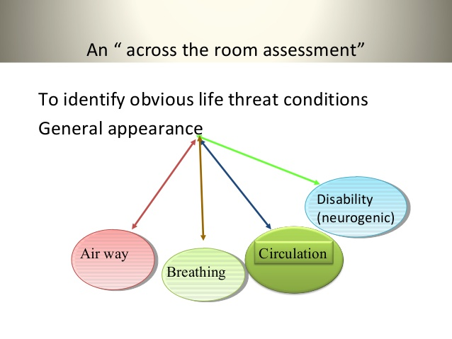

Slide 18
Across the room assessment
• Air way
Abnormal airway sounds, strider, wheezing grunting Unusual posture e.g.. Sniffing position, inability to speak, drooling or inability to handle secretion
• Breathing
Altered skin signs, cyanosis, dusky skin, tachypnic bradypnea, or apnea periods, retractions, use accessory muscles, nasal flaring, grunting, or audible wheezes

Slide 19
Across the room assessment
• Circulation
Altered skin signs, pale, mottling, flushing Un controlled bleeding
• Disability (neuro.)
Decrease LOC
Decrease Interaction with environment
Inability to recognize family members
Unusual irritability Response to pain or stimuli
Decrease Flaccid or hyper active muscle tone

Slide 20
Characteristics of triage nurse
Extensive knowledge to emergency medical treatment
Adequate training and competent skills, language, terminology
Ability to use the critical thinker process
Good decision maker

Slide 21
Role of triage nurse
• Greet patients and identify your self.
• Maintain privacy and confidentiality
• Visualize all incoming patients even while interviewing others.
• Maintain good communication between triage and treatment area
• maintain excellent communication with waiting area.
• Use all resources to maintain high standard of care.

Slide 22
Role of triage nurse
Teaching ----- use of thermometer, first aid ??? avoid lecturing.
Crowd control
Communicate with team leader and seek feed back on decisions.

Slide 23
THANK YOU

