Slide 1
Simulation

Slide 2
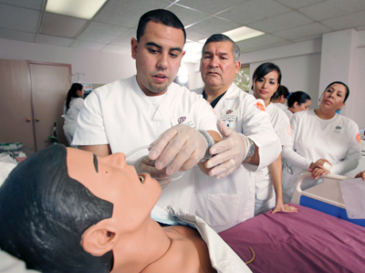

Slide 3
Objectives
State the meaning
Define simulation
Trace back the origin of simulation
Explain the purpose
List the uses
Describe the principles
Describe the steps followed
Explain the role of a teacher
Enumerate the types
Analyse the values
List the advantages and disadvantages

Slide 4
Meaning :
It is a technique or device that attempt to create characteristics of a real world. In health care , simulation refer to a device representing a simulated patient or part of a patient, or a situation happens in the health care setting , such a device can respond to and interact with the action of a learner

Slide 5
Definition
Simulation has been defined as an attempt to give appearance and /or to give the effect of something else.
(Barton 1970)

Slide 6
Origin
War game in ancient India
Chess is believed to be the original war game and decides the fate of the battles
during I world war it used to train the pilots in air force
By 18th century military game were in use for the analysis of real world battle situation

Slide 7
Purpose
Help the students to practice decision making skill
Develop problem solving skills
Develop human interaction abilities.
Student achieves cognitive affective and psychomotor outcomes
To make Learning more creative by Learning by doing

Slide 8
Uses
Used to achieve learning objectives
Help student gain skill in applying the nursing process
Learn to solve problems efficiently with minimal wasting of time.
In the acquisition of communication skills.
An avenue for attitude change

Slide 9
Cont……….
Fostering decision making skills
Can be applied to the learning of psychomotor skills.
Used for evaluation (student learning and competencies.)

Slide 10
Principles:
Clear stated objectives
Actual patient care experiences
Proper orientation of proceedings/scenario
Must challenge the use of problem solving and critical reasoning
Role of educator must be a facilitator
It should be a collaborative approach between educator and simulator
Each simulation should include feedback and evaluation session

Slide 11
Steps :
Step I: prepare the group. Assign letter designation to all the members
Step II: planning, preparation and deciding the topic of skill to be practiced
Step III: Prepare a detailed schedule of interaction. Decide who will start the conversation
Step IV: Decide the procedure of evaluation
Step V: Conduct the practice session, provide feedback for the improvement
Step VI: Change the topic and move on to the other skill

Slide 12
Role of a teacher
Planning
Facilitating
Debriefing

Slide 13
Types
Written simulation .
Audiovisual simulation.
Live stimulated simulation.
Stimulated simulation

Slide 14
Different equipment used
Video recording
Simulation device
Part task trainer
Complex task trainer
Integrated simulators
Standardized patient/Simulated patient
Screen based computer simulator

Slide 15
Values of simulation
Ensures safe nursing practice.
Help to learn psychomotor skills
Develop critical thinking abilities
Help to inculcate proper attitude among nursing students
Create a real life situation
Gives feedback for the improvement

Slide 16
Advantages
Reduces the complexities of real life .
Motivate people to learn.
Effective for all type of students.
Encourages creative and divergent thinking.

Slide 17
Cont………..
Learning by doing.
Opportunity to learn from mistakes.
Develop problem solving skills.
Student centered teaching method

Slide 18
Disadvantages
Time consuming
Costly
Usable for small groups.
Models often easily damaged

Slide 19
Cont…………..
Never same as performing technique on a patient.
Cannot generalize the result of single simulation to all situations
Emotion laden simulation may cause mental trauma

Slide 20
Doubts?

