Slide 1

WELCOME
Sr Dhanya Chf
HOD/Asso. Professor
Dept. Psychiatric Nursing, JMCON

Slide 2

PREVENTION of mental illness

Slide 3
Levels of prevention
Health maintenance
Mental health
Ability to cope with activities of daily living in an adaptive manner
Primary prevention
Specific protection of vulnerable populations
Secondary prevention
Mental illness
Inability to adapt
Early diagnosis and prompt treatment
Tertiary prevention
Rehabilitation

Slide 4
Mental health education -To the public
Primary prevention - To the caregivers
To the caregivers
Aware about characteristics of the mentally healthy person
Role of the caregiver
To the public
Awareness about personal hygiene and mental hygiene for better self esteem.
Misconceptions towards mental illness.
Some tips to be kept in mind while working in the community

Slide 5
Misconception towards mental illness and mentally ill
Is mental illness hereditary?
Is mental illness contagious?
Do ghost, black magic ,curse cause mental illness?
Is mental illness treatable?
Can patients take up responsibility after recovery?
Can marriage cure mental illness?
Notes:
lac

Slide 6
Remember
Do not give false reassurance
Do not make any decisions for the family
Do not criticize or blame
Help them to develop confidence in their abilities
Do not make them dependent on you
Avoid half-hearted care

Slide 7
Role of nurse in primary prevention
Individual centered intervention
Antenatal care
Ensuring timely obstetrical assistance
Dietary corrections
Correction of endocrine disorders
Liberalization of laws
Training programs for physically and mentally handicapped
Counseling the parents of physically and mentally handicapped
Fostering bonding behaviors

Slide 8
Intervention oriented child in the school
Teaching growth and development of the parents and teachers
Identifying scholastic problems
Family centered interventions
to ensure harmonious relationship
To keep families intact
For families in crisis
Mental health education
Society centered preventive measures

Slide 9
Role of nurse in secondary prevention
Early diagnosis and case finding
Early reference
Screening programs
Early and effective treatment for patients
Training of health personnel
Consultation services
Crisis intervention

Slide 10
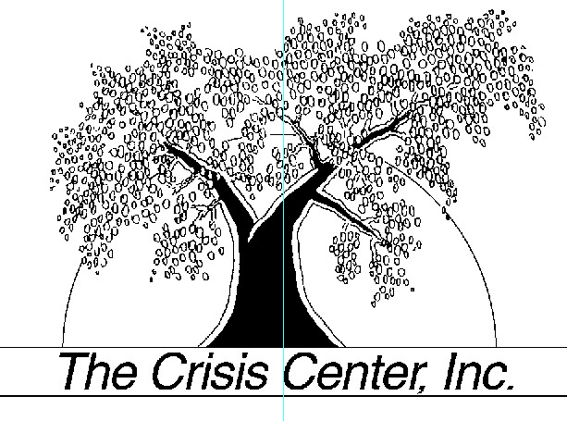
Secondary prevention

Slide 11
What is Crisis?
Crisis is an inevitable aspects of human existence. stressful events ,or crises, are a common part of life. They may be Social , Psychological or Biological in nature
Notes:
Crisis is an inevitable aspects of human existence.

Slide 12
A crisis is a disturbance caused by a stressful event or a perceived threat.
Notes:
The persons usual way of coping becomes ineffective in dealing with threat, causing anxiety.

Slide 13
Signs and symptoms of crisis
Anxiety-heavy burden of free floating anxiety
Depression, anger and guilt
Use of healthy and unhealthy coping mechanisms
Impairment in ADL and neglect in responsibilities
Irrational and blame others

Slide 14
Balancing factors
Perception
Of the
event
Coping
mechanism
Situational
support
Notes:
In describing the phases of crisis ,it is important to consider the balancing factors.

Slide 15
EFFECT OF BALANCING FACTORS
ON A STRESSFUL EVENT
Precipitating event
State of disequilibrium
Perception of event
Unrealistic
Inadequate
ineffective
Realistic
Adequate
effective
support
Coping mechanism
Problem resolved
Problem unresolved

Slide 16
Phases of crisis
PHASE-I
PHASE-II
PHASE -III
PHASE -IV
Perceived threat Anxiety
Experiences a sense of vulnerability + anxiety
Amenable for assistance
Severe to panic levels of anxiety

Slide 17
Types of crisis
Social \unanticipated environmental crisis
Maturational\Developmental crisis
Situational crisis\Traumatic stress

Slide 18
Crisis intervention
Crisis intervention may be defined a short term, inexpensive therapy focused on immediate problem and usually limited to six weeks.
Is a supportive therapy with the restoration of the individual to pre crisis level of functioning or possible higher level of functioning.
It can offer immediate help to a person in crisis needs.
Notes:
It is a supportive therapy with the restoration of the individual to pre crisis level of functioning or possible higher level of functioning.

Slide 19
Levels of crisis intervention
Individual
approach
Generic
approach
General support
Environmental manipulation

Slide 20
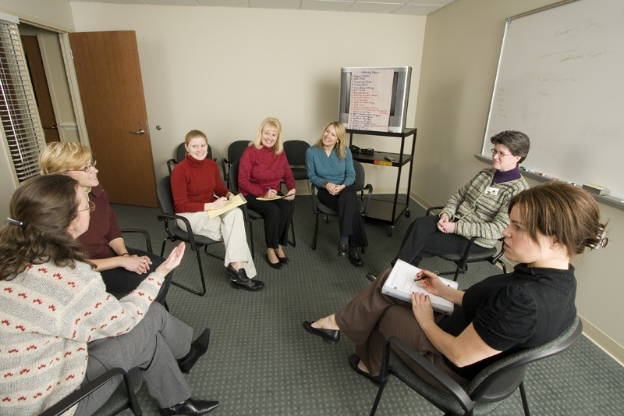
STEPS OF CRISIS INTERVENTION
Assessment
planning
Implementation
evaluation

Slide 21
Techniques of crisis intervention
Catharsis
Clarification
Suggestion
reinforcement of behaviour
Support of defenses
Raising self esteem
Exploration of solutions

Slide 22
Modalities of crisis intervention
Mobile crisis programs
Family work
group work
Telephone contacts
Disaster response
Prevention work
Home visit
Victim outreach programs
Health education
Notes:
Modalities are based on the philosophy that the health care team must be aggressive and go out to the patients rather than wait for the patients to come to them. varieties of community settings ranging from patients home s to street corners.

Slide 23
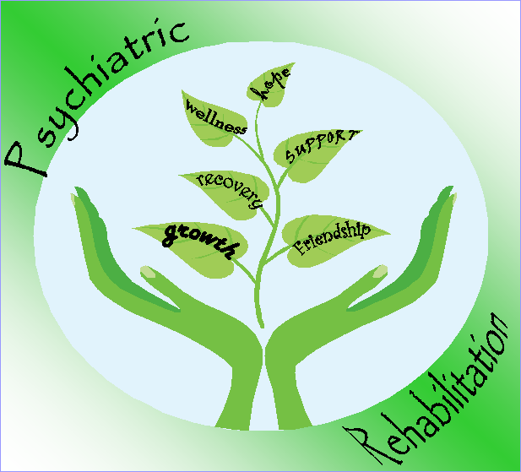
Tertiary prevention

Slide 24
REHABILITATION
Rehabilitation is defined as “an attempt to provide the best possible community role which will enable the patient to achieve the maximum range of activity, interest and of which he is capable”

Slide 25
Role of nurse in Tertiary prevention
Family involvement
Occupational and recreational activities
Community based programs
Constant Communication between community health nurse and mental health institution
Collaborative relationship between mental health care providers and community agencies
Training in community living program(TCL)
Assessing stigma prevailing in the community
Change in the Environmental emotional climate

Slide 26

THANK YOU

Slide 27


Slide 28

‘lkj =
Good afternoon

Slide 29
COMMUNITY MENTAL HEALTH &NURSING

Slide 30
Definition-CMH
It is the application of specialized knowledge to populations and community to promote and maintain mental health, and to rehabilitate populations at risk that continue to have residual effects of mental illness.

Slide 31
CMH AIMED TO
Change
-in the methods of treatment
-in the institutionalized care
Focus on
-De-institutionalization
.De centralization
-De-professionalism
-De-mystification

Slide 32
De-institutionalization
Government pushed for de-institutionalization of psychiatric hospitals
  States offered monetary rewards for asylums decreasing their populations
  During the de-institutionalization process, three out of every four patients were released from the Asylum
Notes:
32

Slide 33
De-institutionalization
Consequences
  Asylums’ cottages and buildings were gradually closed
  Relocation trauma was great: patients were released to their families, nursing homes, and half-way houses
  Homeless population soared
  By 1986 number of patients in mental institutions in the U.S. was reduced.
Notes:
33

Slide 34
De- Centralization
Means the development of setting up of psychiatric units in general wards. (General Hospital Psychiatric units(GHPU)

Slide 35
De-Professionalism
Not only the doctors and nurses a wide range of population to be trained to give mental health care such as community leaders, spiritual leaders clergyman ,teachers , general practitioners, police, and voluntary health workers.

Slide 36
De-Mystification
Reduces the threats and secrets in psychiatric treatments and cares which was given in the mental asylums and avoid the mysticism of mental illness by providing open and humanitarian approach to the mentally ill.

Slide 37
COMMUNITY MENTAL HEALTH IN INDIA
Community mental health in India was outlined by Indira Gandhi in may 1981 during World Health Assembly.
“We would like to go homes instead of putting the sick in the institutions. Services must begin where people are and where problems arise”.
Concentrated on PHC-Primary Health Centre:- One of the most important elements in the supply of health care in India.

Slide 38
CMH…..
Next imp phase of development is setting up of General Hospital Psychiatric units(GHPU):- It provided a great push for the greater acceptance of psychiatric services by the public without fear of social stigma.
Next phase of development in mental health services through Community care approach started in Bangalore and Chandigarh.

Slide 39
Importance of CMH
It focuses on mental health of the family rather than individual patient.
Promotion and maintenance of the mental health rather than clinical management of the mental illness and various kinds of social and psychological pathologies.
Social ,psychological and cultural situation is the determination of mental health rather than intra-psychic ones.
Family, community and the group relationship as the key influence of the mental health of the individual.

Slide 40
Approaches of CMH
Attainable by the use of multidisciplinary approach including all mental health team (psychiatrist, physician, psychologist, psychiatric nurse, occupational-therapist, clergyman, community leaders etc.)
Attainable through primary, secondary and tertiary prevention

Slide 41
Mental health services/Facilities available in the community
Day care centers/ day hospitals
Community mental health centres
Youth centres
Walk in clinic
Psychiatric hospitals/Partial hospitalization
Halfway homes
Group homes
Quarter way homes
Foster homes
Sheltered workshops
Self-help groups
Suicide prevention centers
Crisis intervention clinics
Churches, temples, mosques

Slide 42

Partial hospitalization
It is an innovative alternative for hospitalization. Day care centers ,day hospitals and day treatment programs comes under partial hospitalization. It has the advantage that lesser separation from families, more involvement in the treatment program and lessening the patient’s preoccupation with the illness

Slide 43
Day care centers/ day hospitals
Program organized on a day time basis. Patient receives full range of treatment, services and return home at the end of the day. Family will feel relief for few hours.
Eg ; in India more centers are available for mentally retarded individuals.
Sanjivini New Delhi
NIMHANS,Bangalore
Richmond fellowship,Bangalore
Anugraha day care centre, Chennai

Slide 44
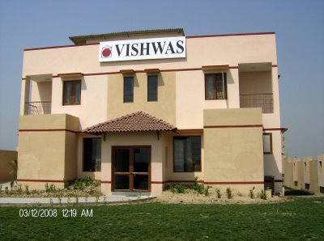
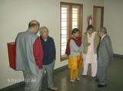
Richmond fellowship(Vishwas)-Day care centre, Bangalore

Slide 45
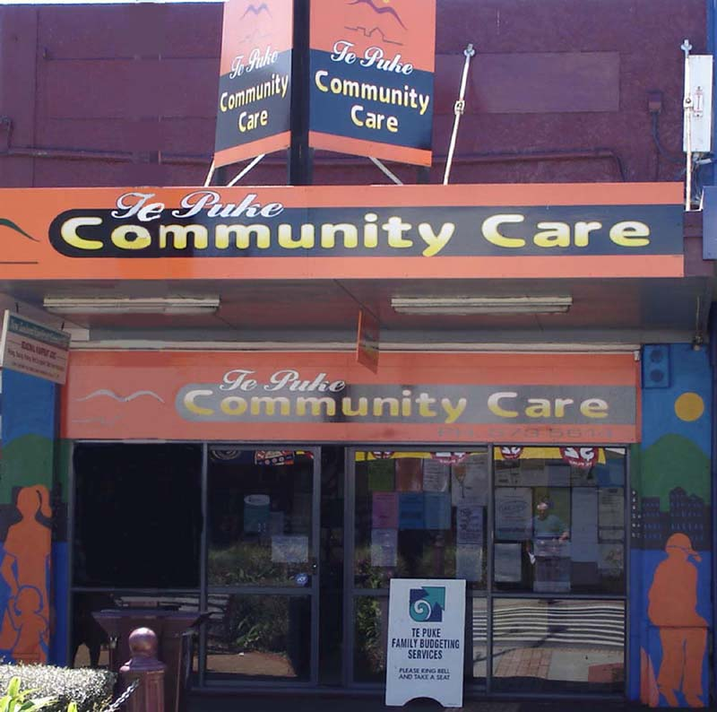
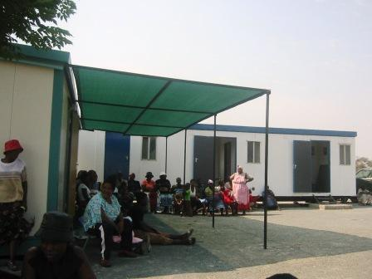
Community mental health centre

Slide 46
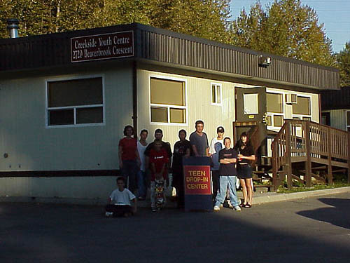
Youth centre

Slide 47
Mental health agency care
Hot line agency;-A telephone line maintained by a trained personnel for crisis or suicide intervention.
Walk in clinic;- A facility available for 24 hrs with psychiatric emergency room
Home visit;- visiting the houses by a team of community mental health people during the period of crisis intervention.

Slide 48

Suicide prevention centres
There are many suicide prevention centres in India in the volundary sectors doing good work and helping those in need
Hotline
National Suicide Hotline 1-800-SUICIDE (784-2 )
Sneha in Chenni
Sahara in Mumbai
Sanjivini and Sumaithri in New Delhi

Slide 49
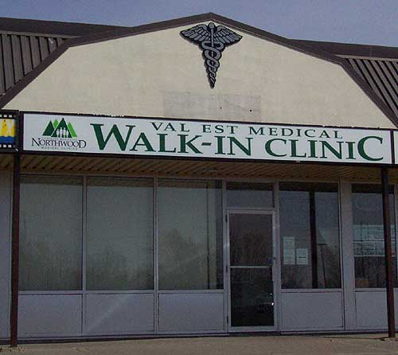
Walk in clinic
A facility of mental health for 24 hours

Slide 50

Halfway homes
The patients no longer need the full services of a hospital but are not yet ready for a completely independent living. They need supervision for medication and for carrying on domestic activities. If they are still in job, they will leave the job, and come back to this half way house.

Slide 51

Quarter way Homes
This is the place usually located within the hospital campus itself, but not having the regular services of a hospital. There may not be routine nursing staff or routine rounds and most of the activities of the place are taken care of by the patient themselves.

Slide 52
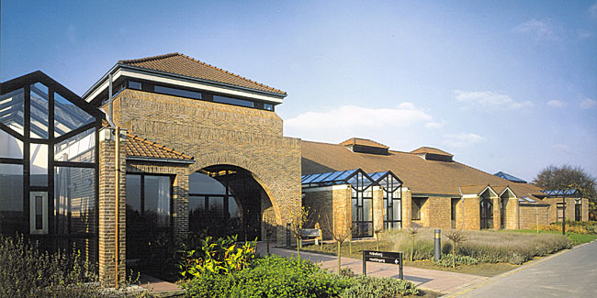
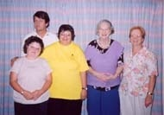
Group homes
Homes belong to hospital or rented by 15-20 mentally ill recovering patients. These ex-patients stay together, meet their financial commitment and live in a society like other members.

Slide 53
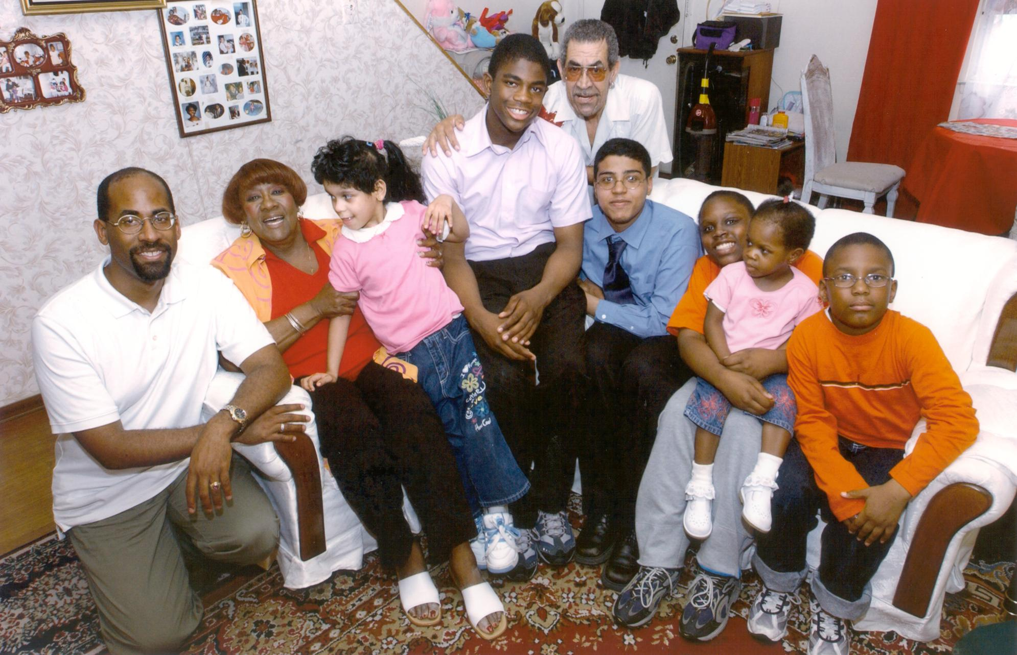
Foster homes
It is a home in which a patient recovering from a mental disorder is placed in a voluntary family by a social agency for family care.

Slide 54
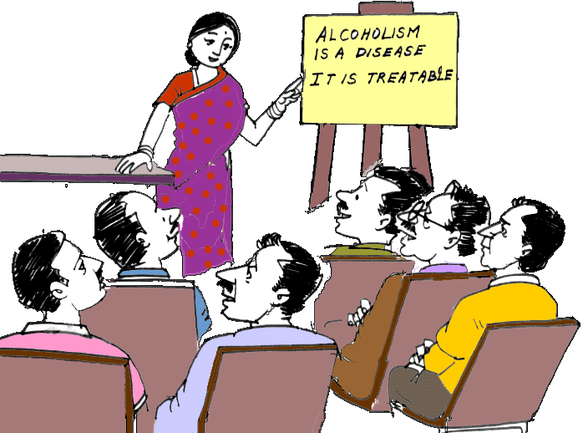
Self help groups
These groups will help the individuals as well as members of the family.
Eg;-AA GROUPS, MR GROUPS

Slide 55

Crisis intervention clinic

Slide 56
Definition-CMHN
CMHN is the application of knowledge of psychiatric nursing in preventing, promoting, and maintaining mental health of the people ;to help in early diagnosis and care and to rehabilitate clients after mental illness.

Slide 57
Principles of CMHN
Community mental health nursing is a holistic approach to promote, to maintain, to rehabilitate and to restore the community mental health by the mobilization of community resources.
CMH influenced and reflected by mental health of individuals and their belief in the community.
The primary concern of CMHN is towards the targeted population, social and community networks.
CMHN is focuses on inter-relationship found in the group context. (Remember 4Ds)

Slide 58
Goals of CMHN
To provide preventive activities to the population for the purpose of promoting mental health
To develop innovative approaches to primary preventive activities.
To provide intervention as early as possible.
To provide corrective learning experience to the client –group for the purpose of developing sense of worth and independence

Slide 59
Goals of CMHN
To anticipate when population become at risk for particular emotional problem and to identify the change in the social and psychological factors which adversely affects the populations interaction with the environment
To change the social stigma prevails in the community.
To assist in providing mental health education for the awareness and assessment of mental health and illness.

Slide 60
Gift of life.ppt

Slide 61
D:\My documents\MENTAL HYGIENE.ppt

Slide 62
Levels of prevention
Health maintenance
Mental health
Ability to cope with activities of daily living in an adaptive manner
Primary prevention
Specific protection of vulnerable populations
Secondary prevention
Mental illness
Inability to adapt
Early diagnosis and prompt treatment
Tertiary prevention
Rehabilitation

Slide 63
Role of nurse in primary prevention
Individual centered intervention
Antenatal care
Ensuring timely obstetrical assistance
Dietary corrections
Correction of endocrine disorders
Liberalization of laws
Training programs for physically and mentally handicapped
Counseling the parents of physically and mentally handicapped
Fostering bounding behaviors

Slide 64
Role of nurse in secondary prevention

Slide 65
Crisis intervention

Slide 66
What is Crisis?
Crisis is an inevitable aspects of human existence. stressful events ,or crises, are a common part of life. They may be Social , Psychological or Biological in nature
Notes:
Crisis is an inevitable aspects of human existence.

Slide 67
A crisis is a disturbance caused by a stressful event or a perceived threat.
Notes:
The persons usual way of coping becomes ineffective in dealing with threat, causing anxiety.

Slide 68
Types of crisis
According to Baldwin in 1987 .(identified six classes of emotional crisis)
Dispositional crisis
Anticipated life transition
Traumatic stress\ situational crisis
Maturational crisis\developmental crisis
Crisis reflecting psychopathology
Psychiatric emergencies

Slide 69
Balancing factors
Perception
Of the
event
Coping
mechanism
Situational
support
Notes:
In describing the phases of crisis ,it is important to consider the balancing factors.

Slide 70
EFFECT OF BALANCING FACTORS
ON A STRESSFUL EVENT
Precipitating event
State of disequilibrium
Perception of event
Realistic
Adequate
effective
Unrealistic
Inadequate
ineffective
support
Coping mechanism
Problem resolved
Problem unresolved

Slide 71
Levels of prevention
Health maintenance
Mental health
Ability to cope with activities of daily living in an adaptive manner
Primary prevention
Specific protection of vulnerable populations
Secondary prevention
Mental illness
Inability to adapt
Early diagnosis and prompt treatment
Tertiary prevention
Rehabilitation

Slide 72
Role of nurse in primary prevention
Individual centered intervention
Antenatal care
Ensuring timely obstetrical assistance
Dietary corrections
Correction of endocrine disorders
Liberalization of laws
Training programs for physically and mentally handicapped
Counseling the parents of physically and mentally handicapped
Fostering bounding behaviors

Slide 73
Role of nurse in secondary prevention

Slide 74
Crisis intervention

Slide 75
What is Crisis?
Crisis is an inevitable aspects of human existence. stressful events ,or crises, are a common part of life. They may be Social , Psychological or Biological in nature
Notes:
Crisis is an inevitable aspects of human existence.

Slide 76
A crisis is a disturbance caused by a stressful event or a perceived threat.
Notes:
The persons usual way of coping becomes ineffective in dealing with threat, causing anxiety.

Slide 77
Types of crisis
According to Baldwin in 1987 .(identified six classes of emotional crisis)
Dispositional crisis
Anticipated life transition
Traumatic stress\ situational crisis
Maturational crisis\developmental crisis
Crisis reflecting psychopathology
Psychiatric emergencies

Slide 78
Balancing factors
Perception
Of the
event
Coping
mechanism
Situational
support
Notes:
In describing the phases of crisis ,it is important to consider the balancing factors.

Slide 79
Crisis intervention
Crisis intervention may be defined a short term, inexpensive therapy focused on immediate problem and usually limited to six weeks.
Is a supportive therapy with the restoration of the individual to pre crisis level of functioning or possible higher level of functioning.
It can offer immediate help to a person in crisis needs.
Notes:
It is a supportive therapy with the restoration of the individual to pre crisis level of functioning or possible higher level of functioning.

Slide 80
Levels of crisis intervention
Individual
approach
Generic
approach
General support
Environmental manipulation

Slide 81
STEPS OF CRISIS INTERVENTION
Assessment
planning
Implementation
evaluation

Slide 82
Techniques of crisis intervention
Catharsis
Clarification
Suggestion
reinforcement of behaviour
Support of defenses
Raising self esteem
Exploration of solutions

Slide 83
Modalities of crisis intervention
Mobile crisis programs
Family work
group work
Telephone contacts
Disaster response
Prevention work
Home visit
Victim outreach programs
Health education
Notes:
Modalities are based on the philosophy that the health care team must be aggressive and go out to the patients rather than wait for the patients to come to them. varieties of community settings ranging from patients home s to street corners.

Slide 84
Role of nurse in tertiary prevention

Slide 85
Rehabilitation

Slide 86
Levels of prevention
Health maintenance
Mental health
Ability to cope with activities of daily living in an adaptive manner
Primary prevention
Specific protection of vulnerable populations
Secondary prevention
Mental illness
Inability to adapt
Early diagnosis and prompt treatment
Tertiary prevention
Rehabilitation

Slide 87
Role of nurse in primary prevention
Individual centered intervention
Antenatal care
Ensuring timely obstetrical assistance
Dietary corrections
Correction of endocrine disorders
Liberalization of laws
Training programs for physically and mentally handicapped
Counseling the parents of physically and mentally handicapped
Fostering bounding behaviors

Slide 88
Role of nurse in secondary prevention

Slide 89
Crisis intervention

Slide 90
What is Crisis?
Crisis is an inevitable aspects of human existence. stressful events ,or crises, are a common part of life. They may be Social , Psychological or Biological in nature
Notes:
Crisis is an inevitable aspects of human existence.

Slide 91
A crisis is a disturbance caused by a stressful event or a perceived threat.
Notes:
The persons usual way of coping becomes ineffective in dealing with threat, causing anxiety.

Slide 92
Types of crisis
According to Baldwin in 1987 .(identified six classes of emotional crisis)
Dispositional crisis
Anticipated life transition
Traumatic stress\ situational crisis
Maturational crisis\developmental crisis
Crisis reflecting psychopathology
Psychiatric emergencies

Slide 93
Balancing factors
Perception
Of the
event
Coping
mechanism
Situational
support
Notes:
In describing the phases of crisis ,it is important to consider the balancing factors.

Slide 94
Crisis intervention
Crisis intervention may be defined a short term, inexpensive therapy focused on immediate problem and usually limited to six weeks.
Is a supportive therapy with the restoration of the individual to pre crisis level of functioning or possible higher level of functioning.
It can offer immediate help to a person in crisis needs.
Notes:
It is a supportive therapy with the restoration of the individual to pre crisis level of functioning or possible higher level of functioning.

Slide 95
Levels of crisis intervention
Individual
approach
Generic
approach
General support
Environmental manipulation

Slide 96
STEPS OF CRISIS INTERVENTION
Assessment
planning
Implementation
evaluation

Slide 97
Techniques of crisis intervention
Catharsis
Clarification
Suggestion
reinforcement of behaviour
Support of defenses
Raising self esteem
Exploration of solutions

Slide 98
Modalities of crisis intervention
Mobile crisis programs
Family work
group work
Telephone contacts
Disaster response
Prevention work
Home visit
Victim outreach programs
Health education
Notes:
Modalities are based on the philosophy that the health care team must be aggressive and go out to the patients rather than wait for the patients to come to them. varieties of community settings ranging from patients home s to street corners.

Slide 99
Home work
Role of nurse in tertiary prevention
Any Queries ?

Slide 100

THANK YOU

