Slide 1
Concepts of Normal and Abnormal behavior
MENTAL HEALTH NURSING
PRESENTED BY : SR. Dhanya
Associate Professor

Slide 2
SPECIFIC OBJECTIVES
Define Normal and abnormal Behavior
Behavioral Responses Traits of persons with Normal behavior
Models of Normal and Abnormal Behavior
Factors influencing Normal and Abnormal behavior

Slide 3
Introduction
Psychiatric nursing is a branch of nursing that deals with care of psychiatric pt’s who are considered abnormal in their behavior
Abnormal means deviation or different from the norm or standard
Influenced by socio-cultural factors

Slide 4
Normal behavior
Emotionally upset at various times
Temporary change in feelings, thinking & behavior
Examples:
Fear of impending exams (anxious and worry)
Loss/excess of appetite, sleep,
If unable to write exam or loss of memory (Emotional illness)
Similarly, death of husband/child can affect mother
She may cry frequently, unable to sleep/eat, neglect other family members & household work

Slide 5
Continuum of Behavioral Responses
Normal(Adaptive responses) Abnormal (Maladaptive responses)
Anticipation
Mild
Moderate
Severe
Extreme

Slide 6
Traits of persons with Normal behavior
Attitudes towards self
Perception of reality
Resistance to stress
Environmental mastery
Autonomy
Growth, self actualization

Slide 7
Traits of persons with abnormal behavior
Deviation from statistical norms
Deviation from social norms
Maladjustment
Personal distress
Personal immaturity

Slide 8
Models
Psychoanalytic Model
Emphasizes man’s basic instinctual drive
Normalcy is ability to gratify these drives within limits imposed by society
Abnormalcy is faulty or exaggerated impulses

Slide 9
Behavioristic model
Emphasizes overt behaviour as person’s attempt to adapt to environmental stimuli
Abnormally is ineffective adaptation due to learning of maladaptive responses or failure to learn adaptive ones

Slide 10
Medical model
Medical model considers organic pathology as the definite cause for mental disorder.
According to this model abnormal people are the ones who have disturbances in thought, perception and psychomotor activities.
The normal are the ones who are free from these disturbances.

Slide 11
Humanistic model
Emphasizes man’s natural tendencies towards responsible self direction & self fulfillment
Abnormality is failure to develop one’s full humanity due to either blocking or distorting these tendencies

Slide 12
Socio-cultural model
The beliefs, norms, taboos and values of a society have to be accepted and adopted by individuals.
Breaking any of these would be considered as abnormal.
Normalcy is defined in context with social norms prescribed by the culture.
Thus cultural background has to be taken into account when distinguishing between normal and abnormal behaviour.

Slide 13
Statistical model
It involves the analysis of responses on a test or a questionnaire or observations of some particular behavioral variables.
The degree of deviation from the standard norms arrived at statistically, characterizes the degree of abnormality.
Statistically normal mental health falls within two standard deviations (SDs) of the normal distribution curve.

Slide 14
Existential model
Emphasizes primary reality of the person’s conscious experience & decisions
Abnormality is failure to achieve an adequate self identity & a meaningful way of life

Slide 15
Interpersonal model
Emphasizes role of interpersonal relationship in shaping development & behavior
Abnormality is faulty interpersonal relations & accommodations of a pathological type

Slide 16
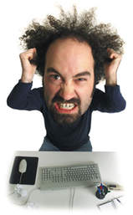
Factors influencing Abnormal behavior
Organic factors
Psychological factors
Sociological factors

Slide 17
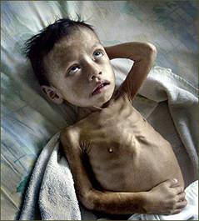
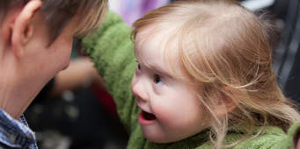
Organic Factors
Malnutrition
Down syndrome
Fatigue
Psychosis
Hormonal imbalance
Brain infection

Slide 18
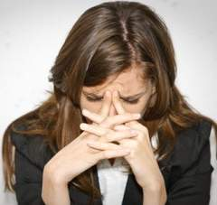
Psychological Factors
Early maternal deprivation
Over indulgence
Marital discord
Paternal rejection
Sibling rivalry
Broken homes
Over protection
Faulty parental models
Pathological interaction in family

Slide 19
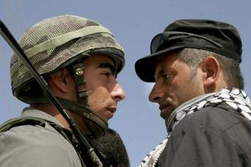
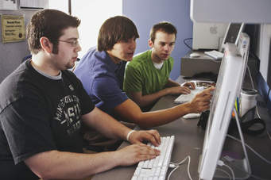
Socio-cultural Factors
War & violence
Group prejudice
Economic & employment problems
Technological & social changes
Mass media
Impact of western culture
Stigma
Joint family system

Slide 20


