Slide 1
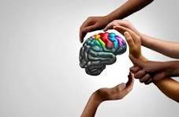
MENTAL HEALTH NURSING
PRESENTED BY : SR. PRIYA MATHEW
LECTURER

Slide 2
SPECIFIC OBJECTIVES
Define Mental Health
Define Mental Health Nursing
Explain the Mental Health Terminologies

Slide 3

MENTAL HEALTH
Mental health is the successful adaptation to stressors from the internal or external environment

Slide 4

MENTAL ILLNESS
Mental illness is the mal adaptive responses to stressors from the internal or external environment, evidenced by thoughts, feelings, and behaviors that are incongruent with the local and cultural norms, and interfere with the individuals social, occupational and physical functioning

Slide 5
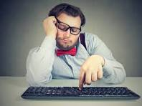
APATHY
Lack of emotional feeling

Slide 6

APHASIA
Absence or impairment of the ability to communicate through speech, writing, or signs, due to dysfunction of brain centers

Slide 7

ANHEDONIA
Inability to experience pleasure in any activity

Slide 8
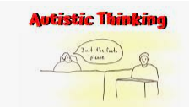
AUTISTIC THINKING
Pre occupations totally removing a person from reality

Slide 9
CIRCUMSTANTIALITY
A pattern of communication that is demonstrated by the speaker’s inclusion of many irrelevant and un necessary details in his speech before he is able to come to he point

Slide 10
TANGENTIALITY
A form of thinking/ speech in which the client tends to wander away from the intended point, and never returning to the original ideas

Slide 11
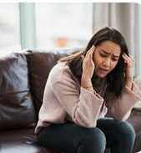
DELUSION
A false, unshakable belief, which is not amenable to reasoning and is not in keeping with the patients socio- cultural and educational back ground

Slide 12
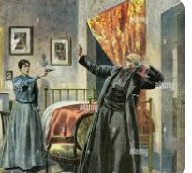
DELUSION OF PERSECUTION
In a persecutory delusions, individuals believe that they are being malevolently treated in some way.

Slide 13

DELUSION OF REFERENCE
The individual may falsely believe that others are talking about him

Slide 14

DELUSION OF JEALOUSY
The content of jealous delusions centers around the theme that the person’s sexual partner is unfaithful.

Slide 15
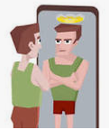
DELUSION OF GRANDIOSITY
Individuals with grandiose delusions have irrational ideas regarding their own worth, talent, knowledge or power

Slide 16
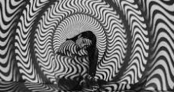
ILLUSION
The misinterpretation of a real, external sensory experience. It is mental misperception of actual sensory stimuli

Slide 17
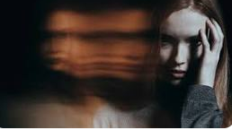
HALLUCINATION
A false sensory perception in the absence of an actual external stimulus.

Slide 18
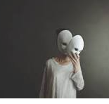
DEPERSONALIZATION
A person’s subjective sense of being unreal, strange or unfamiliar

Slide 19
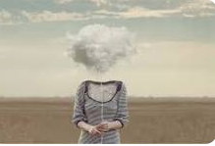
DEREALIZATION
A subjective sense that the environment is strange or un real, a feeling of changed reality

Slide 20
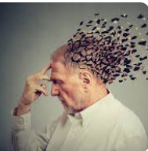
DEMENTIA
A global impairment of cognitive functioning that is progressive and interferes with social occupational abilities

Slide 21
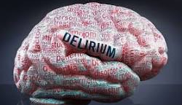
DELIRIUM
State of mental confusion and excitement that happens in a short period of time and is characterized by disorientation for time and place, usually, with illusions and hallucinations.

Slide 22
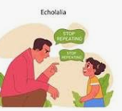
ECHOLALIA
Pathological repetition of the speech of another

Slide 23

ECHOPRAXIA
Pathological repetition by imitation of the behavior of another

Slide 24
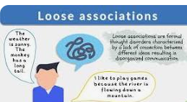
LOOSENING OF ASSOCIATION
A pattern of spontaneous speech in which things said lack a meaningful relationship, or there is idiosyncratic shifting from one frame of reference to another

Slide 25

MOOD
Emotion that is prolonged to the point that it colors a person’s entire psychological thinking.

Slide 26

AFFECT
A short lived emotional response to an idea or an event

Slide 27

THOUGHT INSERTION
The delusional belief that thoughts are being put in to one’s mind

Slide 28
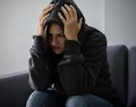
THOUGHT WITHDRAWAL
The delusional belief that thoughts are taken away by some external agent, often associated with thought block.

Slide 29

THOUGHT BROADCAST
The delusional belief that one’s thoughts are being broadcast or projected in to the environment

Slide 30


