Slide 1
MODULE –
DIABETIC MELLITUS

Slide 2
TYPE 1 DM
Formerly known as juvenile-onset diabetes or insulin-dependent diabetes, accounts for about 5%-10% of all people with diabetes.
Type 1 diabetes generally affects people under 40 years of age, although it can occur at any age.

Slide 3
Etiology and Pathophysiology
Type 1 diabetes is an autoimmune disorder, in which the body develops antibodies against insulin and/or the pancreatic beta-cells that produce insulin.
This eventually results in not enough insulin for a person to survive.
Genetic predisposition and exposure to a virus are factors that may contribute to the pathogenesis of immune-related type 1 diabetes

Slide 4
Genetic Link
Predisposition to type 1 diabetes is related to human leukocyte antigens (HI.As)
Theoretically, when an individual with certain HLA types is exposed to a viral infection, the beta-cells of the pancreas are destroyed, either directly or through an autoimmune process.
The HLA types associated with an increased risk for type 1 diabetes include HLA-DR3 and HLA-DR4

Slide 5
Idiopathic diabetes is a form of type 1 diabetes that is strongly inherited and not related to autoimmunity.
It only occurs in a small number of people with type 1 diabetes, most often of Hispanic, African, or Asian ancestry.
Latent autoimmune diabetes in adults (LADA), a slowly progressing autoimmune form of type 1 diabetes, occurs in adults and is often mistaken for type 2 diabetes.

Slide 6
Onset of Disease
In type 1 diabetes, the islet cell autoantibodies responsible for beta cell destruction are present for months to years before the onset of symptoms.
Manifestations of type 1 diabetes develop when the person's pancreas can no longer produce sufficient amounts of insulin to maintain normal glucose.

Slide 7
Once this occurs, the onset of symptoms is usually rapid, and patients often are initially seen with impending or actual ketoacidosis.
The patient usually has a history of recent and sudden weight loss and the classic symptoms of polydipsia (excessive thirst), polyuria (frequent urination), and polyphagia (excessive hunger).

Slide 8
The individual with type 1 diabetes requires insulin from an outside source (exogenous insulin) to sustain life.
Without insulin, the patient will develop diabetic ketoacidosis (DKA), a life-threatening condition resulting in metabolic acidosis.
Newly diagnosed patients with type 1 diabetes may experience a remission, or "honeymoon period" for 3-12 months after treatment is initiated.

Slide 9
During this time, the patient requires little injected insulin because beta cell insulin production remains sufficient for healthy blood glucose levels.
Eventually, as more B-cells are destroyed and blood glucose levels increase, the honeymoon period ends and the patient will require insulin on a permanent basis.

Slide 10
Type 2 diabetic mellitus
Type 2 diabetes mellitus was formerly known as adult-onset diabetes (AODM) or non-insulin-dependent diabetes (NIDDM).
Type 2 diabetes is, by far, the most prevalent type of diabetes, accounting for approximately 90%-95% of patients with diabetes.
Many risk factors contribute to the development of type 2 diabetes, including being overweight or obese, being older, and having a family history of type 2 diabetes.
Although the disease is seen less frequently in children, the incidence is increasing due to the increasing prevalence of childhood obesity.

Slide 11
Etiology and Pathophysiology.
Type 2 diabetes is characterized by a combination of inadequate insulin secretion and insulin resistance.
The pancreas usually produces some endogenous (self-made) insulin.
However, the body either does not produce enough insulin or does not use it effectively, or both.
The presence of endogenous insulin is a major distinction between type 1 and type 2 diabetes. (In type 1 diabetes, there is an absence of endogenous insulin.)

Slide 12
Genetic Link
Although the genetics of type 2 diabetes is not yet fully understood, it is likely multiple genes are involved.
Genetic mutations that lead to insulin resistance and a higher risk for obesity have been found in many people with type 2 diabetes.
Individuals with a first-degree relative with the disease are 10 times more likely to develop type 2 diabetes.

Slide 13
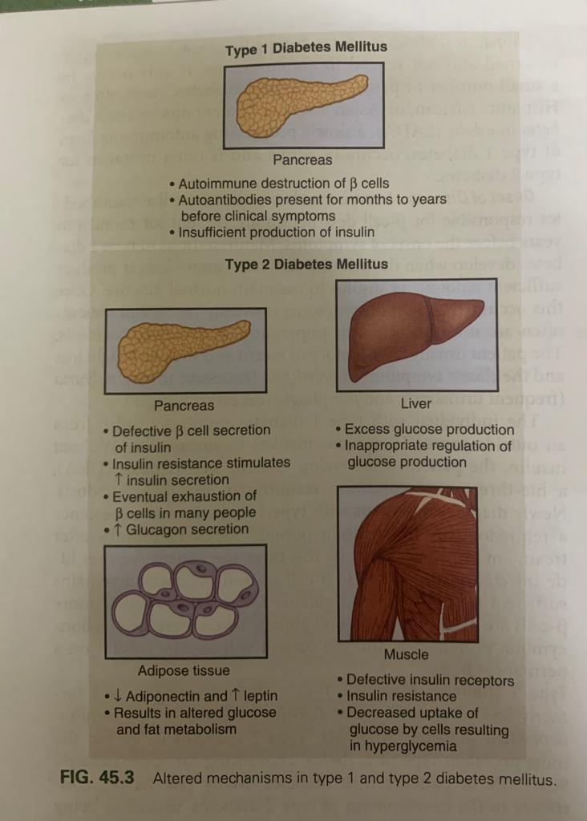
Metabolic abnormalities have a role in the development of type 2 diabetes

Slide 14
The first factor is insulin resistance, a condition in which body tissues do not respond to the action of insulin because insulin receptors are unresponsive, insufficient in number, or both.
Most insulin receptors are located on skeletal muscle, fat, and liver cells.
When insulin is not properly used, the entry of glucose into the cell is impeded, resulting in hyperglycemia.

Slide 15
In the early stages of insulin resistance, the pancreas responds to high blood glucose by producing greater amounts of insulin (if B-cell function is normal). This creates a temporary state of hyperinsulinemia that coexists with hyperglycemia.

Slide 16
A second factor in the development of type 2 diabetes is a marked decrease in the ability of the pancreas to produce insulin, as the -cells become fatigued from the compensatory overproduction of insulin or when beta cell mass is lost.
The underlying basis for the failure of beta cells to adapt is unknown. It may be linked to the adverse effects of chronic hyperglycemia or high circulating free fatty acids.
In addition, the a-cells of the pancreas increase production of glucagon.

Slide 17
This leads to a third factor which is in appropriate glucose production by the liver.
Instead of properly regulating the release of glucose in response to blood levels, the liver does so in a haphazard way that does not correspond to the body’s needs at the time .

Slide 18
A fourth factor is the altered production of hormones and cytokines by adipose tissue (adipokines).
Adipokines secreted by adipose tissue appear to play a role in glucose and fat metabolism and are likely to contribute to the pathophysiology of type 2 diabetes.*
Adipokines are thought to cause chronic inflammation, a factor involved in insulin resistance, type 2 diabetes, and cardiovascular disease (CVD).
The two main adipokines believed to affect insulin sensitivity are adiponectin and leptin.

Slide 19
Finally, the brain, kidneys, and gut also have roles in the development of type 2 diabetes, and scientists are continuously learning more about metabolic factors in the development of type 2 diabetes.

Slide 20
PREDIABETES
Prediabetes is a warning sign that you're heading toward Type 2 Diabetes.
According to the American Diabetes Association, have prediabetes if:
Hemoglobin a1c is between 5.7-6.4%.
Fasting Blood Glucose is between 100-125 mg/dL
Oral Glucose Tolerance Test 2 hours after eating reads between 140-199 mg/dL

Slide 21
These statistics typically measure insulin resistance, which means that the body is not using insulin properly.
Insulin is a hormone released by the pancreas in response to glucose.
When body is using insulin properly, the process looks like this:

Slide 22
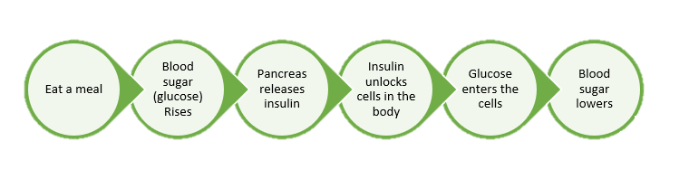

Slide 23
Think of insulin as a key and cells as a lock.
In someone who does not have insulin resistance, insulin unlocks the cells so that glucose exits bloodstream and enters the cells for energy.
In someone with insulin resistance, it's as if the cells have changed the locks.
Insulin can no longer interact with cells and be used as energy.
Instead, the glucose remains in the bloodstream, causing blood sugar to remain high.
As a result, these blood sugar levels appear on lab tests.

Slide 24
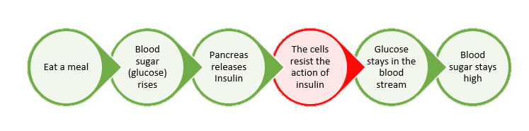

Slide 25
RISK FACTORS OF PRE DIABETES
The difficult characteristic of prediabetes is that many people do not show symptoms until the condition has progressed to Type 2 Diabetes.
The best way to detect prediabetes is by conducting regular blood tests as part of ongoing physical exams with doctor.
It is especially important to be diligent with screening for prediabetes if an increased risk of developing the condition.

Slide 26
Weight and waist size Overweight and high fat tissue increase insulin resistance. Studies have also shown a connection between insulin resistance and waist size: men with 40+ inch waist/women with 35+ inch waist.
Dietary patterns. Eating processed foods and drinking artificially sweetened beverages increases risk of prediabetes and Type 2 Diabetes.
Inactivity. Regular exercise helps to control the weight, uses stored glucose as energy, and helps body's cells avoid insulin resistance.

Slide 27
Genetic factors such as family history and race / ethnicity Individuals with a family history of diabetes are more likely to develop prediabetes. African Americans, Hispanics, Native Americans, and Asian-Americans are also more likely to develop prediabetes.
Other conditions Health conditions such as gestational diabetes (for both the mother and the child), polycystic ovarian syndrome, and obstructive sleep apnea, can increase risk of pre-diabetes.

Slide 28
PREVENTION
The Centers for Disease Control and Prevention (CDC) has done extensive research on reversing prediabetes and found three main lifestyle changes that can reduce the risk of developing Type 2 Diabetes by more than 60%.
These lifestyle changes are directly related to food choices and movement and have been shown to be even more effective than medication.
Nutritionists can decide how to best implement these changes into their lifestyle

Slide 29
Moderate weight loss 5-7%
Research shows that moderate weight loss of 5-7% can drastically reduce the likelihood of developing Type 2 Diabetes.
As a reference, this would be a 5-6 kg loss for someone weighing 90kg.
The Diabetes Prevention Program study identified that changes in food habits and increased movement not only helped people lose weight, it also helped them keep the weight off.
The idea is to maintain a healthy long-term weight to avoid blood sugar re-entering the danger zone.
Even if the person isn’t overweight, developing better habits via a prediabetes diet and incorporating physical activity could be the two missing pieces to the puzzle that will help return your blood sugar back to normal.

Slide 30
Regular physical activity
The studies done by the CDC have shown that one of the main contributors to reversing diabetes is incorporating more physical activity.
The CDC recommends incorporating a minimum of 150 minutes per week of moderate activity.
Moderate activity can be determined by using something called the "talk test".
While person doing the activity, he should be able to talk and carry on a light conversation, but he should not be able to sing a song.
Incorporating 150 minutes of movement per week will help with the weight loss goal as well as lowering blood sugar
The type of activity it totally up to him and should be something that he is enjoy doing.
walking outside with a friend, taking a zumba class, or swimming- the possibilities are endless!

Slide 31
Food choices
Although there can be many contributors to the development of prediabetes, it really boils down to food choices (the elusive prediabetes diet).
The food choices not only directly impact the body's physiological processes, but they can also influence the weight.
weight in itself can be a contributing factor to prediabetes.
The general principles are to include more high-fiber foods, fresh fruits and vegetables, and lean proteins while limiting highly processed foods and sugary drinks.

Slide 32
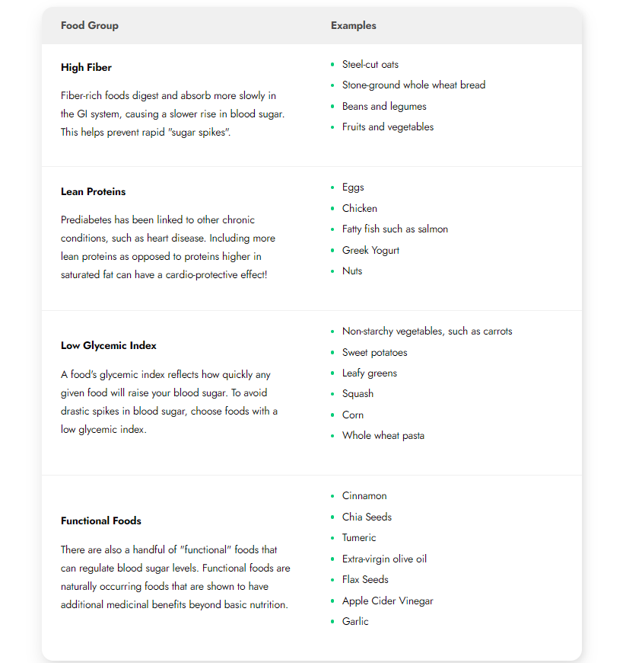

Slide 33
FOODS TO BE AVOIDED
As part of prediabetes diet, it is recommended to avoid processed and refined foods as much as possible.
These foods tend to be void of nutrients and have a high Glycemic Index, which can cause drastic spikes in blood sugar.
Try to eat these foods and ingredients sparingly:
Highly Processed and Refined Foods
Processed and refined foods are extremely low in fiber and nutrients, which tends to absorb more quickly in the GI tract. These are the types of foods that cause drastic spikes in blood sugar. Replacing these foods with more nutrient-dense options will help prolong the release of glucose into the bloodstream.
  Trans fats
  White breads, pastas, and rice
  Packaged snack foods

Slide 34
Foods High in Sugar and Sweeteners
Foods high in sugar and other sweeteners will cause a rapid spike in blood sugar, so avoiding these foods is important for prediabetes management.
Fruits are "OK" because the sugar type is natural (vs added) and is far less than you'll find in sweetened products. So instead of these foods, try incorporating some fresh fruits
  Flavored coffee drinks
  Sweetened breakfast cereals
  Sugary drinks like soda
  Alcohol

Slide 35
GLYCEMIC INDEX

Slide 36
The Glycemic Index is a number that tells how fast or how slow the body converts carbohydrates into blood sugar. The scale ranges from 1 to 100; for a prediabetes diet, the lower the number, the better:
55 or less = Low (good)
56 - 69 = Medium
70 or higher = High ("bad")
Research suggests that focusing on foods with low-glycemic index carbohydrates and high fiber may protect against diabetes and cardiovascular disease.
Specifically, another study found that increased fiber may improve glucose control .

Slide 37
Glycemic Index labeling is also supported by various scholarly publications.
The Glycemic Index value for a specific food can vary depending on:
How you cook it
How old the food is
Fat and fiber tend to lower glycemic index
For example, the longer you cook pasta, the lower the glycemic index.
The glycemic index increases in fruits (such as bananas, peaches, etc.) as they ripen.

Slide 38
Glycemic Index vs. Glycemic Load
For example, watermelon has a high Glycemic Index value (80), but a Glycemic Load is only 5 because the food has relatively little carbohydrates.
calculate a food's glycemic load by multiplying the per-serving carbohydrate level by the glycemic index and dividing by 100.
Above 20 is high, 11 to 19 is moderate, and 10 and below is considered low.
Ultimately, when building a meal plan to better regulate your blood sugar, it is important to be mindful of all three key metrics:
The total carbohydrates in the food
The speed with which food will increase the blood glucose: glycemic index
The ultimate level to which the blood glucose could rise: glycemic load

Slide 39


