Slide 1

QUALITATIVE RESEARCH
Presented by,
Mrs. Anila James
Lecturer
jmcon

Slide 2
CENTRAL OBJECTIVES
At the end of teaching students acquire depth knowledge on qualitative research design and able to explain and apply this knowledge in the research studies.

Slide 3
SPECIFIC OBJECTIVES
At the end of the class student will be able to
Define qualitative research design
Explain the types of qualitative research design
Describe the advantages and disadvantages of qualitative research design

Slide 4

What is Qualitative Research?
It represents a basic level of enquiry (Naturalistic ) that seeks to discover and understand concepts, phenomena or cultures.

Slide 5
RESEARCHER QUALITIES
An open and enquiring mind.
Good listening – Capturing mood and affective
components; Appreciating context;
Sensitivity.
Adaptiveness & Flexibility.
Grasp of the issues to interpret information.
Lack of bias with openness to contrary findings.

Slide 6

Types of qualitative research
Phenomenology
Ethnographic study
Grounded theory
Case study
Historical research

Slide 7
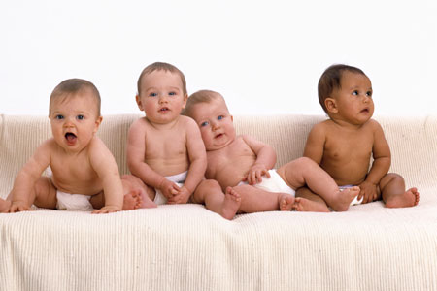
Phenomenology:
Phenomenological study is a science whose purpose is to describe particular phenomena or the appearance of things as lived experience (Cohen, 1987).

Slide 8

Example…
The lived experience of a mother who lost her children during the Tsunami.

Slide 9
Data generation:
formal and informal interviews
participant observation
field notes
memoing
observation and participation in family activities
audio taped interviews Triangulation
Interim summary
Formal interviews audio taped and transcribed verbatim by professional transcriptionist

Slide 10
Contd..
Data presented to families for validation and more input
Redundancy (data saturation) provided criterion for ending data collection.
Audit trail-having a full record of all activities (field notes, researcher diary, raw data, coding and analytical process)
Debriefing- peers
Above were imported into a computer software programme for data management and analysis
Coded data clustered into broad categories and further into meaningful themes

Slide 11

ETHNOGRAPHY

Slide 12

ETHNOGRAPHY- “Portrait of people”
Derived from anthropology
The work of describing culture.
Provides a mechanism for studying our own culture and that of others.

Slide 13

Steps of ethnographic research
Identify the culture to be studied
Identify the significant variables with in the culture
Literature review
Gaining entry
Cultural immersion
Acquiring informants
Gathering data
Analysis of data
Description of culture
Theory development

Slide 14
Fundamental characteristics of ethnography
Researcher is the instrument
Fieldwork.
The cyclic nature of data collection and analysis.
The focus is on culture.
Cultural immersion.
Reflexivity.

Slide 15
Example….
Exploration of the understanding and meaning of chronically ill adults about their body image.

Slide 16

Grounded Theory .
Studies in which data are collected and analyzed and then a theory is developed that is grounded in the data.

Slide 17
Example……………
To describe the experience of patients who were on ventilators & the impact of it on their quality of life.
Thematic analysis was used to describe quality of life.

Slide 18
Case study method
An intensive investigation of single situations which serve to identify and describe basic phenomena.
Case studies provide an excellent opportunity for triangulation: that is, using a number of research methods to complement and confirm findings. Using observation (participant/non participant), interviews and questionnaire

Slide 19
Historical approach
A narrative description or analysis of events that occurred in the remote or recent past.
Example……..
What causes war?
Researcher develop the explanation of the causes of war

Slide 20
CONCEPT OF HISTORICAL RESEARCH
Past oriented, may be longitudinal or cross sectional in nature.
Historical research may be more difficult to conduct than some of the other types of research.
Concerns identification, location, evaluation and synthesis of data from the past.
Discovers past events to relate present and to the future.
Uses all the steps of the scientific method.
Has no scope to produce or alter the form of data but to find data and accept the data .

Slide 21
STEPS OF HISTORICAL RESEARCH
Defining a problem area.
Developing specific Questions/Hypothesis.
Collection of Data.
Analysis of Data.
Interpretation – Researcher should devote considerable efforts to identifying and evaluating data sources on events, situations and human behavior that occurred in the past.

Slide 22
COLLECTION OF DATA
Collection of data may require months or years of dedicated searching from periodicals, newspapers, magazines, diaries, letters, books, minutes of meetings, medical or legal documents.
Non written materials like relics and artifacts.
Visual materials in form of photographs and films.
Audio Materials like tapes and records.
Oral reports in form of Interviews.

Slide 23
DATA ANALYSIS AND INTERPRETATION
Researcher must not only be aware of their own bias and that of ideology but also bias from data sources.
Researcher explains not only what happened but how and why it happened. Explores relationships among events, ideas, people, organizations and institutions and interpret them within the context of the period being studied.
Researcher be sensitive to material , must show genuine engagement in the subject, balance the forces of self interest, societal interest and historical interest to achieve a coherent , convincing and meaningful account.

Slide 24
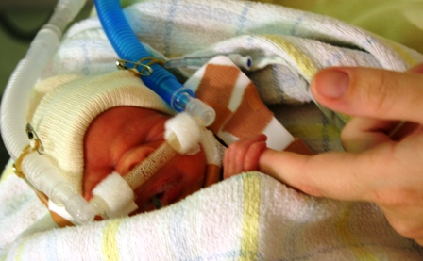
RESEARCH PROCESS IN A QUALITATIVE DESIGN
Statement of the problem
“lived experience of mothers of extreme preterm neonates admitted in NICU, selected Hospital”

Slide 25

Purpose To discover, to describe, to understand

Slide 26

Review of literature
Researcher reviews the literature to compare the findings of qualitative research after data analysis.

Slide 27

Research Methodology
Research Design
Emergent nature of design
Methodological triangulation
Researcher is part of research process
Subjective

Slide 28

Setting
Naturalistic setting
Place where individuals of interest live

Slide 29

Population
Mothers whose babies were admitted in St John’Medical College Hospital.

Slide 30

Sample
Participants must have experienced the phenomena
Subjects – Terms such as “participants or “informants” are used.

Slide 31

Sample size
No criteria for sample size
Depends upon the purpose and the quality of informants
Guiding principle is data saturation – Sampling to a point that no new information is achieved
Number needed for saturation depends on data quality and type of data.

Slide 32

Types of data
Self report – Usually large amount of text
Observation
Physiologic data
Decisions about what to collect evolve in the field

Slide 33

Tool for data collection
Researcher as instrument
Researcher interprets data

Slide 34
Tool for data collection
Researcher as instrument
Researcher interprets data

Slide 35

Data Collection Procedure
Interview, observation, field notes, participant interaction and other type of physical evidences.

Slide 36


Data Analysis
Narrative analysis
Data triangulation

Slide 37

Steps in qualitative data analysis
Reading: Developing an intimate relationship with the data
Coding: Identifying emergent themes
Choosing & using a computer software-optional, helps for data management and not for analysis.
Displaying data: distinguishing
nuances of a topic

Slide 38

Data reduction: Getting the big picture
Interpretation: Identifying & explaining data core meaning
Discovery of theme
The comprehension of the meaning of text and reflection.

Slide 39

Findings:
Report is rich with narrative
Themes are conceptualized

Slide 40
Themes identified were:
Findings revealed :-
-acute stress in mothers.
-Fear of death
-Burden of care giving
- Constrained physical health
- Emotional conflict
- Need for social support
- Searching for a new meaning and religious
practices
- Financial constraints
-Filial reconstruction.
- Disturbances in occupational life

Slide 41
Threats to validity
Description – inaccurate, incomplete data (audio or videotaping whenever possible)
Reactivity- researchers' presence interferes with setting (overcome by rapport, series of interview)
Respondent bias-withholding information obstructiveness (stranger) (same as above)
Researcher bias –assumptions, preconceptions
(overcome by-identify personal issues, areas of role conflict, gatekeepers interest)

Slide 42
Comparison of quantitative and qualitative research
Quantitative Verification of theory -Tests hypothesis | Qualitative Discovery of theory -Understanding of phenomena under study. -Suggests hypothesis

Slide 43
Comparison
Quantitative Fixed design Numerical data Closed-ended question format-Fixed response categories | Qualitative Flexible design Textual data Open-ended question format-contribute to detailed information Produce a wealth of detailed data about a much smaller number of people. Depth information

Slide 44
QUANTITATIVE
QUALITATIVE
Probability sampling Large sample size.
sampling calculated for the required precision
Non-probability
No rule for sample size.
Data saturation depends on what we want to know

Slide 45

Analytical techniques
QUANTITATIVE QUALITATIVE
Analysis tend to be Usually inductive
deductive. Test hypothesis Unit of analysis
using appropriate statistical can be individuals,
methods of analysis

Slide 46
CONCLUSION
Qualitative Research has various advantages over quantitative research except that it is time consuming. We need to develop positive attitude and required skills to conduct qualitative research.

Slide 47
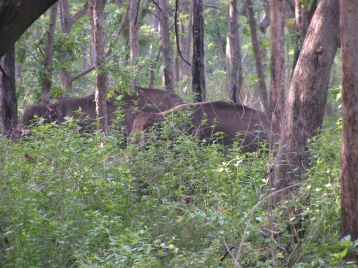
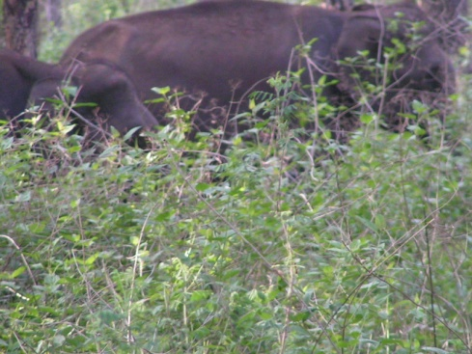
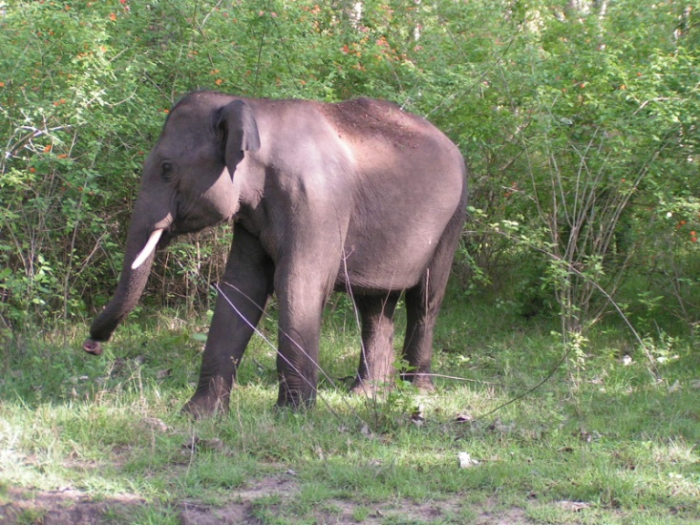
The Ultimate Challenge
“Rich and in depth data”
Notes:
Rich-ness represents valid and reliable data which is meaningful, clinically applicable and patient centred.

Slide 48

BIBLIOGRAPHY
Sharma KS, Nursing research & statistics. New Delhi: Elsevier publishers, 2012.
Polit FD , Beck Tc . Nursing research : principles and methods. 7th edition. 2004.
Basvanthappa BT, Nursing research and statistics , 3rd edition. New Delhi: jaypee publication , 2014
Houser J. Nursing research reading using and creating evidence, 2011.

