Slide 1

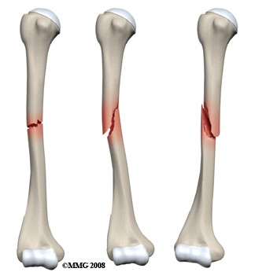
FRACTURES
BY
MS.SIFY ANTOO
CLINICAL INSTRUCTOR
JMCON

Slide 2
OBJECTIVES
Define fracture
Explain the classification of fracture
Describe the bone healing process
Discuss the clinical features of fracture
Explain the management of fracture
Point out the complications of fracture
Discuss the nursing management of farcture

Slide 3
DEFINITION
A fracture is a break in the continuity of bone and is defined according to its type and extent.
Fractures occur when the bone is subjected to stress greater than it can absorb

Slide 4
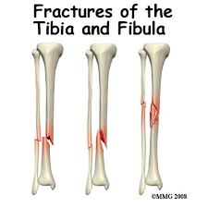
Cont……..
A fracture is a disruption or break in the continuity of the structures of the bone

Slide 5
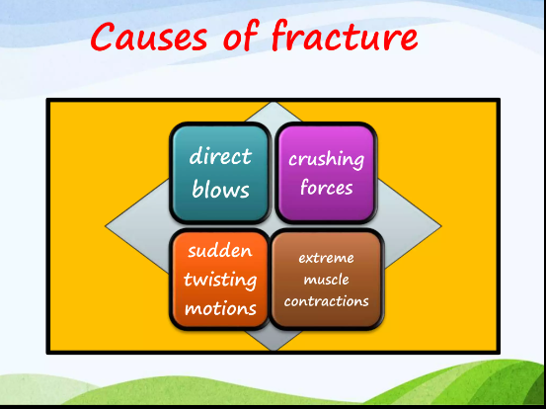

Slide 6
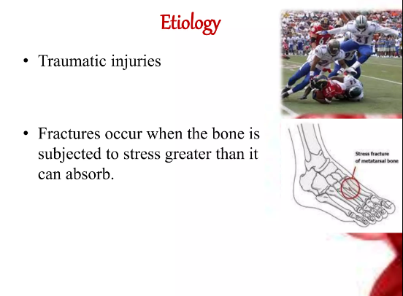

Slide 7
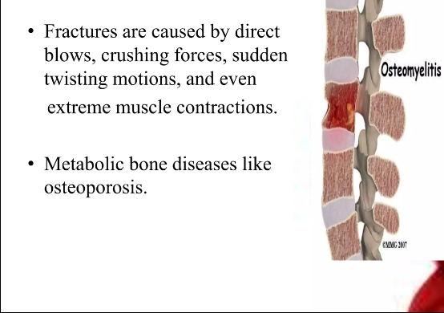

Slide 8
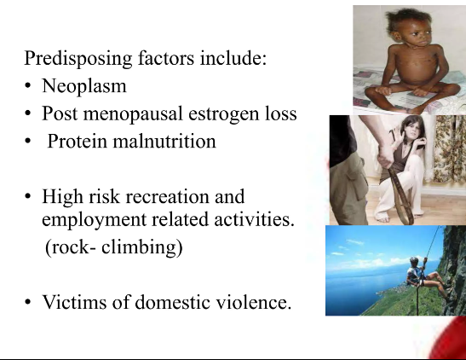

Slide 9
CLASSIFICATION
Depending on the communication or non-communication with the external environment
Open or closed (compound or simple)

Slide 10
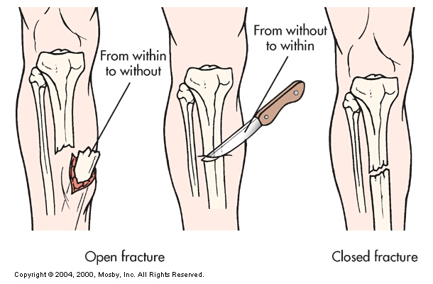
Cont….
In an open # the skin is broken, exposing bone and causing soft tissue injury.

Slide 11
Cont….
Open fractures are graded according to the following criteria:
Grade I is a clean wound less than 1 cm long.
Grade II is a larger wound without extensive soft tissue damage.
Grade III is highly contaminated, has extensive soft tissue damage, and is the most severe.

Slide 12
Cont….
In a closed # the skin has not been ruptured and remains intact

Slide 13
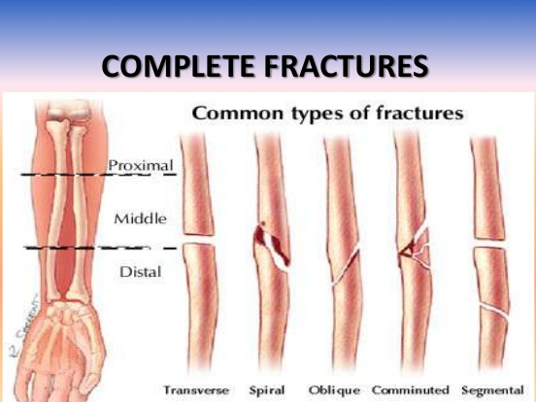
Cont….
2. Complete or incomplete
# are complete if the break is completely through the bone

Slide 14
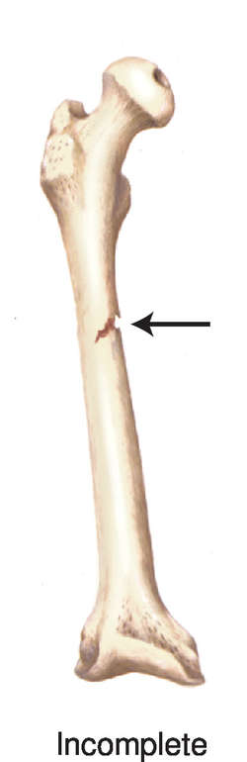
Cont….
Incomplete # it occurs partly across a bone shaft but the bone is still in one piece.
An incomplete # is often the result of bending or crushing forces applied to a bone.

Slide 15
Cont….
3. According to the direction of the # line
Linear
Oblique
Transverse
Longitudinal
Spiral

Slide 16
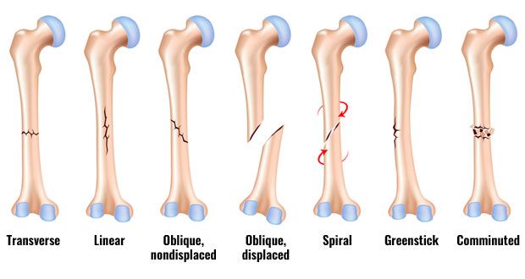

Slide 17
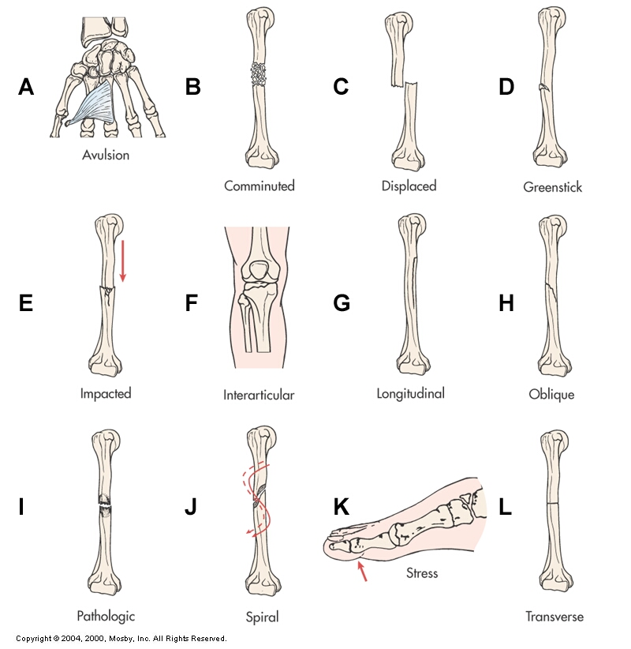
Cont….
A. Transverse # : a fracture that is straight across the bone

Slide 18
Cont….
B. Spiral #: a fracture that twists around the shaft of the bone

Slide 19
Cont….
C. Greenstick: a fracture in which one side of a bone is broken and the other side is bent

Slide 20
Cont….
D. Comminuted: a fracture in which bone has splintered into several fragments

Slide 21
Cont….
E. Oblique # : a fracture occurring at an angle across the bone (less stable than a transverse fracture)

Slide 22
Cont….
F.Pathologic # : a fracture that occurs through an area of diseased bone (eg, osteoporosis, bone cyst, Paget’s disease, bony metastasis, tumor); can occur without trauma or a fall

Slide 23
Cont….
7. Stress #: occurs in normal or abnormal bone that is subject to repeated stress, such as jogging or running

Slide 24
Cont….
4. Displaced or non-displaced
Displaced # the two ends of the broken bones are separated from one another and out of their normal positions.

Slide 25
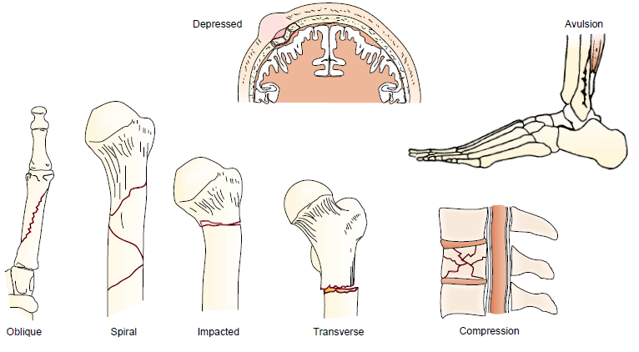
OTHER TYPES OF FRACTURES
Avulsion: a fracture in which a fragment of bone has been pulled away by a ligament or tendon and its attachment

Slide 26
Cont….
Compression: a fracture in which bone has been compressed (seen in vertebral fractures)

Slide 27
Cont….
Depressed: a fracture in which fragments are driven inward (seen frequently in fractures of skull and facial bones)

Slide 28
Cont….
Impacted: a fracture in which a bone fragment is driven into another bone fragment

Slide 29
Cont….
Displaced # are usually comminuted
#( more than two fragments) or oblique.

Slide 30
Cont….
In a non-displaced # the periosteum is intact across the # and the bone is still in alignment.
Non- displaced # are usually transverse, spiral, or greenstick

Slide 31
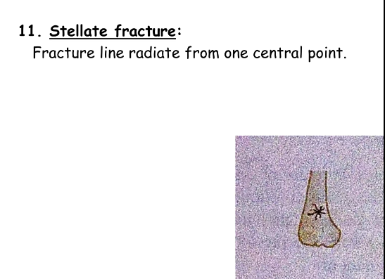
OTHERS

Slide 32
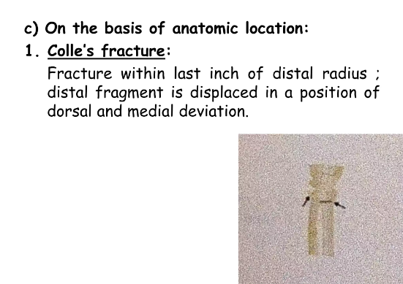

Slide 33
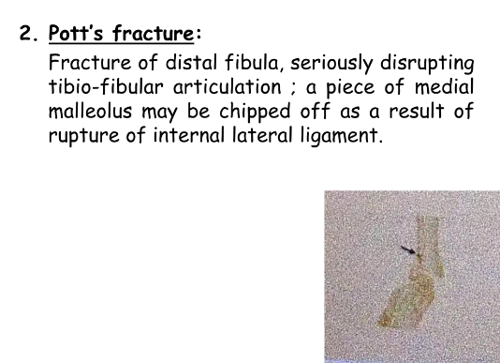

Slide 34
CLINICAL MANIFESTATIONS
The clinical manifestations of a fracture are:
Pain
Loss of function
Deformity
Shortening of the extremity
Crepitus
Local swelling
Discoloration

Slide 35
Cont….
PAIN
The pain is continuous and increases in severity until the bone fragments are immobilized.
The muscle spasm that accompanies fracture is a type of natural splinting designed to minimize further movement of the fracture fragments.

Slide 36
Cont….
LOSS OF FUNCTION
After a fracture, the extremity cannot function properly, because normal function of the muscles depends on the integrity of the bones to which they are attached.
Pain contributes to the loss of function.

Slide 37
Cont….
DEFORMITY
Displacement, angulation, or rotation of the fragments in a fracture of the arm or leg causes a deformity

Slide 38
Cont….
SHORTENING
In fractures of long bones, there is actual shortening of the extremity because of the contraction of the muscles that are attached
above and below the site of the fracture.

Slide 39
Cont….
CREPITUS
When the extremity is examined with the hands, a grating sensation, called crepitus, can be felt.
It is caused by the rubbing of the bone fragments against each other.

Slide 40
Cont….
SWELLING AND DISCOLORATION
Localized swelling and discoloration of the skin (ecchymosis) occurs after a fracture as a result of trauma and bleeding into the tissues.

Slide 41
FRACTURE HEALING
Reparative process of self-healing (union) occurs in the following stages:
Fracture hematoma ( bleeding, edema)
Granulation tissue → active phagocytosis absorbs the products of local necrosis.

Slide 42
Cont….
The hematoma converts in to granulation tissue( consisting of new blood vessels, fibroblasts, and osteoblasts) produces the basis for new bone substances called osteoid during days of 3-14 post injury

Slide 43
Cont….
3. Callus formation
Minerals and new bone matrix are deposited in the osteoid
Callus consist of cartilage, osteoblasts, calcium and phosphorus
Usually appears by the end of 2nd week

Slide 44
Cont….
Ossification (3 wks – 6 mos)
During this stage the clinical union, the patient may allowed limited mobility and the cast may be removed

Slide 45
Cont….
Consolidation (distance between fragments decreases → closes).
Takes up to one year
It can be equated with radiologic union
Remodeling (union completed; remodels to original shape, strength)

Slide 46
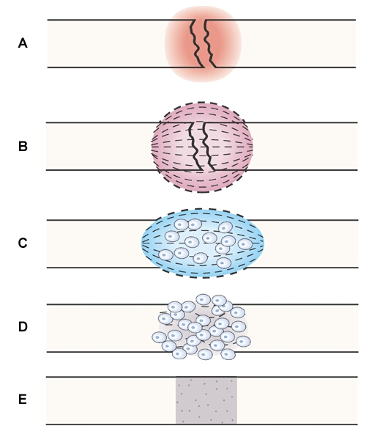
Cont….

Slide 47
COLLABORATIVE CARE
Overall goals of treatment:
Anatomic realignment of bone fragments (reduction)
Immobilization to maintain alignment (fixation)
Restoration of normal function

Slide 48
FRACTURE REDUCTION
Reduction of a fracture (“setting” the bone) refers to restoration of the fracture fragments to anatomic alignment and rotation

Slide 49
FRACTURE REDUCTION
Closed reduction
Nonsurgical, manual realignment
Open reduction
Correction of bone alignment through a surgical incision

Slide 50
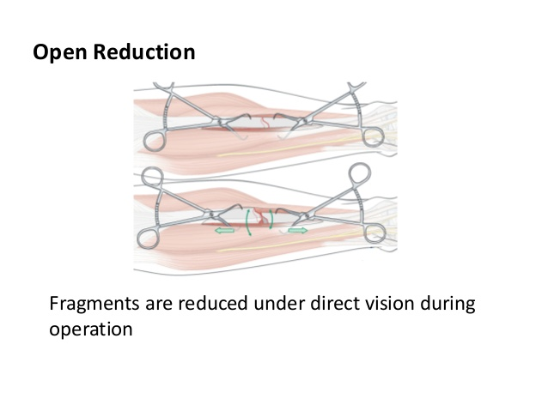
Cont….

Slide 51
Cont….
Traction (with simultaneous counter-traction)
Application of pulling force to attain realignment
Skin traction (short-term: 48-72 hrs)
Skeletal traction (longer periods)

Slide 52
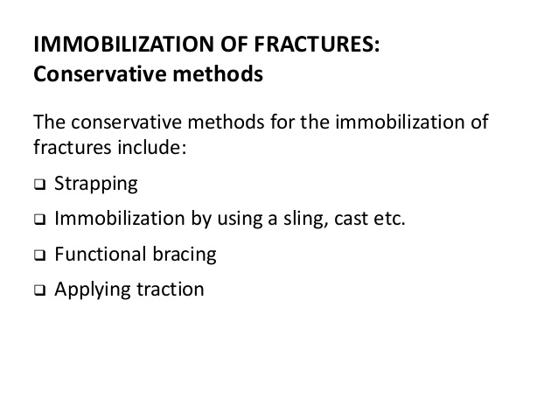
Cont….

Slide 53
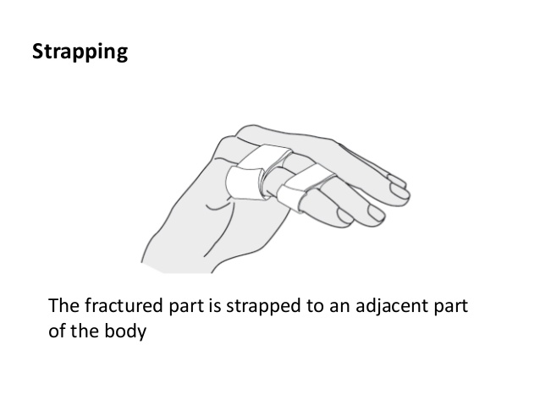
Cont….

Slide 54
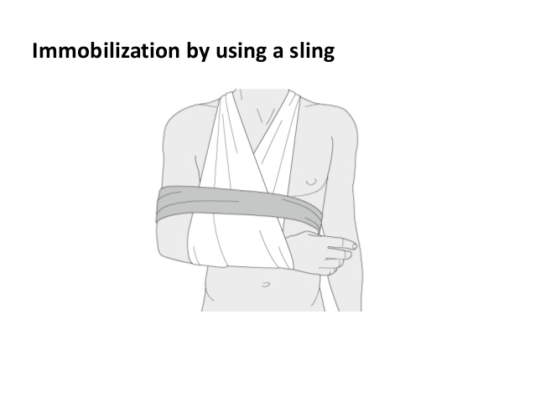
Cont….

Slide 55
Cont….
Casts
Temporary circumferential immobilization device
Common following closed reduction

Slide 56
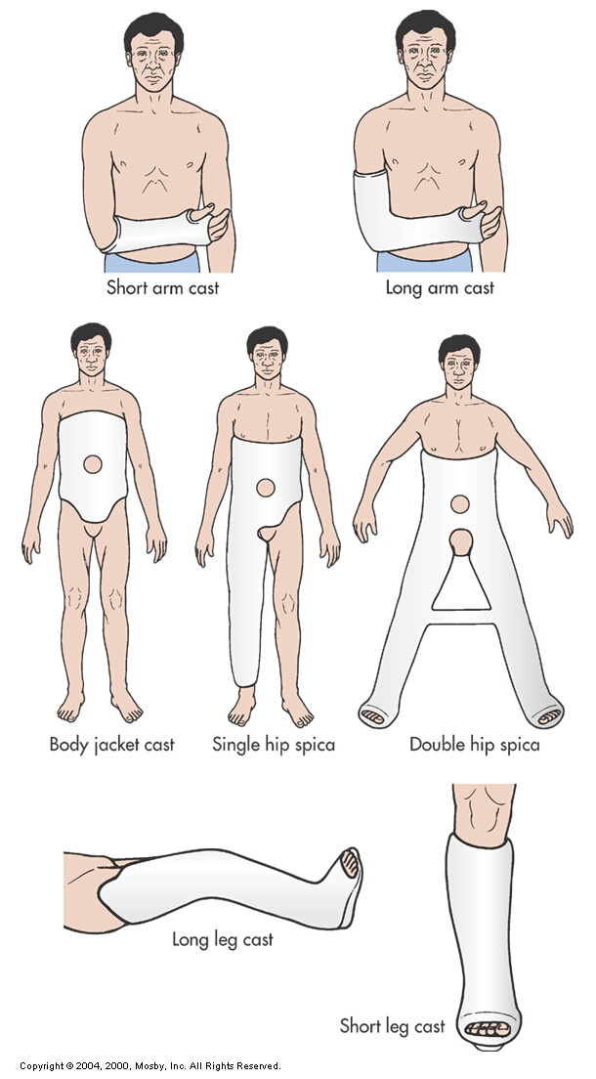
Cont….

Slide 57
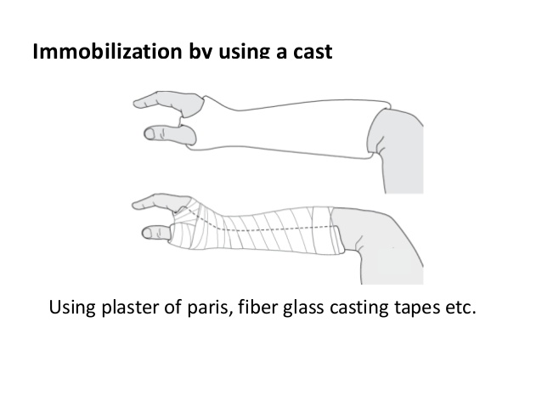
Cont….

Slide 58
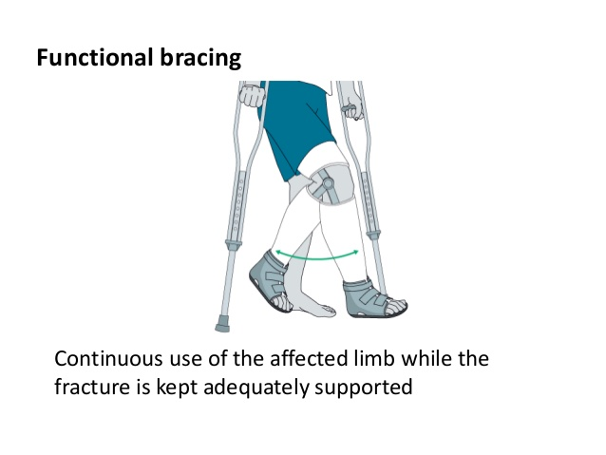
Cont….

Slide 59
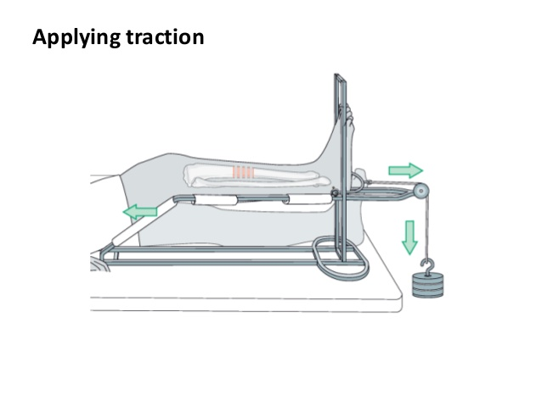
Cont….

Slide 60
Cont….
Traction
Application of a pulling force to an injured part of the body while countertraction pulls in the opposite direction

Slide 61
Cont….
Purpose of traction:
Prevent or reduce muscle spasm
Immobilization
Reduction
Treat a pathologic condition

Slide 62
Cont….
External fixation
Metallic device composed of pins that are inserted into the bone and attached to external rods

Slide 63
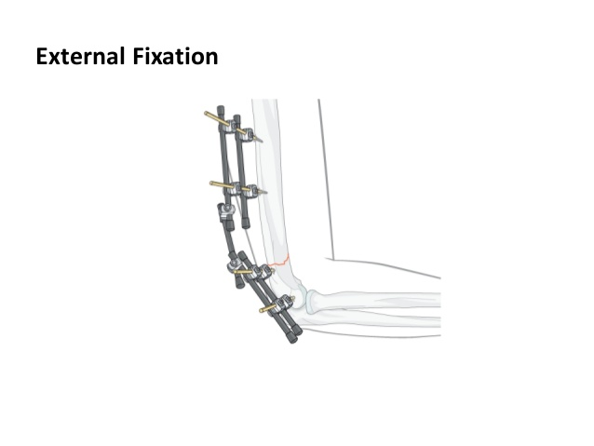
Cont….

Slide 64
Cont….
Internal fixation
Pins, plates, intramedullary rods, and screws
Surgically inserted at the time of realignment

Slide 65
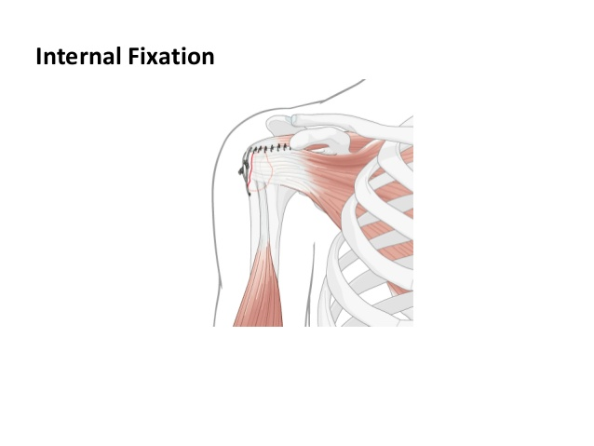
Cont….

Slide 66
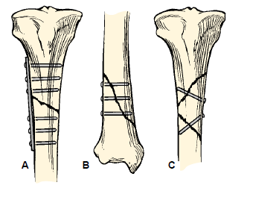
TECHNIQUES OF INTERNAL FIXATION
(A) Plate and six screws for a transverse or short oblique fracture.

Slide 67
Cont….
(B) Screws for a long oblique or spiral fracture.

Slide 68
Cont….
(C) Screws for a long butterfly fragment

Slide 69
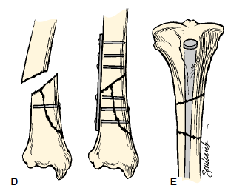
Cont….
(D) Plate and six screws for a short butterfly fragment.

Slide 70
Cont….
(E) Medullary nail for a segmental fracture

Slide 71
NURSING MANAGEMENT NURSING ASSESSMENT FOR FRACTURES
Brief history of the accident
Mechanism of injury
Special emphasis focused on the region distal to the site of injury

Slide 72
Cont….
Neurovascular assessment
Color and temperature
cyanotic and cool/cold: arterial insufficiency
Blue and warm: venous insufficiency
Capillary refill (want < 3 sec)
Peripheral pulses (↓ indicates vascular insufficiency)

Slide 73
Cont….
Neurovascular assessment
Edema
Sensation
Motor function
Pain

Slide 74
NURSING DIAGNOSES
Risk for peripheral neurovascular dysfunction
Acute pain
Risk for infection

Slide 75
Cont….
Risk for impaired skin integrity
Impaired physical mobility
Ineffective therapeutic regimen management

Slide 76
NURSING MANAGEMENT NURSING IMPLEMENTATION
General post-op care
Assess dressings/casts for bleeding/drainage
Prevent complications of immobility
Measures to prevent constipation
Frequent position changes/ ambulate as permitted

Slide 77
Cont….
ROM exercised of unaffected joints
Deep breathing
Isometric exercises
Trapeze bar if permitted

Slide 78
Cont….
Traction
Ensure:
No frayed ropes, loose knots
Ropes in pulley grooves
Pulley clamps fastened securely
Weights must hang freely
Appropriate body alignment

Slide 79
Cont….
Inspect skin
Around slings
Around pins

Slide 80
Nursing Implementation: Cast care
Casts can cause neurovascular complications if
Too tight
Edematous
Frequent neurovascular checks
Ice and elevation during early phase

Slide 81
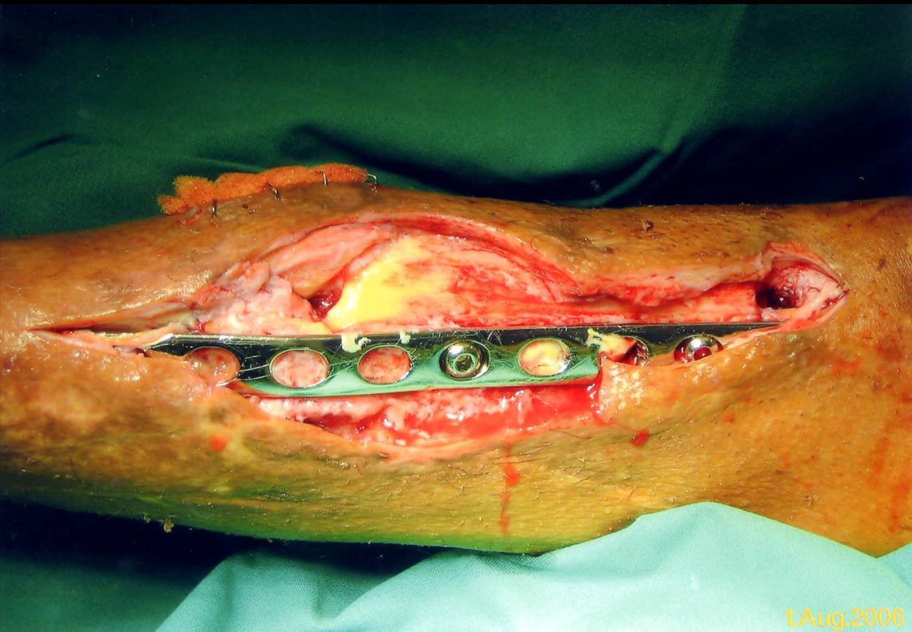
COMPLICATIONS OF FRACTURES
INFECTION
Open fractures and soft tissue injuries have ↑ incidence
Osteomyelitis can become chronic

Slide 82
Cont….
Collaborative Care
Open fractures require aggressive surgical debridement
Post-op IV antibiotics for 3 to 7 days (prophylactic)

Slide 83
Cont….
2.Compartment Syndrome
Condition in which elevated intracompartmental pressure within a confined myofascial compartment compromises the neurovascular function of tissues within that space

Slide 84
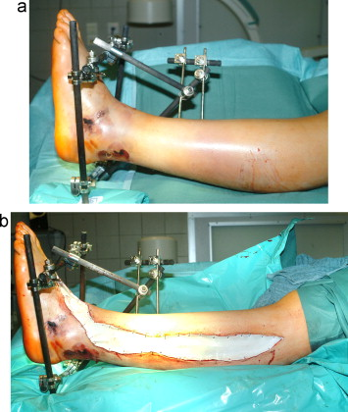

Slide 85
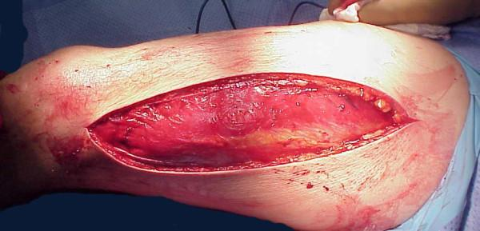
Cont….
Causes capillary perfusion to be reduced below a level necessary for tissue viability

Slide 86
Cont….
Two basic etiologies create compartment syndrome:
Decreased compartment size (dressings, splints, casts)
Increased compartment content (bleeding, edema)

Slide 87
Cont….
Clinical Manifestations
Six Ps
Paresthesia (unrelieved by narcotics)
Pain (unrelieved by narcotics)
Pressure

Slide 88
Cont….
Clinical Manifestations
Six Ps:
Pallor (loss of normal color, coolness)
Paralysis
Pulselessness (decreased/absent pulses)

Slide 89
Cont….
Clinical Manifestations
Six Ps:
Patient may present with one or all of the six Ps
Compare extemities

Slide 90
Cont….
Clinical Manifestations
Absence of peripheral pulse = ominous late sign
Myoglobinuria
Dark reddish-brown urine

Slide 91
Cont….
Collaborative Care
Prompt, accurate diagnosis is critical
Early recognition is the key
Do not apply ice or elevate above heart level

Slide 92
Cont….
Collaborative Care
Remove/loosen the bandage and bivalve the cast
Reduce traction weight
Surgical decompression (fasciotomy)

Slide 93
Cont….
3. Venous Thrombosis
Veins of the lower extremities and pelvis are highly susceptible to thrombus formation after fracture, especially hip fracture

Slide 94
Cont….
4. Fat Embolism Syndrome (FES)
Characterized by the presence of fat globules in tissues and organs after a traumatic skeletal injury

Slide 95
Cont….
5. SHOCK (EARLY)
Hypovolemic or traumatic shock resulting from hemorrhage (both visible and nonvisible blood loss) and from loss of extracellular fluid into damaged tissues may occur in fractures of the extremities, thorax, pelvis, or spine

Slide 96
OTHER EARLY COMPLICATIONS
Deep vein thrombosis (DVT), thromboembolism, and pulmonary embolus

Slide 97
Cont….
DELAYED UNION AND NONUNION (DELAYED)
Delayed union occurs when healing does not occur at a normal rate for the location and type of fracture.

Slide 98
Cont….
Delayed union may be associated with distraction (pulling apart) of bone fragments, systemic or local infection, poor nutrition, or comorbidity

Slide 99
Cont…..
Nonunion results from failure of the ends of a fractured bone to unite.

Slide 100
Cont….
Complex regional pain syndrome (CRPS), formerly called reflex sympathetic dystrophy (RSD), is a painful sympathetic nervous system problem.

Slide 101
Cont….
AVASCULAR NECROSIS OF BONE (DELAYED)
Avascular necrosis occurs when the bone loses its blood supply and dies.
It may occur after a fracture with disruption of the blood supply

Slide 102
Cont….
HETEROTROPHIC OSSIFICATION (DELAYED)
Heterotrophic ossification (myositis ossificans) is the abnormal formation of bone, near bones or in muscle, in response to soft tissue trauma after blunt trauma, fracture, or total joint replacement.

Slide 103


