Slide 1


Slide 2


Slide 3
Objectives
At the end of the class students will able to:
define field trip
list down purposes of field trip
explain the guidelines for field trip
describe organization of field trip
enlist the advantages and disadvantages of field trip

Slide 4

DEFINITION
It is defined as an educational procedure by which the students obtain first hand information by observing places ,objects , phenomena or activities and process in their natural setting to further learning

Slide 5

PURPOSES OF FIELD VISIT

Slide 6
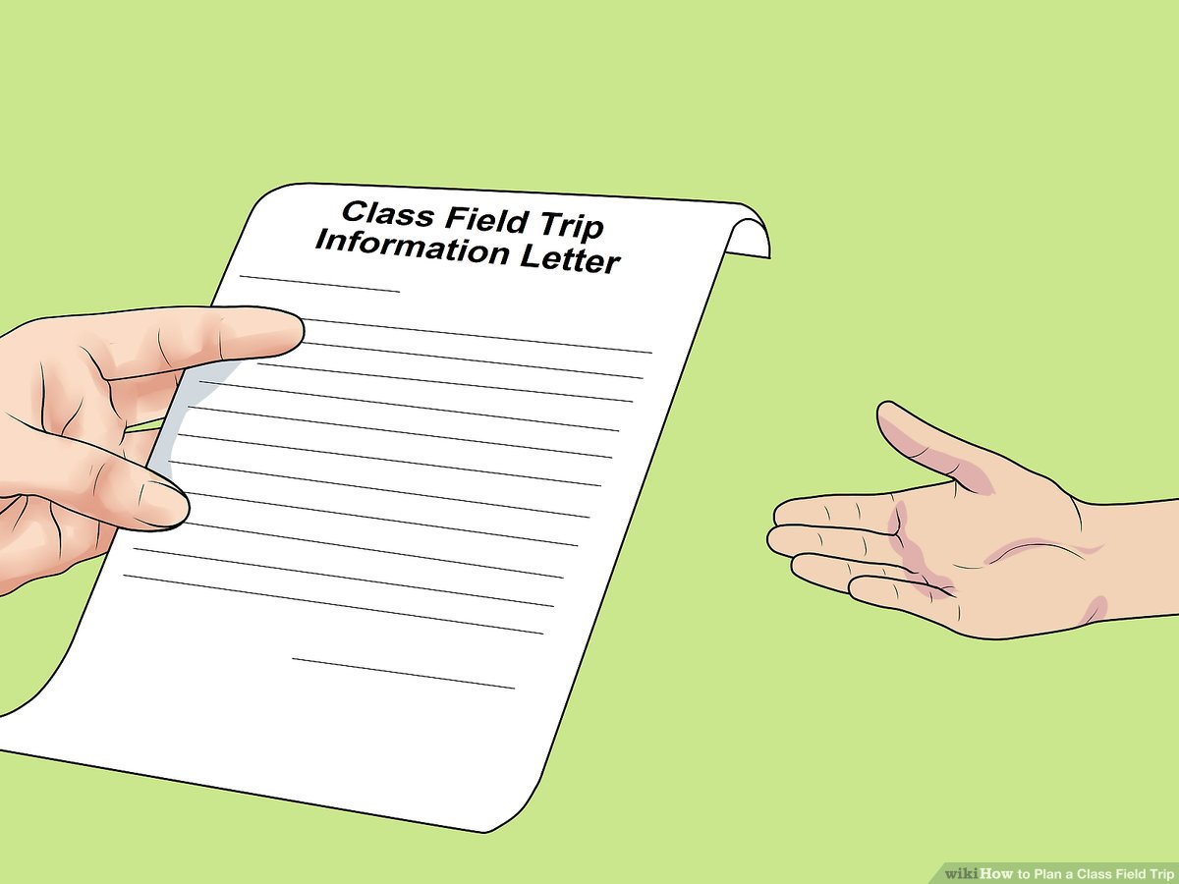
GUIDELINES FOR USING FIELD TRIP AS A TEACHING METHOD

Slide 7
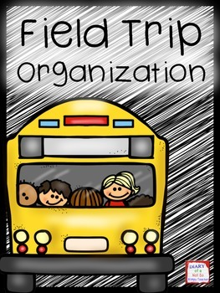

Slide 8

DISADVANTAGES OF FIELD TRIP
Field trip is time consuming
Careful planning is required
Many parties to be involved , cooperation coordination of various agencies required Transportations may be problem
Since the students are going out of school / college premises it are risky, safety precautions are essentials

Slide 9


Slide 10


Slide 11

Write a note on planning of organizing a field visit to milma dairy
Submit on 7/03/2023 before 4.30pm

Slide 12

Teachers reference
Sudha R.Nursing education:principles and concepts. Jaypee Brother’s publishers.2013.page no:88,89
Dinesh Kumar Sharma. Communication and educational technology: lotus publishers 2008. page no :177-180
Prammela.R.Methods of teaching nursing communication and educational technology.jaypee brother’s medical publishers. 2010 page no:287,288

Slide 13
Student’s reference
Sudha R.Nursing education:principles and concepts. Jaypee Brother’s publishers.2013.page no:88,89
Dinesh Kumar Sharma. Communication and educational technology: lotus publishers 2008. page no :177-180

Slide 14
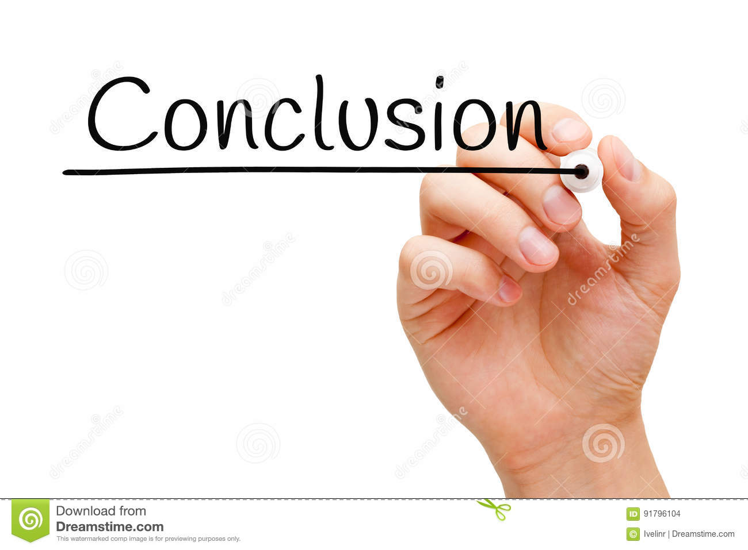

Slide 15


