Slide 1


Slide 2
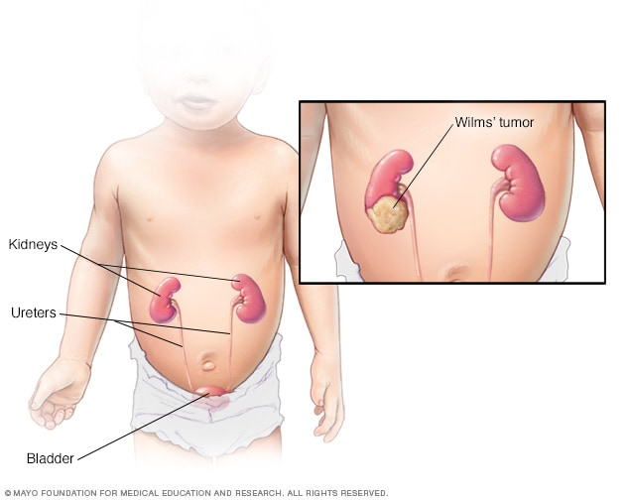
WILMS TUMOR
Ms. Jaicy John
Asst.professor
JMCON

Slide 3
OBJECTIVES
General Objective:- On completion of class student will acquire in depth knowledge regarding wilms tumour and able to manage a child with wilms tumour according to the severity by applying nursing process approach in a positive manner.

Slide 4
Cont..
Specific Objective:- At the end of the class the student will be able to.
define the wilms tumour.
enlist the risk factors of wilms tumour
explain pathophysiology of wilms tumour
identify the clinical manifestations of wilms tumour
recognise diagnostic measures for wilms tumour
discuss therapeutic management of wilms tumour
detect the complications of wilms tumour
evaluate nursing care of a wilms tumour

Slide 5
DEFINITION
Nephroblastomas or Wilm's tumour is a malignant kidney tumour, reproducing the metanephros-derived embryonal tissue
Nephroblastoma, or Wilms’ Tumor, is the most common solid abdominal tumor in childhood and usually appears as a painless abdominal mass in an otherwise well child

Slide 6
EPIDEMIOLOGY
Childhood kidney tumours in 90% of the cases are nephroblastomas
Nephroblastoma incidence is lower in Asian countries
It is a young child cancer:- 77 percent under 5years, and 90% of the cases occurring before the age of 7 years.

Slide 7
CONT…
The median age is 31/2 years. The peak ages are from 1 through 3 years.
One eighth of all patients are younger than 1 year.
There is equal incidence in boys and girls.
10% of the cases nephroblastomas are combined with polymalformative syndromes.

Slide 8
RISK FACTORS
Aniridia
hemihypertrophy.
sporadic or familial

Slide 9
WAGR Syndrome
WAGR stands for Wilms tumour, aniridia, genitourinary malformation and mental Retardation.
Patients with the other features of the syndrome have a 30% lifelong risk of nephroblastoma.
This syndrome is due to a deletion of part of chromosome 11 that includes the WT1 gene

Slide 10
Beckwith-Weidemann Syndrome:
This is a rare condition resulting from a deletion of another part of chromosome 11, from a genetic locus designated WT2 (Wilms Tumour 2)
The exact gene has not been determined.
The syndrome also consists of macrosomia, hemihypertrophy, macroglossia, omphalocele and visceral hypertrophy

Slide 11
PATHOPHYSIOLOGY
Wilms' tumors may be separated into 2 prognostic groups based on pathologic characteristics:
Favorable - Contains well developed components. Most tumors have favorable histology
Anaplastic - Contains diffuse anaplasia (poorly developed cells). 7% of children with wilms tumor have unfavorable histology with anaplastic changes. Diffuse anaplastic changes generally predict a poor outcome

Slide 12
CONT…
Malignant nephrogenic blastoma
Cellular, encapsulated intra-abdomen tumor
Renal ischemia

Slide 13
CONT…
Abdominal mass
Rupture of capsule weight loss,
hematuria, fever,
Vomiting, hypertension
Rapid metastasis to
Lungs, liver &brain

Slide 14
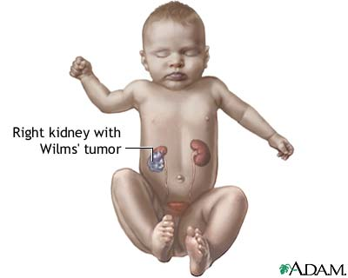

Slide 15
CLINICAL MANIFESTATION
Swelling in the abdomen
Abdominal pain;-
Fever(20% )
General discomfort or uneasiness
constipation

Slide 16
CONT…
High blood pressure
Increased growth on only one side of the body
Loss of appetite
Nausea
Vomiting

Slide 17
CONT…
Dyspnea
Cough
Shortness of breath
Chest pain
Rarely, anaemia or polycythaemia
Haematuria

Slide 18
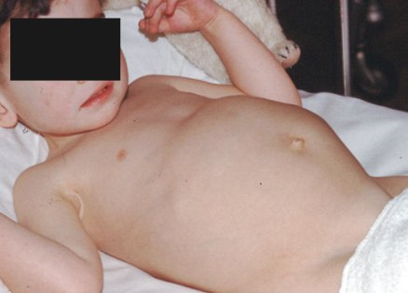
Wilms' tumour

Slide 19
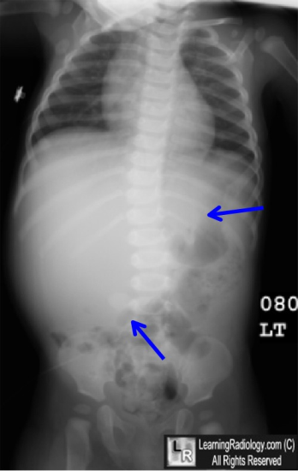
DIAGNOSTIC MEASURES.
History
Physical examination
Abdomen X-ray
IV pyelography:-.
Urinalysis.
Bone marrow aspiration;-.

Slide 20
CONT…
Chest X-ray:-
Inferior venacavagram:-
Haematological studies:-
Computed tomography
MRI
Renal function test

Slide 21
NATIONAL WILMS TUMOR STUDY 5 STAGING SYSTEM
Stage I - Tumor limited to kidney and completely excised. No penetration of the renal capsule or involvement of renal sinus vessels.
Stage II - Tumor extends beyond the kidney but is completely excised with negative margins and lymph nodes

Slide 22
Cont..
(a) penetration of the renal capsule
(b) invasion of the renal sinus vessels
(c) spillage of tumor locally during removal

Slide 23
Stage III - Gross or microscopic residual tumor remains postoperatively, including inoperable tumor, positive surgical margins, diffuse tumor spillage involving peritoneal surfaces, regional lymph node metastasis, or transected tumor thrombus. Biopsy before resection

Slide 24
Cont..
Stage IV - Hematogenous metastasis (lung, liver, bone, brain) or lymph node metastasis outside the abdominal or pelvic cavities.
Stage V - Bilateral renal tumors at diagnosis

Slide 25
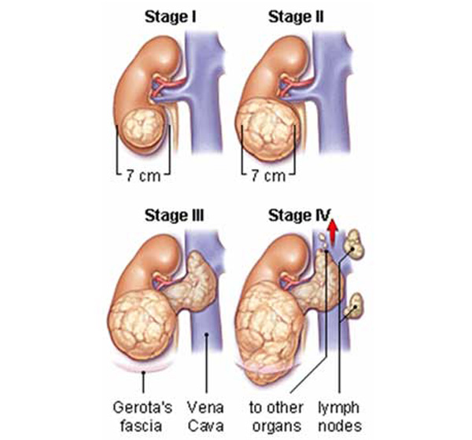

Slide 26
TREATMENT.
Radiation therapy:-
Chemotherapy
Surgery

Slide 27
NURSING MANAGEMENT.
Assessing for the presence of the tumour
Preparing parents and child for diagnostic procedures
Preoperative care:-
Post operative care:-
Family support:-

Slide 28
NURSING DIAGNOSIS
Imbalanced nutrition less than body requirements related to insufficient dietary intake
High risk for fluid volume deficit related to altered intake, excessive losses through normal route
Impaired oral mucous membrane related to chemotherapy

Slide 29
Ineffective protection related to abnormal blood profiles
Anxiety of the child and family related to change in health status, threat of the death etc.
High risk for injury related to internal biochemical factors of regulatory function, abnormal blood profile
High risk for impaired skin integrity related to external factors of radiation and chemotherapy

Slide 30
Imbalanced nutrition less than body requirements related to insufficient dietary intake
Assess the history of food intake(24 hour recall), financial and cultural influences
Assess the appetite changes, presence of illness and diagnosis, effect of nutrition on skin.
Assess the height and weight, head circumstance, skin fold thickness compare with previous values and standard charts.

Slide 31
cont
Assess the abdominal girth, stool characteristics, presence of diarrhea, bowel sounds for increased motility.
Request parent to bring foods from home and preserve in age appropriate quandities.
Administer mineral or vitamin supplements.
Avoid excessive handling of the infant after feeding

Slide 32
High risk for fluid volume deficit related to altered intake, excessive losses through normal route
Assess fluid losses, sources, amounts and effects urinary outputs
Assess weight naked on same scale daily in morning or before breakfast.
Assess for presence of electrolyte depletion and possible cause.
Encourage increased oral fluid intake in proportion to lossess.
Weigh the baby daily.
Use infusion pump or volume control chamber for IV with a pediatric infusion set with a long tubing

Slide 33
Impaired oral mucous membrane related to chemotherapy
Assess oral cavity for ulcer, pain, gingivitis and stomatitis.
Provide mouth rinses, cleanising with swabs or toothbrush.
Administer medication topically before meals.
Offer smooth, bland foods that are not hot or spicy.
Administer an antiseptic mouth rinse 30 minutes before any food or fluid intake.
Instruct to use soft brush or swab to clean mouth

Slide 34
Ineffective protection related to abnormal blood profiles
Assess bleeding for any sites, WBC count, platelet count, RBC etc.
Pad the sides of the bed
Use protective measures such as glove, mask and cap
Administer blood transfusions as ordered for severe blood loss.
Instruct the child and parents to avoid rough play, straining at defecation, blowing nose hard.
Instruct the parents to avoid persons with upper respiratory tract infection

Slide 35
Anxiety of the child and family related to change in health status, threat of the death etc.
Assess source and level of anxiety and need for support that will relieve it.
Allow expression of concerns and inquires about disease and possible consequences of surgery.
Allow parents to stay with the child or open visitation
Orient the child to the surgical and ICU unit, equipment, noises and staff.
Explain all procedures and care in simple, direct, honest terms and repeat as often as necessary.
Utilize the therapeuticplay, drawings, models for instruction to the child

Slide 36
High risk for injury related to internal biochemical factors of regulatory function, abnormal blood profile.
Assess the blood pressure every 2 hourly.
Avoid palpation of the abdominal mass. Post sign on bed stating not to palpate.
Assess the bowel activity such as elimination pattern, bowel sounds and bowel movements.
Assess the incision site for redness, swelling and drainage.
Assess the urinary output and characteristics of the urine

Slide 37
High risk for impaired skin integrity related to external factors of radiation and chemotherapy.
Assess the skin and mucous membrane for color change, warmth and dryness.
Assess for any skin rashes, dermatitis, pruritis and scratching.
Assess for open wound and types of drainage.
Assess the skin cleaniless and examine body prominence for changes
Apply emollients, lotions to skin, bony prominence with gentle massage using fingers and hands.
Maintain body alignment and encourage to maintain correct posture
Provide nutritional diet that is high in protein and calorie

Slide 38
REFERENCE
Hockenberry.J.M.(2015) Wong’s Essentials of Pediatric Nursing (9th edition). Missouri:Mosby publications.PP-897-898
Marlow.R.D., and Redding. A.B,(2013).Textbook of Pediatric Nursing(6th edition). New Delhi: Publication.PP-476-491
Kyle Terri (2013) Essentials of Pediatric Nursing (2nd edition) Philadelphia: Lippincott Williams & Wilkins, PP:634-636
O.P.Ghai and et al (2013) Ghai Essential Pediatrics (8th edition) New Delhi: CBS publishers PP-402-404.

Slide 39


