Slide 1
Population, Sample & Sampling
Ms. Anusha Selvin Mary
Asst. Professor
JMCON

Slide 2
Definition of population
Population is the aggregation of all the units in which a researcher is interested
1. Target Population:
- People who are meeting the degignated set of criteria
- that are confirmed to designated criteria and also accesible as subjects

Slide 3
sample
A selected subset of the population tat is selected for a study
It is defined as representative unit of a target population
sampling
It is a process of choosing a portion of entire population
It is a process of slecting representative units from a entire population of study

Slide 4
purposes
1. Economical:
-It is not possible and economical to study an entire
population interms of time, money and resources
-It provides an economical option for the researcher to generate evidences
2. Improved quality of data:
Maintain the quality of research work which is not possible in entire population
3. Quick study result
- immpossible to generate result in larger population
Generating faster result is an objective
4. Precision and accuracy of data:

Slide 5
Characteristics of good sample
Representative- generalize the findings
Free from bias and errors- random sampling error
No substituion or incompleteness
Appropriate sample size- in quantitative study larger the sample better the probability

Slide 6
Sampling process
Identify and defining the target population:
-The target population who meet the designed set of criteria is identified which helps the researcher to generalize the information
2. Describing the accessible population and ensuring the sampling frame:
- Researcher eshtablish a description about accessible population available for resaerch
- select a sample from accessible population

Slide 7
3. Specifying the sampling unit:
- Researcher eshtablish inclusiona and exclusion criteria to select the sampling unit.
- It eliminate confusion while selecting sample
4. Specifying sample selection methods:
- It is the important stage of the process where the researcher decide about the sampling technique( eg- probability or non probability) to be used.
- It depend upon the type of population, availability f resources, knowledge and kind of the study

Slide 8
5. Determining sample size:
- Researcher determine the size of the sample to plan for implementation of the sampling process acordingly
6. Specifying sampling plan:
- prepares a final sampling plan
7. Selecting a desired sample
- Select a representative part of the population used by the researcher for data collection

Slide 9
Types of sampling technique
It has two types
Probability sampling technique
Non probability sampling technique
Probability sampling technique:
It involves random selection of elements of the population which provides equal chances to all individuals in the population of getting selected

Slide 10
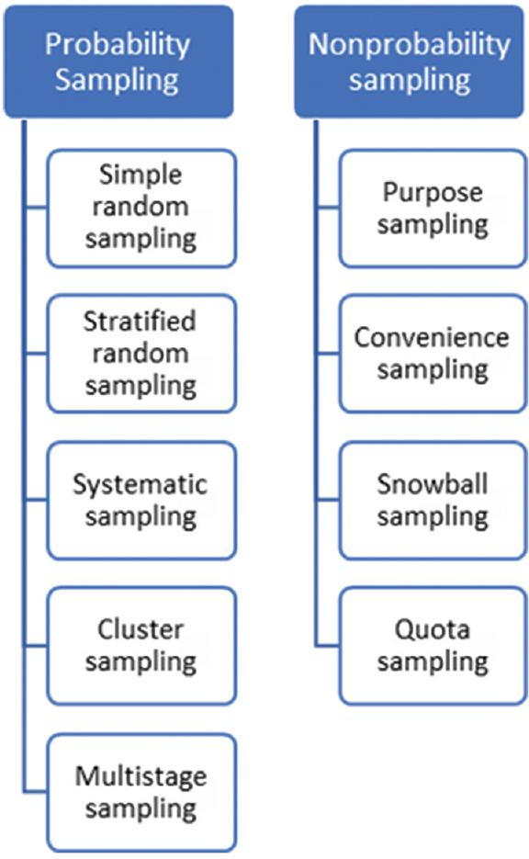

Slide 11
Types of sampling technique
Sampling is the process of selecting a representative part of the population
It should represent the characteristics of the population
PROBABILITY SAMPLING TECHNIQUE;
It is based on the theory of probability
Random selection of elements /members of the population
Every subject has equal chance to be selected
Chances of bias are less as the subjects are randomly selected

Slide 12
1. Simple Random sampling:
Basic probability sampling design
The whole process of sampling is carried out in a single step
The essential prerequisite is
- population must be homogenous
- researcher must have the list of elements
/members
First step is
- to identify the accessible population and prepare a list of all elements
- the list of subjects in the population is known as sampling frame

Slide 13
It has 3 methods
a. The lottery method
- oldest and mechanical method
- each member attributed to a unique number
- researcher cnoose the number tags
- replacement method and non replacement
b. Use of table of random numbers
- most commonly and accurately used method
- Random tables present several numbers in rows and columns
- researcher initially prepares a number list
- the same proceedure is continued until desired number is selected
- if repeatedly similar numbers are encountered they are ignored and the next number is selected

Slide 14
c. Use of computers:
- Random table is generated from computer if population is more
Merits:
Ease of seempling the sample
Fair way of selecting sample
Requires minimum knowledge about the poulation
Most unbiased method
Free from sampling errors
Sample errors can be easily computed
Demerits:
Requirement of uptodate list of all memebers
More proceedure needed
Expensive and time consuming

Slide 15
2. Stratified random Sampling:
- used for heterogenous population
- divides the population into different homogenous subgroup or strata
- Randomly select subject from different strata
- strata are divided according to selected triats
- eg) Age, gernder, religion
Proportionate Stratified Random sampling
- Sample choosen from each stratum is proportion to the size of the population
- utilize similar sampling fraction for each stratum irrespective of the difference in stratal population

Slide 16
b. Disproportionate startified random sampling:
- Samlple choosen is not in a proportion
Sampling fraction is the only diffrence
Merits:
Ensure representation of all groups
To observe existing replationship between two subgroups
Save money time and energey
Demerits:
Requires accurate information on the proportion
Large population must be vailable

Slide 17
3. Systemic random sampling
Can be linked to an arithmatic progression
Difference between two consecutive number is the same
Selection of f th case
F= no of subject in target population/ sample size
Merits:
Convenient and simple to carried out
Distribution of sample is spread even
Time consuming and cheaper
Demerits:
- if the first seubject is not randomly selected it is non random sampling
Sometimes result in biased sample

Slide 18
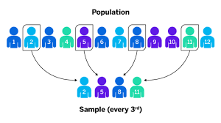

Slide 19
4. Cluster or multi stage sampling
Random selection of sampling unit consisting of population element
From each sampling unit a sample of population element is drawn by either simple or dtratified random sampling
Used in case where popualtion elements are scattered
Geographical units are most commonly used
One stage cluster- choose random sample of cluster and gather data from each subject
B. Two stage cluster: randomly selecting multiple cluster and choose subjects randomly

Slide 20
c. Multistage sampling
Identify cluster as population at different level
Select them using simple random sampling
Select units using simple or stratified sampling

Slide 21
Probability poportion to size cluster:
Its a variant of cluster sampling
When the size of cluster is not same the proceedure of sampling in which the units are selected with probability proportional to measure of size
Merits:
Cheap , quick and easy for larger population
Same cluster can be used again
Demerit; over represented or underepresentad sample

Slide 22
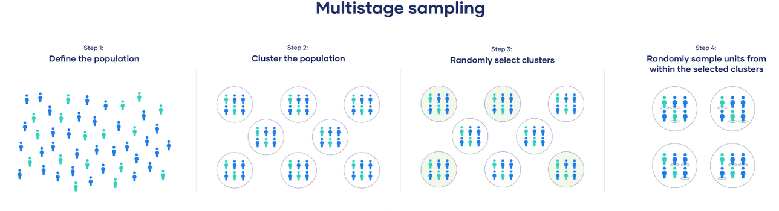

Slide 23
Sequential sampling;
- Sample selection is diffreent
Sample size is not fixed
Initially select small sample and if unable to draw result more sample is selected

Slide 24
Non probability sampling
Its a technique where the samples are gathered in a process that does not give all the individuals in the population equal chances of being selected in the sample.
Elements are chosen by choice and not by chance through non random sampling methods
This method are more likely to produce a biased sample than random methods

Slide 25
USES:
The researcher targets to make a qualitative, pilot, or exploratory study
Research does not aim to produce results that will be utilized to generate generalizations pertaining to the entire population
Used in an initial study( pilot study) and can be carried out again.

Slide 26
USES:
Requires in-depth knowledge about the accessible population
Used when a limited number of individuals possess the trait of interest
MERITS:
Simple to draw a sample
Saves resources as it requires less field work
DEMERITS:
Requires considerable knowledge about the population
Conscious biases may occur

Slide 27
purposive sampling
More commonly known as judgemental or authoritative sampling
Subjects are chosen to be part of the sample with a specific purpose in mind
The researcher believes that some subjects are fit for research compared to other individual
USES:
Requires in depth knowledge about the accessible population.
Used when a limited number of individuals possess the trait of interest

Slide 28
MERITS:
Simple to draw a sample
Saves resources as it requires less fieldwork
DEMERITS:
Requires considerable knowledge about the population under study
Conscious biases may occur

Slide 29
Convenience sampling
Most common of all sampling techniques
Subjects are selected because of their convenient accessibility and proximity to the researcher
Fast , inexpensive, easy and the subjects are readily available
Subjects are chosen very easy to recruit for the study
It is also known as accidental sampling
MERITS:
This technique is considered easiest, cheapest, and least time consuming
Helps in saving time, money, and resources
DEMERITS:
Chances of sampling bias
Non representative sample
Findings cannot be generalized

Slide 30
Consecutive sampling
Consecutive sampling is similar to convenience sampling
It includes all accessible subjects who fulfils the exclusion and inclusion criteria as part of the sample
It is considered as the best of non probability sampling as it includes all subjects available and gives a better representation of the population
It is also known as total enumerative sampling
Generally used in small sized population
E.g.- post kidney transplant patient
MERITS:
Very little effort needed
Not expensive and not time consuming
More representation of samples
DEMERITS:
Does not guarantee the selection of representative sample
Limited option about sample size

Slide 31
Quota sampling
Researcher ensures equal or proportionate representation of subjects from each quota
The basis of quota are usually age , gender, education, race, religion and socio economic status
Eg – selecting college students-
It appears like stratified random sampling technique but selected by a random process
STEPS OF QUOTA SAMPLING:
Dividing the population into exclusive subgroups
Researcher recognize the proportion of the subgroup
Researchers choose subjects from various subgroups when taking into account
The sample is representative of entire population

Slide 32
MERITS:
Best technique to investigate a trait or a characteristic of a certain subgroup
Economically cheap, no need to approach all the candidates
Suitable for studies related to public opinions
DEMERITS:
Always does not guarantee representative sample
Chances of sampling bias

Slide 33
Snowball sampling
This technique is used by researchers to identify potential subjects in studies where subjects are hard to locate eg: HIV patients, drug abusers
It works like a chain referral and its known as chain referral sampling.
The researcher asks for assistance from the subject to identify people with a similar trait of interest after observing the initial subject
MERITS:
Permit the researcher to reac population
Simple, cheap and cost effective
Lesser workforce
DEMERITS:
Less control over sampling method
Representativeness is not guaranteed
Sampling bias is of great concern

Slide 34
TYPES OF SNOWBALL SAMPLING:
Linear snowball sampling- asked to provide reference of only one similar subject
Exponential non discriminative – provide references of at least two similar sample
Exponential discriminative – one sample is selected asked for two reference, out of which one subject is active to provide further reference

