Slide 1
ACID BASE IMBALANCE
By
Jyothy Elizabeth John
Clinical instructor
JMCON

Slide 2
Central objective
At the end of the class,students gain knowledge regarding acid base imbalance and apply this knowledge in clinical practice

Slide 3
Specific objectives
At the end of the class,students will be able to
Define acid base balance
Differentiate the types of acid base disturbances
Explain the defense mechanisms to defend acid base imbalance
Understand metabolic acidosis
Elaborate the pathophysiology and management of metabolic acidosis

Slide 4
Explain respiratory acisosis
Identify the pathophysiology and management of respiratory acidosis
Analyze metabolic alkalosis
Identify the pathophysiology and management of metabolic alkalosis
Understand respiratory alkalosis
Explain the pathophysiology and management of metabolic alkalosis

Slide 5
Introduction
Acid base imbalance is an abnormality of the human body’s normal balance of acids and bases that causes the plasma pH to deviate out of the normal range
An excess of acid is called acidosis or academia
An excess of base is called alkalosis or alkalemia

Slide 6
Our human body produces acid daily as the result of cellular metabolism
Acid is any compound which forms H+ ions in a solution.That is proton donor
Base is any compound which combines with H+ ion in a solution.Proton acceptor
pH is the measure of hydrogen ion concentration

Slide 7
NORMAL VALUES
pH is 7.35-7.45
Bicarbonate level 22-26 meq/l
paCO2 35-45 mm of Hg
PaO2 80-100 mm of Hg

Slide 8
Compensatory mechanisms
Activation of buffers'
Respiratory compensation
Renal compensation

Slide 9
Buffers
Buffers are the first line of defense when there is acid base imbalance
Two most common buffers system are bicarbonate and non bicarbonate
These buffer system regulates the blood pH by binding or releasing H+ion
Eg.HCL(strong acid)+NaHCO3=H2CO3(weak acid)+NaCl
NaOH(strong base)+H2CO3=NaHCO3(weak base)+H2O

Slide 10
RESPIRATORY regulation
Buffers produce only temporary solution to acid base imbalance
When chemical buffers alone cannot prevent changes in blood pH ,the respiratory system acts
This system either eliminates or retain C02 and maintain pH

Slide 11
RENAL REGULATION
Renal system acts slowly
This is the third line of defense
The role of kidney is the preservation of body’s bicarbonate store
It is done by the reabsportion of bicarbonate
The kidneys regulate blood pH by secreting H+ ion into urine and by regenerating HCO3 for reabsorption into the blood

Slide 12
Metabolic acidosis
Metabolic acidosis is a condition that occurs when the body produces excessive quantity of acid or when kidneys do not remove acid from the body
If it is left untreated, it can lead to acidemia or death
In metabolic acidosis, pH is less than 7.35 due to the increased production of H+ion

Slide 13
Etiological factors
Diabetic ketoacidosis:(deposition of ketones due to breakdown of fat)
Lactic acidosis
Renal diseases
Intoxication
Excessive alcoholism
Starvation

Slide 14
Pathophysiology
Metabolic acidosis occurs when either an increase in the production of non volatile acid or loss of bicarbonate from body
To maintain acid base balance ,each day kidney reabsorbs HCO3 through renal tubules
Renal dysfunction causes the reduced absorption of HCO3 and results in the accumulation of acid in blood

Slide 15
Clinical manifestation
Chest pain
Palpitation
Headache
Altered mental status
Nausea
Vomiting
Muscle weakness
Seizure
Coma
Arrythmias

Slide 16
Diagnostic measures
ABG Analysis
Blood pH less than 7.35
Bicarbonate level less than 22 meq/l
Renal function test
Urine analysis to detect ketone

Slide 17
Management
A pH under 7.1 is an emergency condition due to the risk of cardiac arrhythmias
Bicarbonate is given at a time under careful observation
Control of diabetes mellitus
Treatment of underlying pathological condition
If severe acidemia present,dialysis can be done

Slide 18
Alcohol cessation
Encourage the patient to drink plenty of water to make blood alkaline

Slide 19
Respiratory acidosis
Respiratory acidosis is a medical emergency in which hypoventilation increases the concentration of CO2 in the blood(PaCO2) and reduces the pH
It is manifested by low pH,high PaCO2 and a small hike in bicarbonate level
Acute respiratory acidosis develops and resolves within 3 days or less
Chronic respiratory acidosis persists over a longer period

Slide 20
Etiological factors
Respiratory depression
Pulmonary edema
COPD
Aasthma
Pnuemonia
Neuromuscular disorders like GB syndrome
Airway obstruction

Slide 21
Pathophysiology
Respiratory depression causes accumulation of CO2 in the body
CO2 mixes with water and forms carbonic acid
Acid accumulates in the body causes academia
As a compensatory mechanism,kidney starts to reabsorb bicarbonate causes slight rise in HCO3 in plasma

Slide 22
Signs and symptoms
Breathlessness
Restlessness
Lethargy
Tremors
Convulsions
Cyanosis
Tachypnoea

Slide 23
Diagnostic measures
ABG analysis shows low pH
PaCO2 is greater than 42 mm of hg
Chest x ray

Slide 24
Management
Goal of treatment is to improve the ventilation
Bronchodilators to reduce the bronchial spasm
Suctioning to remove the pulmonary secretions which obstruct the airway
Oxygen administration at low flow rate and percentage
Endotracheal intubation and mechanical ventilation

Slide 25
Metabolic alkalosis
Metabolic alkalosis is a clinical disturbance characterized by high pH and a high plasma bicarbonate concentration. It can be produced by the gain of bicarbonate or loss of H+

Slide 26
ETIOLOGICAL FACTORS
Loss of hydrogen ion:via vomiting
Loss of sodium and potassium
Dehydration
Diuretic therapy
Hypokalemia
Hyperaldosteronism
Gastric suctioning

Slide 27
pathophysiology
Loss of H+ion in exchange of Na+
Hypovolemia stimulates renin angiotensin aldosterone system
This leads to the reabsorption of Na+ by distal tubules by exchanging H+
In hypokalemia,K+ shifts from intracellular compartment to extracellular compartment to maintain electrical neutrality.K+is exchanged by H+

Slide 28
Clinical manifestations
Hand tremors
Light headedness
Muscle twitching
Nausea
Vomiting
Confusion
Prolonged muscle spasm

Slide 29
diagnosis
ABG analysis
pH is greater than 7.45
HCO3 level more than 26 meq/l

Slide 30
Management
Sufficient chloride must be provided for the kidney to absorb sodium with chloride
Restoring normal fluid volume
Hypokalemia is managed by the administration of potassium

Slide 31
Respiratory alkalosis
It is a medical condition in which increased respiration deviates the blood pH beyond the normal range with a concurrent reduction in the arterial level of CO2

Slide 32
ETIOLOGICAL FACTORS
Pulmonary disorders cause hyperventilation
Poisoning
Severe stress
Vocal cord paralysis
Thermal insult
Exposure to high altitude areas

Slide 33
pathophysiology
The mechanism of respiratory alkalosis occurs when some stimuli make a person to hyperventilate
This causes increased alveolar ventilation and expulsion of CO2
This alters the dynamic equilibrium of CO2 in circulatory system
The H+ion concentration reduces and causes alkalosis

Slide 34
Clinical manifestations
Palpitation
Convulsions
Sweating
Parasthesia
Confusion
Light headedness
Hypokalemia
Cardiac arrythmias
Muscle weakness

Slide 35
diagnosis
ABG analysis
Low paCO2
High pH

Slide 36
management
Treatement of underlying pathological conditions
Rebreathing of CO2

Slide 37
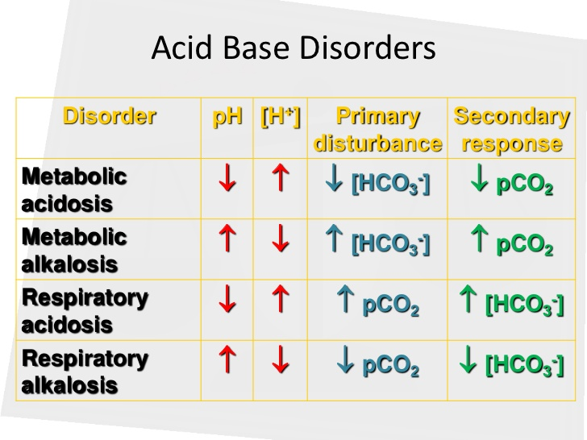

Slide 38
reference
Smeltzer, S., Bare, B. G., Hinkle, J.L., Cheever, K. H. Brunner & Suddarth’s Text Book of Medical Surgical Nursing. New Delhi : Wolters Kluwer.
Boon, N. A., Colledge, N. R., Et al. Davidson’s Principles& Practice of Medicine.Noida: Elsevier.

