Slide 1

INFERTILITY
Mrs. Reena Vincent
Professor
JMCON

Slide 2
Central objective
Students acquire depth knowledge about infertility and its management and able to describe and apply knowledge while giving care to the infertile couples .

Slide 3
specific OBJECTIVES
At the end of the class, students will be able to
define infertility
describe the incidence of infertility
enumerate the causes of male infertility
explain the investigations of male infertility
describe the management of male infertility
list the causes of female infertility

Slide 4
describe the investigations of female infertility
explain the management of female infertility
explain assisted reproductive technology
enlist role of the nurse in infertility management.
Identify the ethical and legal issues related to ART.

Slide 5

INFERTILITY - DEFINITION
Failure to conceive within one or more years of regular unprotected intercourse.

Slide 6
types
Primary infertility denotes those patients who have never conceived.
Secondary infertility indicates previous pregnancy but failure to conceive subsequently.

Slide 7
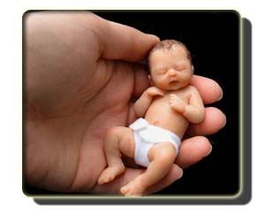
INCIDENCE OF INFERTILITY
WHO estimation
World wide – 60 to 80 million couples suffer from infertility
In India – between 3.9 – 16.8%
In Kerala – around 20%
Male infertility – 30 – 40%
Female infertility – 40 - 55%

Slide 8
MALE INFERTILITY

Slide 9
CAUSES OF MALE INFERTILITY
1.DEFECTIVE SPERMATOGENESIS- (production of sperm cells)
Inadequate sperm count -20million per milliliter of seminal fluid at least 50% of sperm should be motile and 30% should be normal in shape and size.
Causes are
Congenital
Undescended testes (cryptorchidism),hypospadias and epispadias

Slide 10
Thermal factors
Scrotal temp is increased in case of varicocele (varicosity of the spermatic vein ) big hydrocele/filariasis.
Using tight under garments
Working in hot atmosphere
Trauma to the testes
General factors –malnutrition or heavy smoking ,excessive alcohol reduces to the spermatogenesis

Slide 11
Cont…
Endocrine disorders
dysfunction of hypothalamus ,pituitary, adrenals Gonadotrophin deficiency ,thyroid
Systemic diseases –DM,renal failure
Genetic
Iatrogenic- cytotoxic , drugs, antihypertensive, anticonvulsant ,antidepressant
Immunological factors

Slide 12
II Obstruction or absence of seminal
Infection- Mumps orchitis after puberty(testicular inflammation and scarring due to the mumps virus) ,Epididymitis ,tubal infections
congenital anomalies, and trauma
Impaired secretions from seminal vesicles
Infection
Metabolic disorders

Slide 13
Psychosexual problems(impotence )
Physical disability
Drug induced (erectile dysfunction)

Slide 14
Failure to deposit sperm high in the vagina.(coital problems )
Ejaculatory defect –Premature retrograde(ejaculation via urethra is redirected into Bladder ) or absence of ejaculation
Sperm abnormality-loss of sperm motility (asthenospermia ) abnormal sperm morphology
Errors in seminal fluid
Unusually high or low volume of ejaculate
Low fructose content
High prostaglandin content
Undue viscosity

Slide 15

INVESTIGATIONS IN MALE INFERTILITY
Clinical approach to investigations
HISTORY
Age
Duration of marriage
Contraceptive used
History of previous marriage
Sexual dysfunction

Slide 16
General medical history –
STD, mumps orchitis after puberty, DM, recurrent chest infection, bronchiectasis ,relevant surgery such as herniorrhaphy,operation on testes sexual history,erectile dysfunction, social habits particularly heavy smoking and alcohol.

Slide 17
PHYSICAL EXAMINATION-
BMI, hair, growth and gynecomastia –inspection and palpation of genital area. size and consistency of the testes ,
Undescended testes
Varicocele

Slide 18
INVESTIGATIONS IN MALE INFERTILITY
Routine, urine Blood test,PPBS
Semen analysis
SPECIFIC INVESTIGATIONS OF INFERTILITY
Immunological test
Karyotype analysis
Serum FSH,LH,testosterone ,prolactin ,TSH
Testicular biopsy
Trans rectal USG
Vasography

Slide 19
Scrotal ultrasound.
Help to find out if there is a varicocele or other problems in the testicles and supporting structures
Transrectal ultrasound.
It allows your doctor to check your prostate and look for blockages of the tubes that carry semen.
Hormone testing.
Hormones produced by the pituitary gland, hypothalamus and testicles play a key role in sexual development and sperm production.
A blood test measures the level of testosterone and other hormones.

Slide 20
Post-ejaculation urinalysis.
Sperm in your urine can indicate your sperm are traveling backward into the bladder instead of out your penis during ejaculation (retrograde ejaculation).
Genetic tests.
When sperm concentration is extremely low, there could be a genetic cause.
A blood test can reveal whether there are subtle changes in the Y chromosome — signs of a genetic abnormality.

Slide 21
Testicular biopsy.
This test involves removing samples from the testicle with a needle.
If the results of the testicular biopsy show that sperm production is normal

Slide 22
FEMALE INFERTILITY

Slide 23
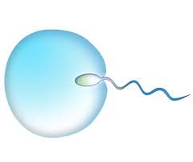
CAUSES OF FEMALE INFERTILITY
DEFECTIVE OVULATION
Endocrine disorders-anovulation (turners syndrome-no ovaries to produce ova )
dysfunction of hypothalamus ,pituitary, adrenals Gonadotrophin deficiency ,thyroid
Systemic diseases –DM,renal failure
Physical disorders-.general ill health. poor diet and stress. Obesity, excessive exercise .
Chronic exposure to x-rays or radioactive substances
Ovarian disorders-polycystic ovarian syndrome, ovarian cysts or tumours,ovarian endometriosis

Slide 24
DEFECTIVE TRANSPORT -Ovum
Tubal obstruction
Fimbrial adhesion
Tubal obstruction
Infection (PID, adhesions gonorrhoea,peritonitis)
Fimbrial adhesion
Previous surgery ,Endometriosis
Cervical factors
Cervical trauma or surgery
Infection, abnormal cervical mucus
Antisperm antibodies in mucus

Slide 25

Cont…..
Vaginal factors
Congenital anomaly-atresia of vagina ,septate vagina, narrow introitus
Infection of the vagina
Psychosexual problems (vaginismus)
Defective implantation
Fibroids, hormonal imbalance
Infection , congenital malformation of the uterus
Unexplained infertility

Slide 26
Combined factors
Advanced age of the wife beyond 35yrs
Infrequent intercourse, lack of knowledge of coital technique ,timing of coitus to utilize the fertile period
Dypareunia
Anxiety and apprehension, use of lubricants during intercourse which may be spermicidal.
Immunological factors

Slide 27
History
Age ,duration of marriage
General medical history –TB ,STDs ,PID, DM
Surgical history –abdominal or pelvic surgery
Menstrual history -hypomenorrhoea, oligomenorrhoea to amenorrhea due to adrenal or thyroid dysfunction

Slide 28
Previous obstetric history –number of pregnancies, interval between them and pregnancy related complications
secondary infertility , post abortal or puerperal sepsis leads to tubal damage
Contraceptive practice –IUCD use may cause PID
Sexual problems –dyspareunia and loss of libido

Slide 29
PHYSICAL EXAMINATION
General examination –
-obesity ,hirsutism, acne, under development of Secondary sexual characters,PCOD
Systemic examination –
Hypertension ,heart diseases, chronic renal lesion, thyroid dysfunction and other endocrinopathies

Slide 30
Gynecological examination
Adequacy of hymen opening
Evidence of vaginal infections
Cervical tear or chronic infection
Undue prolongation of the cervix
Uterine size, position ,mobility
Presence of adnexal masses
Presence of nodules in the pouch of douglas.
Speculum examination –reveal abnormal discharge ,cervical smear for screening

Slide 31
Diagnosis of ovulation
Indirect
Menstrual history
Basal body temperature –Confirm ovulation and time of intercourse.
Temperature must be taken on awakening before any activity start day 1 of the cycle.
Day of intercourse take place also noted .

Slide 32
Findings
Temperature rises (0.5to 1⁰ F)sustains throughout the second half of the cycle and falls 2 days prior to the next period called biphasic pattern.
Presence of biphasic pattern proves ovulation and absence of such pattern shows no ovulation
Record should be continued for more than 3-4 month
Cervical mucus study –
Alteration in the physico-chemical pattern of the cervical mucus due to the effect of the estrogen and progesterone.

Slide 33
Vaginal cytology –Features of progesterone effect if ovulation occurs .
Hormone estimation
Serum progesterone –day 8 and 21 of a cycle
Greater than 6ng /ml suggests ovulation
Serum LH surge
Serum estradiol –Peak rise 24-36 hours prior to ovulation

Slide 34
Endometrial biopsy -Uterine response to uterine activity .
Help in diagnosing luteal phase defect
Done on 21st -23 rd day of cycle
USG- measure the grafian follicle just prior to ovulation (18-20mm) confirm the ovulation .
Direct
Laparoscopy –visualization of recent corpus luteum detection of the ovum from the aspirated peritoneal fluid only the evidence of ovulation

Slide 35
Tubal factors
The anatomical patency and functional integrity of the tubes are assessed by
Dilation and insufflations
Hystero salpingogram
Laparoscopy
sonohysterosalpingography
Hysteroscopy
Falloposcopy
Salpingoscopy

Slide 36
1 Insufflation test (rubins Test)
Done in the post menstrual phase at least 2 days after stoppage of menstrual bleeding
Entry of air or co₂ into the peritoneal cavity when pushed transcervically under pressure .
Observation – Patency of the tube is confirmed.

Slide 37
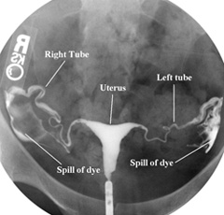
2 Hystero salpingogram(HSG)
To check uterine cavity and fallopian tubes are open and healthy
X-ray procedure Injection of
special dye into the cervix
and into the Uterus .
if the dye fails to spill out
through the end of the tubes
indicates tubes are blocked
or spasm has occurred.

Slide 38
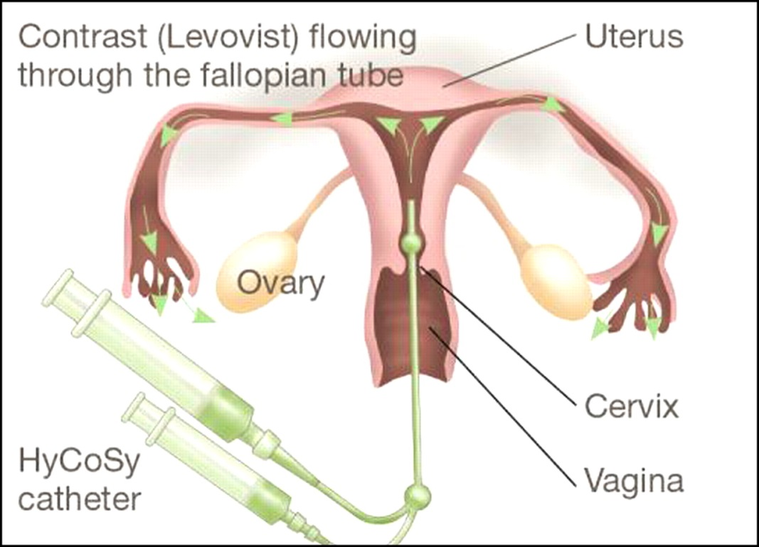

Slide 39
3 Laparoscopy: - Invasive procedure. - To check for pelvic disease; such as endometriosis and to check tubal patency. - Therapeutic as in laparoscopic myomectomy and ovarian drilling.
4 Hysteroscopy: - To evaluate uterine cavity and tubal ostia - In case of repeated failed IVF cycles. - Therapeutic as in intrauterine septum resection ,Poly pectomy ,resection of myoma.

Slide 40
5 Sonohysterosalpingography
Normal saline is pushed within the uterine cavity with a pediatric foley catheter. catheter balloon is inflated at the level of the cervix to prevent fluid leak.
USG can follow the fluid through the tubes up to the peritoneal cavity and in the pouch of douglas
Advantages
Non invasive procedure .it can detect uterine malformations ,polyps and tubal pathology .

Slide 41
6 Falloposcopy
Study entire length of tubal lumen with the help of a fine and flexible fibreoptic device.
It is performed through the uterine cavity using hysteroscope
Helps direct visualization of tubal ostia, mucosal pattern, intratubal polyps or debris

Slide 42
7 . Salpingoscopy
Tubal lumen is studied introducing a rigid endoscope through the fibrial end of the tube .
it is performed through the operating channel of a laparoscope.
Post coital test –to assess the quality of cervical mucous and ability of sperm to survive in it.
Immunological factor –antisperm antibodies are IgG.IgM,IgA .
immunoglobins can bind to different parts of the sperm and make them immobile.

Slide 43
MANAGEMENT OF INFERTILITY IN MALES
To improve spermatogenesis :
General measures.
Medications
Surgical treatment
Psychosexual therapy
Assisted reproductive therapies

Slide 44
To improve spermatogenesis
General
Improvement of general health, reduction of weight in obese, avoidance of alcohol, heavy smoking ,tight undergarments, cold scrotal bath twice in a day for 5mts each time is encouraged.
Avoidance of frequent intercourse to improve sperm count.

Slide 45
Administration of vitamins E,C,D,B12 and folic acid to improv.e spermatogenesis

Slide 46
In hypogonadotrophic hypogonadism
HCG 5000 IU once or twice week to stimulate testosterone production .
Testosterone 100-160 mg per oral daily for 3-4 months.
Clomiphene citrate 25-50mg daily for 25 days with rest of 5 days for 3 cycles.

Slide 47
In presence of antisperm antibodies in the male -dexamethsone 0.5mg daily at bed time
Genital tract infections need prolonged course of antibiotics .
In retrograde ejaculation
phenylephrine is used to improve the muscle tone of the urethral sphincter muscle.

Slide 48
Surgical management
Patient with azoospermic and yet testicular biopsy Shows normal spermatogenesis, obstruction of vas must be suspected .
it can be corrected by microsurgery vasovasostomy
Varicocele is corrected by high ligation of spermatic vein .
Hydrocele must be corrected
Orchidopexy in undescended testes should be done between 2 to 3 years of age.

Slide 49
Impotency
Psychosexual treatment
Medications –erectile dysfunction
Unresponsive cases –artificial insemination

Slide 50
mANAGEMENT Female infertility
A ) An ovulation
Induction of ovulation –following ways may be prescribed
1 General
Psychotherapy to improve emotions
Reduction of weight in PCODS

Slide 51
cont
2 .Drugs –stimulation of ovulation
Medications – clomiphene citrate infrequent
periods and long menstrual cycles.
Dose 50mg can be increased up to 250mg taken one or two times .
Usually starting 2-5days after the period starts.
Clomiphene indirectly stimulating the pituitary gland to secrete FSH gonadotrophin directly stimulate the ovaries to produce multiple follicles

Slide 52
Gonadotrophins –if clomiphene does not work it is the second option .
HCG stimulate the follicle to release the egg.

Slide 53
Luteal phase defect
Natural progesterone as vaginal suppositories 100mg thrice daily from the day of ovulation to continued until menses begins.
if pregnancy test is positive it should be continued up to 10 th week of pregnancy
Luteal unruptured follicle
IM hCG 5000-10,000IU
Bromocriptine therapy if associated with hyperprolactinaemia.

Slide 54
3 Surgery
Laparoscopic ovarian drilling
Using laser vaporision multiple punctures are made (4-5 /ovary) t o achieve spontaneous ovulation or increased sensitivity to clomiphene .
Surgical removal of virilising or other functioning ovarian or adrenal tumour.

Slide 55
Tubal and peritoneal factors –
Peritubal adhesions –laparoscopy
Proximal tubal block- Salphingography
Distal tube block –fimbrioplasty
Mid tubal block –Reversal of tubal ligation

Slide 56
Myomectomy –sub mucous fibroid
Metroplasty –either removal of septum
Enlargement of the vaginal introits
Amputation of cervix for congenital elongation
Bariatric surgery –obesity

Slide 57
Correction of the underlying problem –chronic disease, infection ,hormone production .

Slide 58
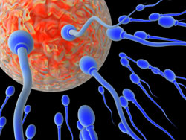
ASSISTED REPRODUCTIVE TECHNOLOGY

Slide 59
Indications for ART
Fallopian tubes are blocked or severely damaged .
Inflammation of endometrium .
When all conservative management of infertility fails .
Problems with male factor-abnormal sperm production and problems of transportation of sperm .
Immunological problems on postcoital examination .
Premature ovarian failure .

Slide 60
1 INTRAUTERINE INSEMINATION (IUI)
Initial step to manage infertility male factor and unexplained infertility.
ovulation induction
Monitoring of the graffian follicle(18 -20mm) insemination is carried out inj.HCG 5000units may be used 36 hours before insemination to trigger the ovulation .
This procedure involves the placement of about 0.3ml-0.5ml of washed processed and concentrated sperm into the intrauterine cavity by means of a transcervical catheter.

Slide 61
Washing will remove the seminal factors
and isolate the pure sperm
Done on patient with patent fallopian tubes
2 TYPES
Artificial insemination husband
Artificial insemination donor
INDICATIONS
Hostile cervical mucus due to production of antibodies
Cervical stenosis
Oligospermia-
Immune factor
Impotency and other coital difficulties

Slide 62
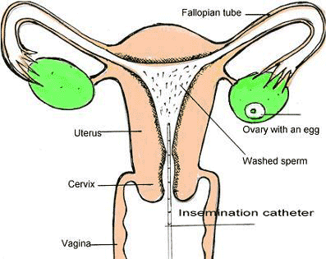
INTRA UTERINE INSEMINATION

Slide 63
Success rate is 5-10 %

Slide 64
2 .Invitro fertilization(IVF) 1978
Fertilization occurs outside body
One or more oocytes are removed from a women's ovary by laparoscopy and fertilized by exposure to sperm under laboratory conditions outside the women's uterus.
Following fertilization resulting embryos are transferred to the women's uterus 2-5 days later.

Slide 65
Indications
Fallopian tubes are missing or blocked.
Severe endometriosis.
Low sperm count.
IUI not successful.
Unexplained infertility for a long time.

Slide 66
Method
Screening before carring out an IVF
General and special gynecological examination
USG
Blood sample test for coagulation time, syphilis, HIV, hepatitis B,and C.
Samples from urethra and cervical channel.

Slide 67
Steps of IVF
Ovulation induction –estrogen levels measured intermittently-frequent USG to monitor the growth of follicles
Aspiration of oocytes (vaginal route)–done 35 hours after administration of injection HCG by laparoscope /USG by mild sedative
Sperm preparation and fertilization of oocytes –sample obtained in a sterile container and then allowed to is liquefy for half an hour
Each oocyte is incubated with approximately 50000 motile sperms.
Embryo (4-8 stage ) transfer trans cervically into women's uterus usually 48-72 hours (3days) after ovum pick up.

Slide 68
Post transfer care
–luteal phase support is maintained by progesterone ,HCG is given in supplemental doses.
Adequate monitoring with or without ovulation induction is a must for all IVF cycles.

Slide 69
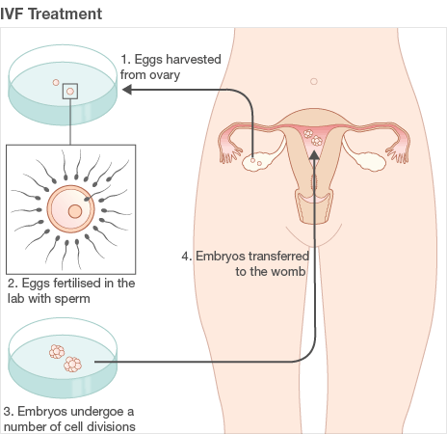
INVITRO FERTILISATION AND EMBRYO TRANSFER

Slide 70
Complications
Multiple gestation
Allergy to drugs
Physical /psychological stress
Procedure
Bleeding
Infection
Anesthetics complication
Result –live birth rate varies from 32.7 % per oocyte retrival

Slide 71
3 .Gamate intra fallopian transfer (GIFT) 1984
Invasive and expensive procedure .
Results better than IVF.
Prerequites
To have normal uterine tube
Contraindicated in fallopian tubes are blocked

Slide 72
Indictions
Unexplained infertility
Infertility due to immunological factors
Due to cervical factors(poor cervical mucus or damage of the cervix).
Mild endometriosis.

Slide 73
Ova are obtained from ovaries exactly as in IVF.
The eggs are examined for maturity and maximum 3 are mixed with the prepared sperm and transferred into the open end of patent fallopian tube through laparoscope.
Fertilization occurs in vivo (in the body ) in the tube and zygote move to the uterus for implantation.

Slide 74
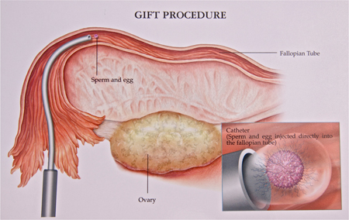

Slide 75
Result overall delivered pregnancy rate is as high as 27-30%

Slide 76
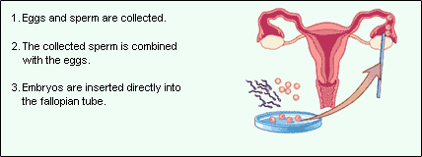
4 .ZYGOTE INTRAFALLOPIAN TRANSFER (ZIFT)1986

Slide 77
Cont…
Successful Pregnancy test takes 28 to 30 days
Fertilization takes place outside the body. (Day after fertilization)
Women must have one functioning tube
GIFT OR ZIFT is avoided when tubal factors are present

Slide 78
5. intra cytoplasmic sperm injection ( ICSI) 1992
Developed in 1992 often successful treatment in male fertility .it is used when IVF is not suitable
Technique - It involves injecting directly a single spermatozoon into the cytoplasm of an oocyte by micro puncture of the zonapellucida.
This procedure is carried out with the help of high quality microscope (400 times )
Sperms are prepared so that most motile of these can be selected.

Slide 79
Indications
Severe oligospermia (<5 million sperm /ml)
Asthenospermia
Presence of sperm antibodies
Obstruction of efferent duct system
Failure of fertilization in IVF
Unexplained infertility
Result
Increased risk of congenital malformation
60-70% fertilization rate.
Pregnancy rate is 20-40 % per embyro transfer

Slide 80
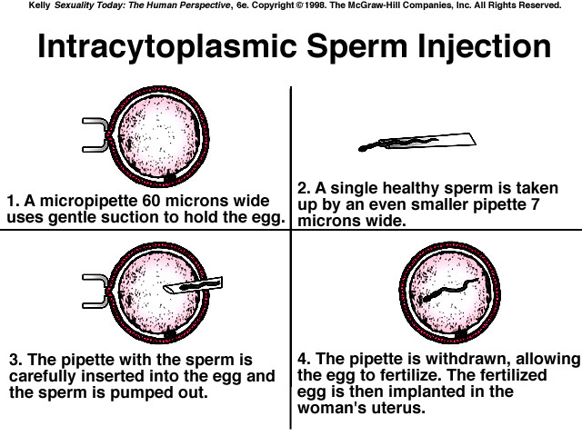

Slide 81
Intra cytoplasmic morphologically selected sperm injection . (IMSI advanced treatment in male infertility.
7000times size enlarged

Slide 82
6 .Embyo cryopreservation
Freezing the unused embryos for restoration of fertility future use.(at -196 ⁰ under liquid nitrogen )
would benefit
Young women undergoing chemotherapy or radiotherapy.
Result –live birth rate is approximately 47 %

Slide 83
7 .Tubal embryo transfer ( TET )
Taking eggs from the women fertilizing them in the laboratory with her partner sperm and transfer embryo is in the fallopian tube 2 days after fertilization 2o 4 cell stage.
8 .Testicular epididymal sperm extraction (TESE,TESA )
Under LA a small portion of testicular tissue is removed and a few viable sperms are extracted for the purpose of ICSI.
It is the process done on males who are unable to produce sperms by ejaculation

Slide 84
Indications
Blockage in the epididymis (either prior to surgery,infection,or from birth) or blockage within the ducts of the testes (efferent ductules ).
Poor sperm production

Slide 85
10 .Microsurgical epididymal sperm aspiration (MESA)
It is a surgical procedure in which viable sperms are extracted to fertilized the egg during IVF.
A large number of epididymal sperms are extracted and frozen and used for subsequent fertilization .

Slide 86
11 .Embryo or oocyte DONATION
Must undergo an assessment and screening process.
Aged over 18 and under 45 for men and 35 for women respectively.
Donor will not have any legal rights or obligations to any child born.
Indications
Women with premature ovarian failure
Women with removed ovaries
Older women
Repeated failure of ART cycles
Genetic diseases

Slide 87
Oocytes are collected from
Sister or friend (age between 21 and 34 years) .
Oocyte donor must screen for infection and genetic diseases.
Estrogen therapy started at the same time .
Progesterone treatment begins on the day of ovum retrieval.

Slide 88
Perfect coordination of embryo and the endometrium is needed for successful implantation .

Slide 89
Alternative to childbirth
Surrogacy (gestational carriers ) -Woman without a functional uterus.
Embryos are transferred to the uterus of an another woman who is willing to carry the pregnancy on behalf of the infertile couple .

Slide 90
Psychosocial aspects of infertility
Guilt, anger, depression, anxiety, inadequacy, grief, loss of control, and low self esteem.
Psychosocial stress and depression more in females .

Slide 91
Advantages of ART
It allowed infertile couples to have children.
It permits screening for the presence of genetic disorders.
One can use frozen sperm allowing fatherhood for a man who is no longer able to provide fresh sperm.
Because a number of morulas are created the extras can be frozen ,stored and used later.

Slide 92
Health hazards of art
Increased risk of fetal congenital malformation or birth defects.
Autosomal dominant gene mutation
Increased number of pregnancy loss, multiple pregnancy and ectopic pregnancy.
Perinatal mortality and morbidity are high.
Ovarian hyper stimulation syndrome
Fertility drugs association with cancer –rare
Psychological stress and anxiety of the couple are severe .

Slide 93
Prognosis of infertility
Pregnancy rate within 2 years ranges from 30-40%.

Slide 94
INFERTILITY COUNSELING
Infertility counseling deals with the psycho- social impact of infertility in terms of : –
Intervention, – Treatment, and – After effects of both successful and unsuccessful treatments.
It also involves therapeutic work to help patient cope with the consequences of infertility and treatment

Slide 95
Objectives & need of infertility counseling
Informed consent.
To offer coping strategies to couples.
To facilitate decision making.
To offer preparation for procedures.
To help client in achieving a better quality of life.
To provide genetic counseling.

Slide 96
Counseling Services
IVF- group discussion by staff.
Third party reproduction for both donors and recipients.
Therapeutic counseling.
Crisis counseling.
Assessment and Follow-up.

Slide 97
Advantages of infertility counseling
Helps to deal with the emotional stress.
Provide extra support.
Allow the client in exploring all possible options for family.
Help the couples in overcoming the dilemmas and deciding the right fertility treatment.
Explains about the infertility management and specific treatment.

Slide 98
Role of Nurse in Infertility counseling: –
Receiving the patient ,family and make them accessible.
Comfortable for counseling. –Fertility nurse specialists provide care for the individuals and couples before, during, and after fertility treatment.
Nurse need to obtain history as prenatal, family and other relevant history.

Slide 99
Contd…
Nurse has to perform primary physical examination and collect other relevant information regarding patient of reports.
Give psychological support throughout the counseling
Collect other information about tests, reports and documents.
Establish plan of care with family and co- ordinate care with other health care professional

Slide 100
Contd…
Maintain privacy and confidentiality of all cases.
Assist to performing inseminations.
Assist to performing embryo transfers.
Ensure follow-up & supportive services to individual and family during counseling.

Slide 101
cont…
Help to reduce a woman’s anxiety, increase her knowledge and validate the significance of her experience throughout evaluation and treatment.
Every nurse should be equipped with information to take an accurate and adequate sexual and reproductive medical history.

Slide 102
cont…
Maintaining personal contact during and after treatment cycles.
Recognizing the need for grief work.
Expressing positive and negative feelings.
Providing easy access to nursing care.
Follow up to discuss options and emotional status.

Slide 103
ETHICAL & LEGAL ASPECT OF ASSISTED REPRODUCTION TECNOLOGY (ART)
Ethical issues prior to conception
Artificial insemination by donor
In-vitro fertilization and embryo transfer
Surrogate motherhood

Slide 104
Is ART ethical?
• Culture and Religion has the strongest impact on humans perspective of live.
Major religions and their view on ART:
The Catholic Church deems certain fertility methods immoral.
The Church does not accept IVF as a fertility method as it involves practices that not only undermine the sanctity of life, but also replace the sacred procreative marriage act in the bringing forth of life.

Slide 105
• IVF procedures often involve the deliberate discarding of embryos that show little promise of surviving to term.
This means that hu man life is potentially treated as a mere defective commodity at its earliest developmental stages, and terminated.

Slide 106
It is also clear that IVF replaces the marriage act with a laboratory procedure to engender life.
The husband and wife merely provide the “raw materials” – the eggs and sperm.
• Worse still, if “donor” eggs or sperm are used, the child is subsequently unaware of his or her lineage, which could result in them lacking knowledge of possible inherited health problems.

Slide 107
Use of Donor Eggs/Sperm
Parentage: Who are the parents? Are they the ones whose genetic material (sperm and egg) combine to form the child or the people who raise the child?
Disclosure: • Should children know that one or both of his or her (rearing) parents did not provide the egg or sperm which brought them into being?
Should children have access to the donor(s) (genetic parents)?
Should genetic parents have visitation rights?
Exploitation
Should the donor be paid?
Eligibility
Same sex couple, single parents, elderly couple,

Slide 108
Couples ethical dilemmas
Will their cultural and religious demands on their emotions perhaps cause them to have doubts during their pregnancy?
Will the potential father fully accept the child?
Whether all the members of the health care team would maintain confidentiality of donor details?

Slide 109
Embryo cryopreservation
Left over embryos are cryopreserved, owners don’t get to use them after all.
Four possible fates for these embryos exist
Thawing and discarding
Donating to research
Indeﬁnite storage
Donating the embryos to another couple for the purposes of uterine transfer
In the event of divorce who gets custody of the embryo?

Slide 110
Surrogacy and Gestational Carriers
Surrogacy and Gestational Carriers
Signiﬁcant medical and emotional risks from carrying a pregnancy and undergoing a delivery
Child selling enterprise -Some also are concerned that the use of surrogates and gestational carriers is a form of “child selling” or the “sale of parental rights”
Parental rights- Possibility of five parents. Genetic father, genetic mother, Rearing father, Rearing mother, gestational mother.

Slide 111
Contd….
Exploitation and commoditization of children.
Citizenship of the oﬀspring(international surrogacy)
Renumeration
The amount of control the couple can exert over the surrogate is an issue. may regulate her nutrition and life style)
Issues related to surrogate’s right to privacy and freedom of choice come into play.
Inconvenience of synchronizing the donor and recipient’s cycles.

Slide 112
Preimplantation Genetic Testing
Pre-implantation genetic diagnosis (PGD) screening of cells from preimplantation embryos for the detection of genetic and or chromosomal disorders before embryo transfer
Status of the embryo
Discrimination
“Designer” babies
Sex selection
•Destruction of unwanted embryos

Slide 113
Cost and Financing of ART
The fact that signiﬁcant economic barriers to IVF exist in many countries results in the preferential availability of these technologies to couples in a position of ﬁnancial strength.

Slide 114
ART in People Living with HIV
HIV infection should not be an exclusion criteria for access to assisted reproduction.
The HIV positive individuals should enjoy equal access to such service and be evaluated using the same principles as applied to the uninfected people.

Slide 115
ART for Unmarried and Same Sex Couples
The Ethics Committee of the American Society for Reproductive Medicine- Programs should treat all requests for assisted reproduction equally without regard to marital/partner status or sexual orientation.

Slide 116
Possible Deleterious Effects of ART
Conﬂicting data exists about the risks of IVF on the developing embryo
There is a general consensus that IVF confers a small but measurable increased risk for a variety of congenital abnormalities including anatomic abnormalities and imprinting errors as compared to the general population

Slide 117
Reporting Regulations
Reporting requirements for ART pregnancy results, have been mandated with legislation in many nations, though not accompanied by legislation deﬁning practice patterns.

Slide 118
Multiple Gestation Pregnancies
Because of the increased social costs and health risks associated with multiple births, legislation or guidelines from professional societies have been introduced in many countries restricting the number of embryos that may be transferred per IVF cycle.

Slide 119
Ethical considerations in abortion
Aborting damaged fetuses and not healthy ones.
Who determines healthy fetus?
Pro-choice advocates stress responsible use of contraceptives, and use of amniocentesis
Pro-life advocates believe fetus is human right from conception and destroying it is a murder

Slide 120
Conclusion
Infertility is a significant social and medical problem affecting couples worldwide
Female and male factors are equally responsible
Evaluation of both partners is essential
Treatment depends on the cause of infertility and varies from ovulation-inducing drugs to surgery to ART
The ART is laborious ,expensive, complicated involves the team work .

Slide 121


Slide 122
References
Fraser DM, Cooper MA. Myles Textbook of Midwives. 14 ed. Edinburgh; Churchill Livingstone: 2003.
Cunningham, Leveno, Bloom. William’s obstetrics. 23rd edition. United states of America; Mcgraw Hill companies: 2010
Dutta D.C. Textbook of obstetrics. 8 ed. Calcutta, India; New Central Book agency (P) Ltd: 2004.

Slide 123
Pillitteri A. Maternal and child health nursing. Care of the childbearing and childrearing family. Sixth edition. Philadelphia; Lippincott.
Bhasker N. Midwifery And Obstetric Nursing ,Emmess, medical publishers,3rd ed.2019.

Slide 124


