Slide 1
Face presentation

Slide 2
Define face presentation
Understand the incidence rate
Analyze the etiology of face presentation
Understand the various positions
Describe the various diagnostic methods
Describe the mechanism of labour
Understand the management of labour
Recall the prognosis and complications of brow presentation

Slide 3
Face Presentation
This is a cephalic presentation where the attitude is one of the complete extension ,presenting part is the face and denominator is the chin or mentum.
AETIOLOGY
,pr
Maternal
Multiparty with pendulous abdomen
Contracted pelvis / CPD
Fetal
Congenital Malformation (anencephaly)
Several coils of umbilical cord around the neck
Lateral obliquity of fetus
Flat pelvis
Musculoskeletal abnormality (spasm/ shortening of extensor muscle of neck)
Tumors around neck (congenital goiter)
Pelvic tumours

Slide 4
Incidence rate 1 in 500 births.
Face presentation present during pregnancy is rare while that developing after the onset of labour (secondary )is common.
It occurs more frequently in multipara.

Slide 5
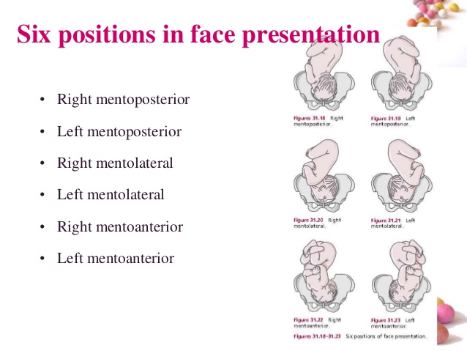

Slide 6
Commonest position is LMA

Slide 7
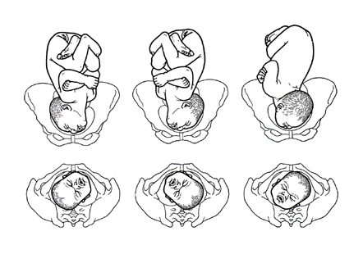
Face presentation

Slide 8
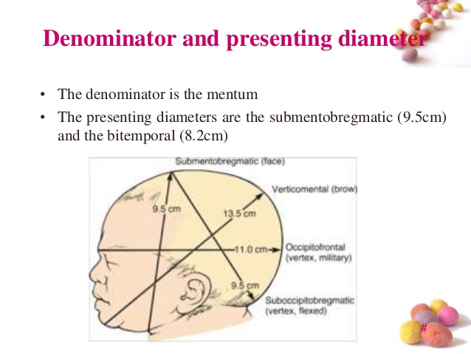

Slide 9
Diagnosis
During pregnancy (difficult)
Inspection –because of S shaped spine there is no visible bulging of the flanks.
Palpation –back is on the flank. The back is difficult to feel.
* The limbs are felt more prominent in mento-anterior position.
Pelvic grip: the occiput is at a higher level than the sinciput.
Head seems big and not engaged.

Slide 10
* Auscultation
The FHS are heard below the umbilicus through the fetal chest wall in mento-anterior position.
Ultrasound or X-ray:
confirms the diagnosis and may identify associated foetal anomalies as anencephaly.

Slide 11
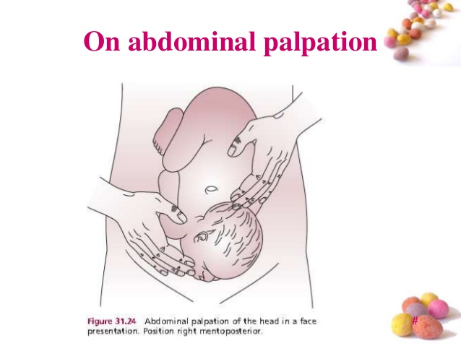

Slide 12
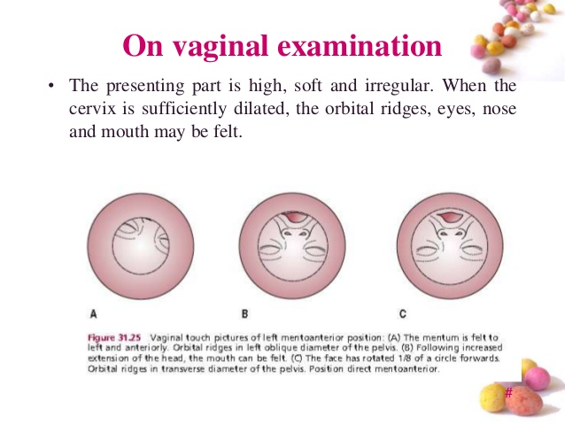

Slide 13
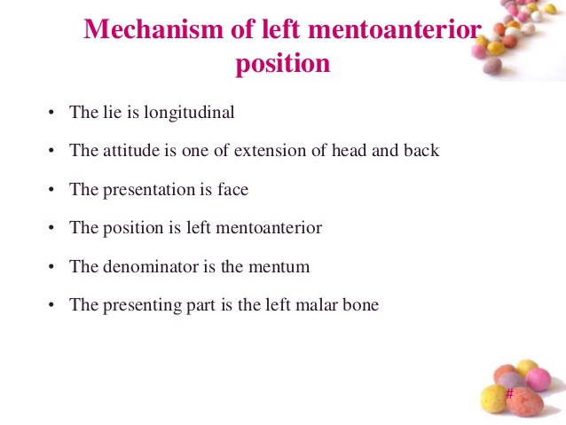

Slide 14
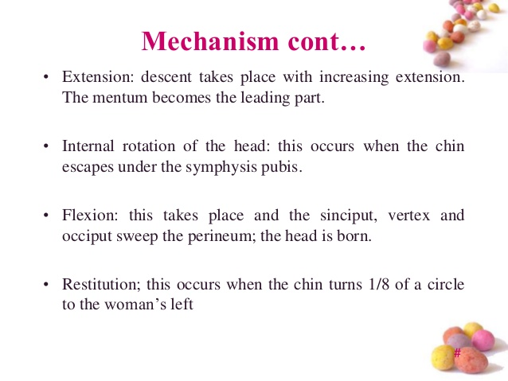

Slide 16
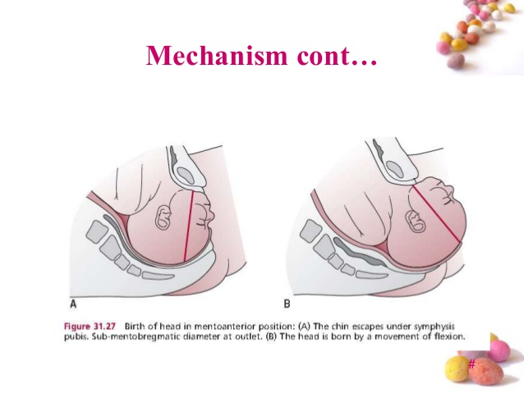

Slide 17
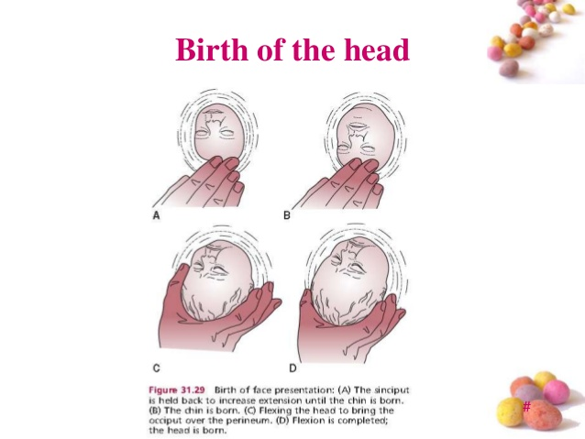

Slide 18
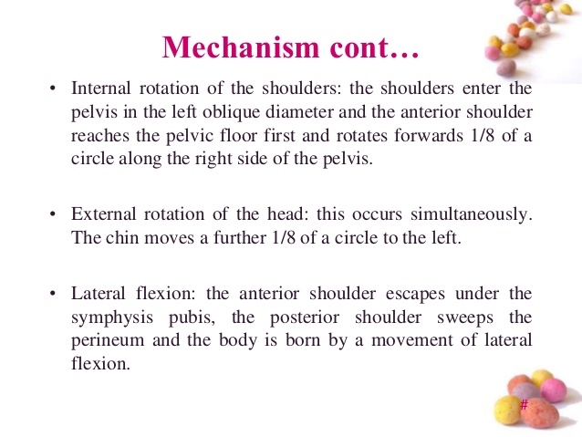

Slide 19
MENTO ANTERIOR
VAGINAL DELIVERY
First stage
In uncomplicated cases, a wait and watch policy is adopted. Labor is conducted in the usual procedure.
Second stage
Wait for spontaneous delivery to occur. Perineum should be protected with liberal mediolateral episiotomy.
In case of delay, forceps delivery is done.

Slide 20
PROGNOSIS
MATERNAL
LMA/RMA risk not much increased. Increased morbidity due to operative delivery and manipulation .
LMP-neglected cases leading to obstructed cases leading to obstructed labour and ruptured uterus.

Slide 21
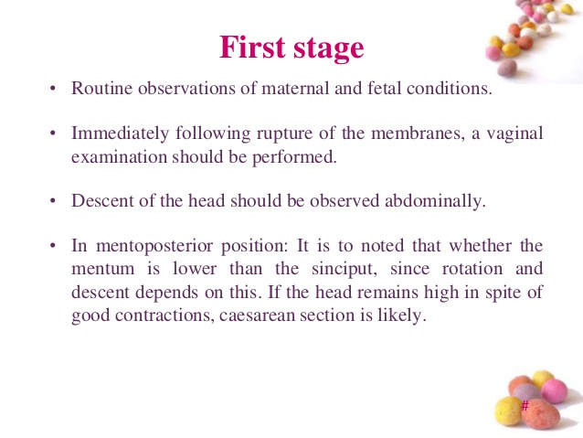

Slide 22
Prognosis
LMA/RMA risk not much increased. Increased morbidity due to operative delivery and manipulation .
LMP-neglected cases leading to obstructed cases leading to obstructed labour and ruptured uterus.
Complications
Cord prolapse
Increased operative delivery
Cerebral congestion due to poor venous return from the head and neck.
Neonatal infections due to bacterial contamination in the vagina.

Slide 23
PPH due to atonic uterus and trauma following delivery.
Perineal damage.
Nursing management
Nursing assessment should include client history ,prenatal diagnosis of any anomalies, multiple gestation
GA documented and verified
Auscultation to assess the fetal wellbeing
Continuously monitor the labour progress ,fetal wellbeing ,maternal pain and coping behaviors

Slide 24
Provide explanation to the client and support persons regarding the plan of care ,reason for augmentation and expectation regarding face or brow presentation particularly fetal appearance.
Offering reassurance and maintaining a vigilant presence.

