Slide 1
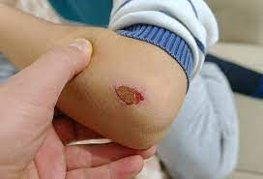
Wound
SHIBI P GEORGE

Slide 2
WOUND
A wound is any type of damage or breakage on the surface of the skin.
The wounds can be due to accidents like burns, paper cuts, skin tears or surgical, any underlying disease, or some other skin conditions that may develop in the wound, for example, eczema or psoriasis.

Slide 3
Types Of Wounds
Wounds can be classified in several ways depending on the healing time and the necessity to consult with Wound Care Specialists depending on the severity of a particular wound.
People are likely to suffer from different types of wounds throughout life while performing daily activities.
Depending on the cause, site, and depth, a wound can lead from simple to severe one.

Slide 4
Open or Closed
- Wounds can be open or closed.
Open wounds are the wounds with exposed underlying tissue/ organs and open to the outside environment, for example, penetrating wounds.
On the other hand, closed wounds are the wounds that occur without any exposure to the underlying tissue and organs.

Slide 5
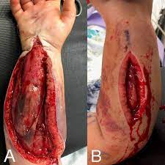
0PEN

Slide 6
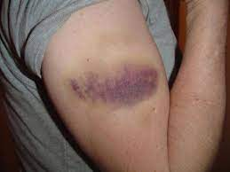
CLOSED

Slide 7
Acute or Chronic
- A wound can be classified as acute or chronic depending on the healing time.
Acute wounds are those that heal without any complications in a predicted amount of time.
While chronic wounds, on the other hand, are those that take a relatively long time to heal with some complications.

Slide 8
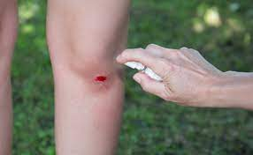
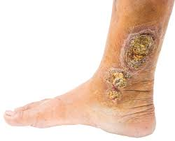
Acute / Chronic

Slide 9
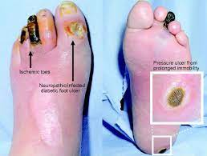
Types of Chronic Wounds

Slide 10
1. Pressure Injuries
- Also known as bedsores, pressure sores, or decubitus ulcers, these wounds cause when there is a pressure and/or shearing force on the skin.
The people who are more prone to these chronic wounds are with limited mobility due to any medical illness or unable to walk, move all or part of their body to a different position.

Slide 11
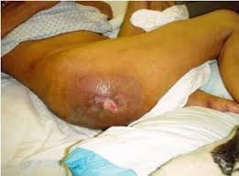
BEDSORE

Slide 12
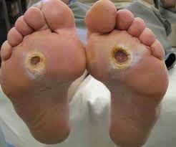
2. Diabetic Ulcers
- These ulcers generally occur on the feet and are a result of changes to nerves and circulation in the body caused by diabetes. It includes Neuropathic, Ischaemic, and Neuro-ischaemic.

Slide 13
Clean or Contaminated
- Wounds can also be classified on the basis if they are clean or contaminated.
Clean wounds are those that do not have any foreign material or debris inside
contaminated wounds or infected wounds are those that might have some dirt, bacteria, or other foreign meterials.

Slide 14
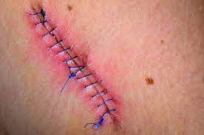
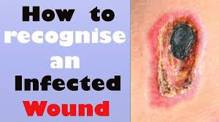

Slide 15
Internal or External
- Wounds can also be internal or external.
Internal wounds can be due to impaired circulation, nervous system functions, neuropathy or medical illness, or decreased supply of blood, oxygen, or other nutrients
external wounds can be due to an outside force or trauma caused by penetrating objects or non-penetrating trauma.

Slide 16
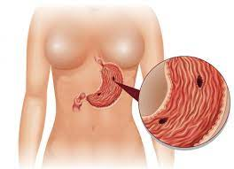
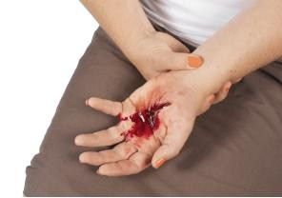

Slide 17
Non-penetrating Wounds: These wounds are the result of blunt trauma or friction with other surfaces. It includes:
Abrasions
Lacerations
Bruises
Concussions

Slide 18
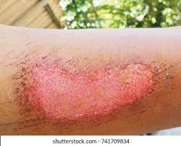
Abrasions
An abrasion is a type of open wound that's caused by the skin rubbing against a rough surface. It may be called a scrape or a graze.

Slide 19
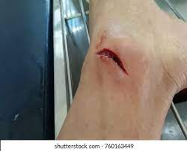
Lacerations
A laceration or cut refers to a skin wound. Unlike an abrasion, none of the skin is missing. A cut is typically thought of as a wound caused by a sharp object, like a shard of glass.

Slide 20
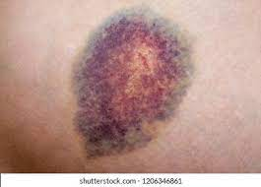
Bruises /CONTUTIONS
Bruises (bleeding into the skin without a cut or laceration) are often occur due to a direct blow to a body part; some children with blood clotting difficulties may be more likely to bruise than others. Cuts, wounds and lacerations result from contact with something sharp, such as a knife, glass or saw.

Slide 21
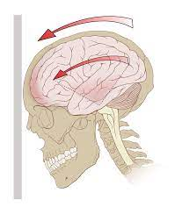
Concussions
A concussion is a type of closed head injury, which is often referred to as a traumatic brain injury or TBI. The symptoms of concussion include headache, dizziness, sleep disturbances, visual changes, difficulty with balance, fatigue and memory problems

Slide 22
AMPUTATIONS
REMOVAL BODY PART (LIMBS) THROUGH TRAUMA.

Slide 23
Penetrating Wounds
Penetrating Wounds They are the result of trauma and break through the full thickness of the skin. It includes:
Stab wounds
Cuts
Surgical wounds etc.
Each type of wound has a different approach and method of treatment. Minor wounds can be treated by a regular medical practitioner but if you see any signs of infection WOUND CARE SPECILIST

Slide 24
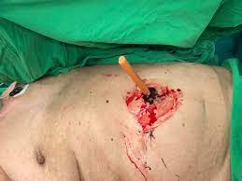
STAB..

Slide 25
COMPLICATIONS OF WOUND
Bleeding
Infection

Slide 26
FA
Management:
Help the person to remain calm. If the cut is large or bleeding heavily, have
them lie down.
If the wound is on an arm or leg, raise the limb above the heart to slow bleeding.
Remove obvious debris from the wound, such as sticks or grass.
If the object is embedded in the body, do NOT remove it.
If the cut is small, wash it out with soap and water.
Do NOT clean a large wound.

Slide 27
After putting on clean latex gloves apply firm pressure to the wound with a folded cloth or bandage for about 10 minutes.
Do not remove the bandage to look at the wound during this time, as it may
begin bleeding again.
If blood soaks through, add another cloth or bandage and continue holding pressure on the cut for an additional 10 minutes.
When bleeding has stopped, tape a clean bandage over the cut.

Slide 28
FA
Seek medical care for a cut or wound if:
It’s jagged or deep, or if it is a puncture wound.
it’s on the face
it’s the result of an animal bite
there is dirt that won’t come out after washing
the bleeding will not stop

Slide 29
?????????????????

Slide 30


