Slide 1

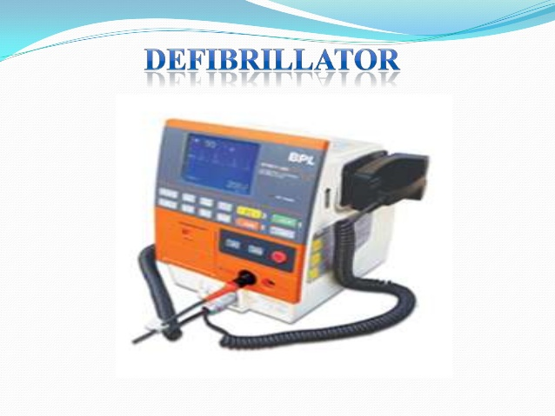

Slide 2
Daisy.M.V(Sr.Daisy Maria)
Lecturer
JMCON

Slide 3
SPECIFIC OBJECTIVES
Define defibrillator
List down the indications of defibrillator
Discuss the principles of defibrillator
Explain the types of defibrillator
Describe the nursing management of defibrillator

Slide 4
DEFINITION
™Defibrillator is a device that deliver a therapeutic dose of electrical energy (electric shock) to the affected heart (fibrillated heart or other shockable rhythm) to force the heart to produce more normal cardiac rhythm.

Slide 5
Cont….
Application of a preset electrical current across the myocardium to cause synchronous depolarization of the cardiac muscle with the aim of converting a dysrhythmia into normal sinus rhythm.

Slide 6
Cont….
Defibrillation is a process in which an electronic device sends an electric shock to the heart to stop an extremely rapid, irregular heartbeat, and restore the normal heart rhythm.

Slide 7
Cont…..
Defibrillation is a common treatment for life threatening cardiac dysrhythmias, ventricular fibrillation, and pulse less ventricular tachycardia.

Slide 8
Cont…..
Defibrillator Does not re-start the heart.
Stops all electrical activity.
If heart is still viable its natural pace maker will take over.

Slide 9
INDICATIOS
Definitive treatment of life threatening cardiac arrhythmias – VENTRICULAR FIBRILLATION PULSELESS VENTRICULAR TACHYCARDIA

Slide 10
Ventricular fibrillation- Irregular contraction of muscle fibres
Ineffective pumping of blood from left ventricle
Steep fall in Cardiac output

Slide 11
Cont…..
The longer the duration of fibrillation, the greater the deterioration of the myocardium, because a fibrillating heart consumes a very large amount of oxygen.
Defibrillators deliver a brief electric shock to the heart, which enables the heart's natural pacemaker to regain control and establish a normal sinus rhythm .

Slide 12
PRINCIPLES OF DEFIBRILLATION
Energy storage capacitor is charged at relatively slow rate from AC line.
Energy stored in capacitor is then delivered at a relatively rapid rate to chest of the patient.

Slide 13
Cont…..
Simple arrangement involve the discharge of capacitor energy through the patien’s own resistance.

Slide 14
TYPES
Manual external defibrillator
Electrodes placed directly around the heart area of chest. Higher Voltage required than internal defibrillator. Classified as - Monophasic Biphasic

Slide 15
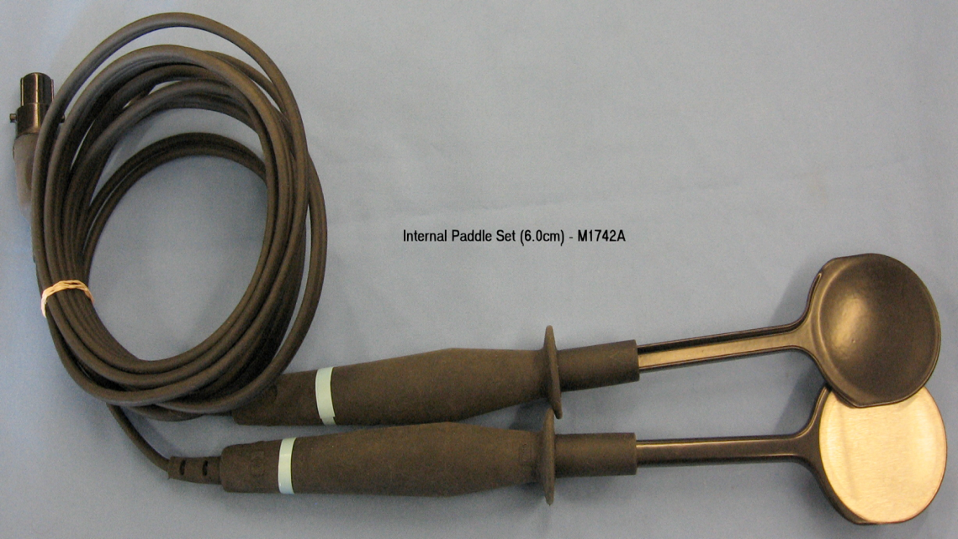
2. Manual Internal
Same as manual external except pads are in direct contact with the heart
Usually found in operating rooms

Slide 16
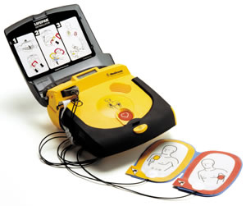
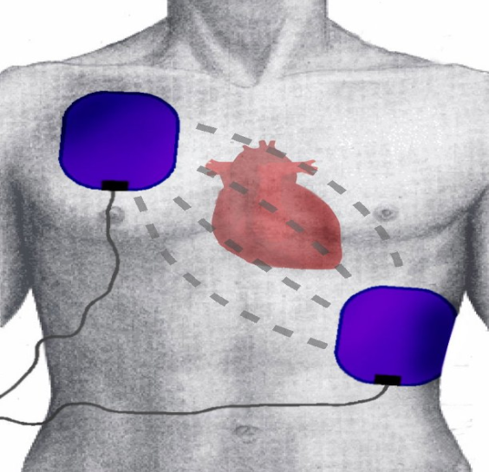
3. Automated External (AED)
Uses computer to analyze heart then suggest whether a shock is needed or not
Usually found in public places
Made simpler for anyone to use

Slide 17
Cont….
AED is a portable type of external defibrillator that automatically diagnoses the ventricular fibrillation in a patient.
• Automatic refers to the ability to autonomously analyze the patient's condition.
• AED is provided with self-adhesive electrodes instead of hand held paddles.

Slide 18
4.Implantable Cardioverter
Similar to pacemakers, constantly monitor patients heart and administer shocks when needed
Limitation – cannot distinguish when heartbeat changes due to exercise and other activities

Slide 19
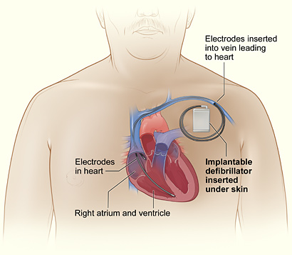

Slide 20
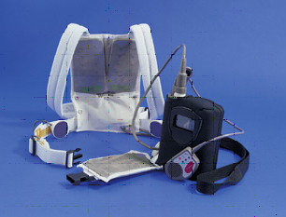
5. Wearable Cardiac
Portable defibrillator that is worn as a vest, monitors heart
Not as common as others

Slide 21
Types of Defibrillator electrodes:
a)Spoon shaped electrode: Applied directly to the heart.
b) Paddle type electrode :Applied against the chest wall
c) Pad type electrode : Applied directly on chest wall

Slide 22
CLASSES OF DISCHARGE WAVEFORM
There are two general classes of waveforms: a) mono-phasic waveform : Energy delivered in one direction through the patient’s heart
b) Biphasic waveform: Energy delivered in both direction through the patient’s heart

Slide 23
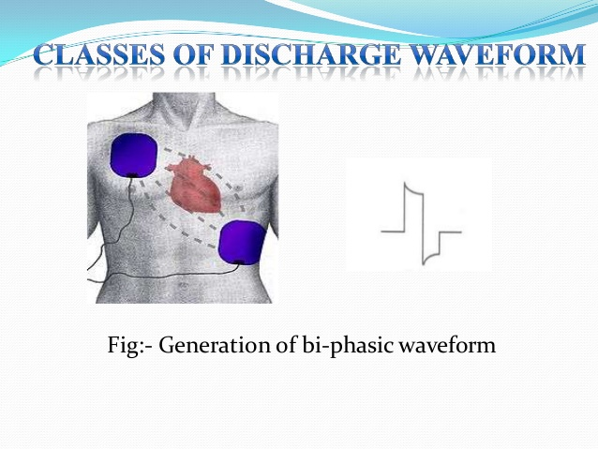

Slide 24
Cont…..
A monophasic type, give a high-energy shock, up to 360 to 400 joules due to which increased cardiac injury and in burns the chest around the shock pad sites.
• A biphasic type, give two sequential lowerenergy shocks of 120 - 200 joules, with each shock moving in an opposite polarity between the pads.

Slide 25
Paddle placement
4 Positions ----
Anterior-lateral > most convenient
Anterior-posterior
Anterior-left infrascapular
Anterior-right infrascapular

Slide 26
Cont….
Anterior-lateral position ---- one – right of sternum below clavicle (2nd & 3rd ICS) other – left 4th or 5th ICS mid axillary line

Slide 27
Efficacy of Defibrillation
Trans – thoracic resistance is the major factor
Which depends upon:
Chest width & configuration
Ventilatory phase
Electrode skin interface

Slide 28
Cont…..
Electrode position
Electrode size
Force of electrode application
Energy level
Time between & no. of shocks

Slide 29
NURSING CARE
PRE-CARE
Immediately before defibrillatioin, do the following:
Call for immediate assistance
Call for defibrillator and crash cart

Slide 30
Cont…..
Assess CAB
Perform CPR until the defibrillator in place
Check the ECG to verify the presence of VF or pulseless VT: confirm in two leads
Check leads for any loose connections
Remove any nitroglycerine patch

Slide 31
INTRACARE
The paddles are lubricated with electrode gel or conducting pads to enhance conduction and prevent burning of the skin
Paddles must lie flat against the chest
To ensure safe defibrillation people who perform it always announce when they are about to shock

Slide 32
Cont….
The phrase “One. I am clear. Two. You are clear. Three. All clear” is recommended

Slide 33
POST CARE
The clinician immediately assesses the ECG and pulse after defibrillation
If the first counter shock is unsuccessful, immediate defibrillation must be performed again at a higher energy level

Slide 34
Cont……
Monophasic DF may be applied up to three times if needed for persistent VF and Pulseless VT
CPR should be continued till restoration of sinus rhythm

Slide 35
DOCUMENTATION
Pre-procedure rhythm
Times and voltage of shocks delivered
Post DF rhythm pattern
Names, times of administration, and doses of administered medications
Other haemodynamic data available before, during, and after DF

Slide 36
SYNCHRONIZED CARDIOVERSION
-is therapy of choice for the patient with ventricular tachyarrhythmia's(eg. VT with pulse) or supraventricular tachydysrhythmias
( eg. AF with a rapid ventricular response)

Slide 37
Cont…..
A synchronized circuit in the DF delivers a shock that is programmed to occur on the R wave of the QRS complex of the ECG
The synchronizer switch must be turned on when cardioversion is planned

Slide 38
Cont….
The synchronization prevents the discharge from occurring during the vulnerable period
of repolarization (T wave), which could result in VT or ventricular fibrillation.

Slide 39
Cont….
When the synchronizer is on, no electrical current will be delivered if the defibrillator does not discern a QRS complex

Slide 40
Cont….
If the cardioversion is elective, anticoagulation for a few weeks before cardioversion may be indicated

Slide 41
Cont….
Digoxin is usually withheld for 48 hours before cardioversion to ensure the resumption of sinus rhythm with normal conduction

Slide 42
Cont….
The patient is instructed not to eat or drink for at least 8 hours before the procedure.
Gel-covered paddles or conductor pads are positioned front and back (anteroposteriorly) for cardioversion.

Slide 43
Cont….
Before cardioversion, the patient receives intravenous sedation as well as an analgesic medication or anesthesia

Slide 44
Cont…..
Respiration is then supported with supplemental oxygen delivered by a bag-mask-valve device with suction equipment readily available

Slide 45
Cont…..
Indications of a successful response are conversion to sinus rhythm, adequate peripheral pulses, and adequate blood pressure.

Slide 46
Cont…..
Because of the sedation, airway patency must be maintained and the patient’s state of consciousness assessed.

Slide 47
Cont….
Vital signs and oxygen saturation are monitored and recorded until the patient is stable and recovered from sedation and the effects of analgesic medications or anesthesia.
ECG monitoring is required during and after cardioversion.

Slide 48
IMPLANTABLE CARDIOVERTER DEFIBRILLATOR
The implantable cardioverter defibrillator (ICD) is a device that detects and terminates life-threatening episodes of VT or ventricular fibrillation in high-risk patients

Slide 49
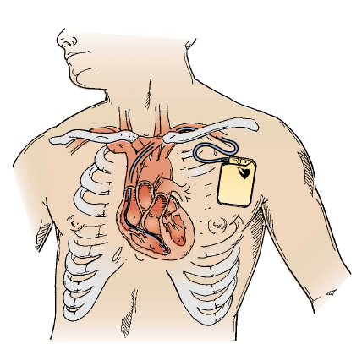

Slide 50
Cont……
Patients at high risk are those who have survived sudden cardiac death syndrome, usually caused by ventricular fibrillation, or have experienced symptomatic VT (syncope secondary to VT).

Slide 51
Cont…..
In addition, an ICD may be indicated for patients who have survived an MI but are at high risk for cardiac arrest.

Slide 52
Cont…..
An ICD consists of a generator and at least one lead that can sense intrinsic electrical activity and deliver an electrical impulse.
The device is usually implanted much like a pacemaker .

Slide 53
Cont….
ICDs are designed to respond to two criteria: a rate that exceeds a predetermined level, and a change in the isoelectric line segments.
When a dysrhythmia occurs, rate sensors take 5 to 10 seconds to sense the dysrhythmia.

Slide 54
Cont…..
Then the device takes several seconds to charge and deliver the programmed charge through the lead to the heart.

Slide 55
Cont….
Battery life is about 5 years but varies depending on use of the ICD over time.
The battery is checked during follow-up visits.

Slide 56
Cont….
Nursing interventions for the patient with an ICD are provided throughout the preoperative, perioperative, and postoperative phases

Slide 57
Cont….
CARDIOVERSION | DEFIBRILLATION
Elective planned procedure | Emergency life saving procedure
Synchronized shock | Un-sychronized shock
Low energy shock | High energy shock
There can be some delay | No delay, immediate

Slide 58
Cont….
Anti-coagulation needed | No anti-coagulation needed
Less damage to myocardium | More damage to myocardium

Slide 59
REFERENCE
Woods SL, Bridges EJ. Cardiac nursing. Sixth edition. Phialadephia: Lippincot Williams and wilkins puplication
Black JM. Medical surgical nursing clinical management for positive outcomes. Seventh edition. Newdelhi : Elsevier publications. Volume2.
Chintamani. Lewi’s Medical- surgical Nursing. First edition. Haryana: Elsevier publications.

Slide 60
THANK YOU

