Slide 1
CARDIOPULMONARY RESUCITATION
Prepared by;
Ms. Remya Ramachandran
Jubilee Mission CON

Slide 2
Cardiovascular disease, disease of heart and blood vessels, is the leading cause of death in the world.
Cancer is the second leading cause of death.
The third leading cause is heart injury. Most people with a heart attack die before reaching a hospital.
In order to save the lives of cardiac emergency victims, first aid must be immediately available.

Slide 3
Rescuers play a vital role and their knowledge and skills can mean the difference between life and death for many victims.

Slide 4
Definition :
Is a Emergency procedure that combines chest compressions often with artificial ventilation in an effort to manually preserve the intact brain function until further measures are taken to restore spontaneous blood circulation and breathing in a person who is in cardiac arrest .

Slide 5
Indications
1. Cardiac.
2. Pulmonary.
3. Respiratory

Slide 6
Cardiac.
Myocardial infarction,
Heart failure,
Dysrhythmia,
Coronary artery spasm,
Cardiac tamponed.

Slide 7
Pulmonary.
Respiratory failure secondary to respiratory depression
airway depression,
impaired ventilation such as pneumothorax, pulmonary embolus, retention of CO.

Slide 8
Respiratory
Drowning,
suffocation
head trauma
neuro muscular paralysis
drug over dose

Slide 9
SIGNS AND SYMPTOMS OF CARDIAC ARREST
i. Apnea
ii. Absence of carotid or femoral pulse.
iii. Dilated pupil
iv. Cyanosis
v. Unconsciousness
vi. Fits

Slide 10
Purposes of CPR
1. To initiate breathing
2. To restore blood circulation
3. Restore – Cardio pulmonary functioning
4. Prevent irreversible brain damage from Anoxia.

Slide 11
COMPONENTS OF CPR

Slide 12
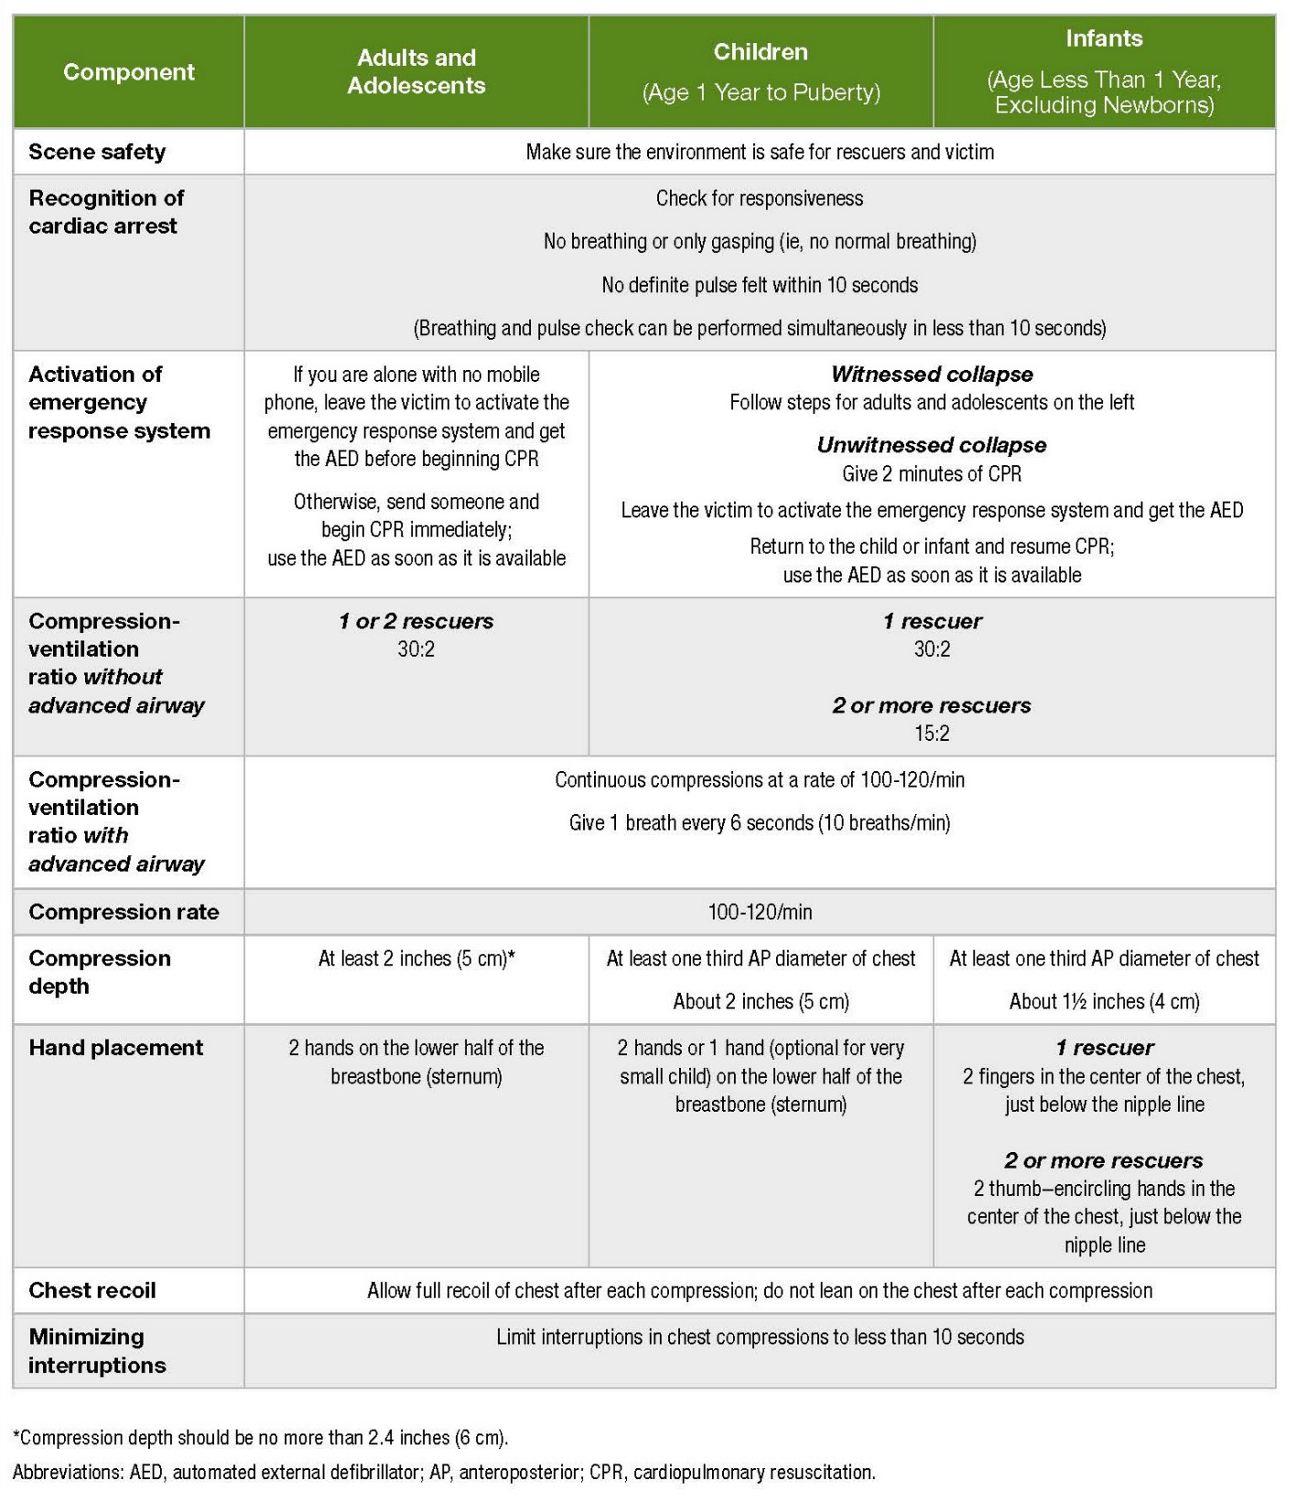

Slide 13
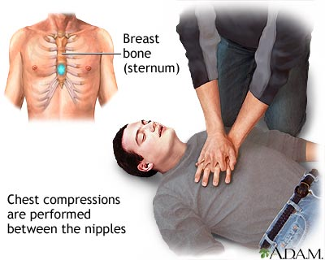
SITE FOR COMPRESSION

Slide 14
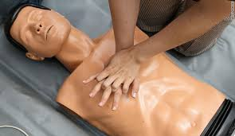

Slide 15
ALGORITHM

Slide 16
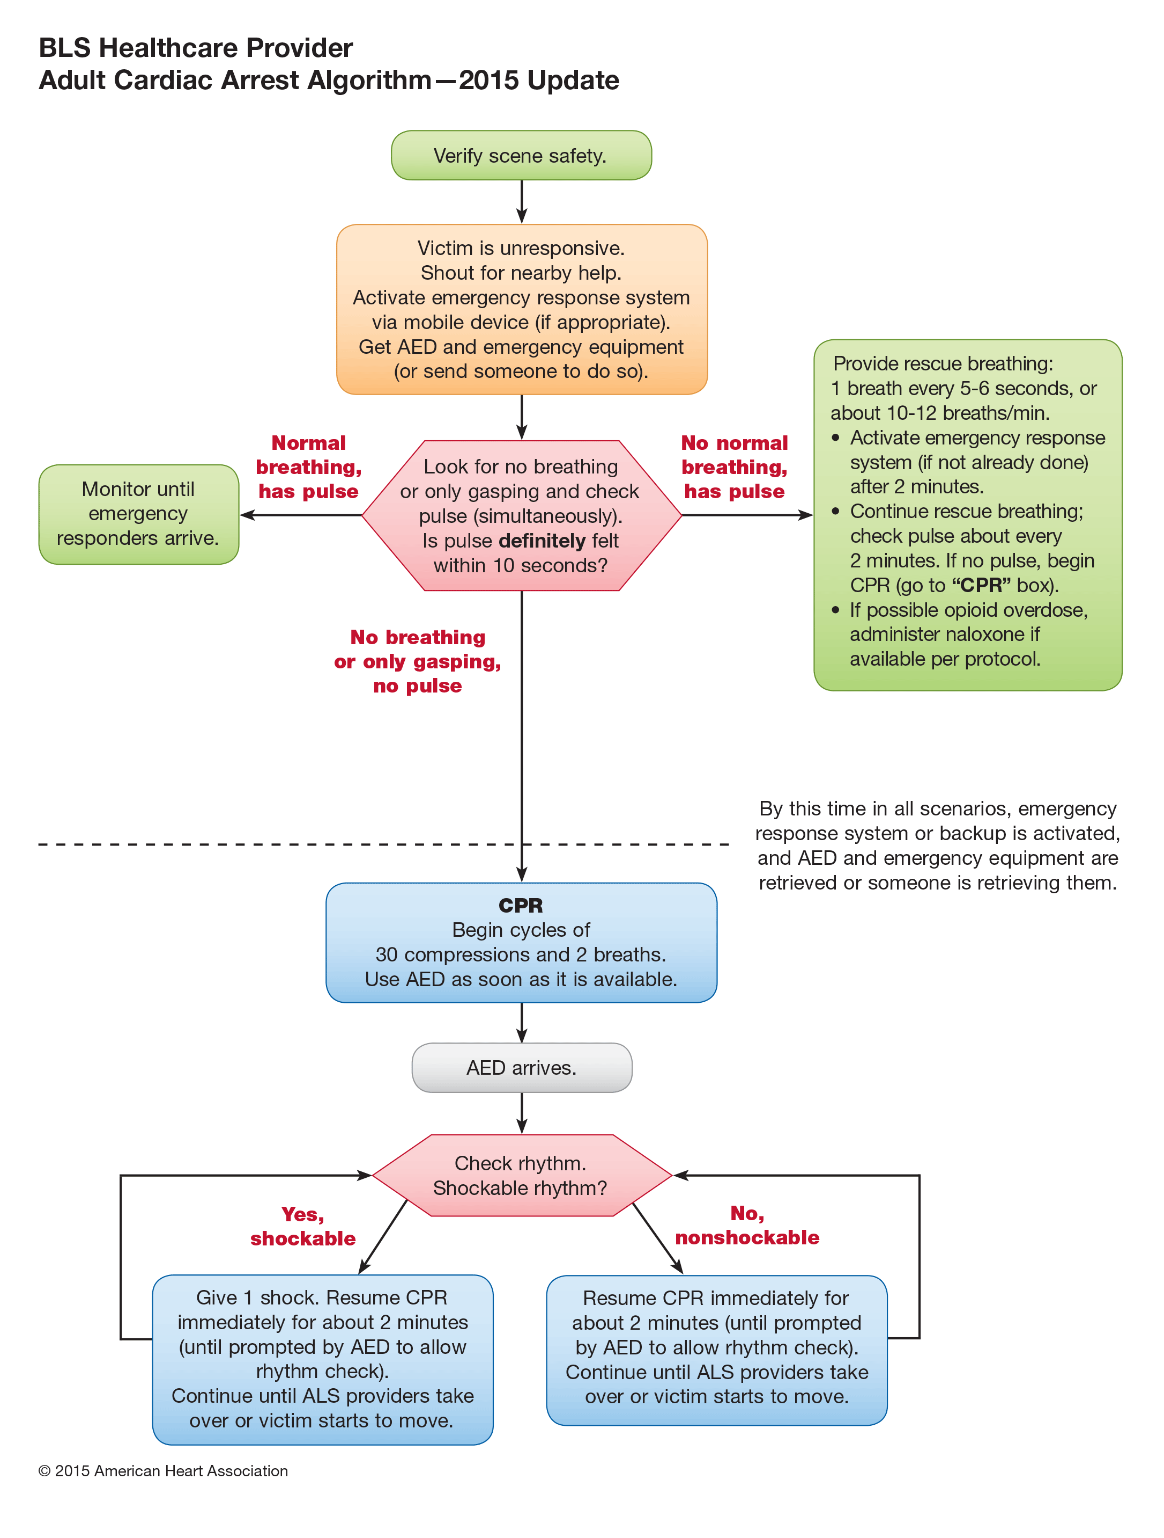

Slide 17
CHEST COMPRESSION DEPTH
During CPR, rescuers should perform chest compressions to a depth of at least 2 inches (5 cm) for an average adult, while avoiding excessive chest compression depths (greater than 2.4 inches [6 cm].
This is because a compression depth of approximately 5 cm is associated with greater likelihood of favorable outcomes compared with shallower compressions.

Slide 18
While there is less evidence about whether there is an upper threshold beyond which compressions may be too deep, a recent very small study suggests potential injuries (none life-threatening) from excessive chest compression depth (greater than 2.4 inches [6 cm].

Slide 19
Chest Recoil:
It is reasonable for rescuers to avoid leaning on the chest between compressions, to allow full chest wall recoil for adults in cardiac arrest.
It is reasonable for rescuers to avoid leaning on the chest between compressions, to allow full chest wall recoil for adults in cardiac arrest.
This is because of full chest wall recoil occurs when the sternum returns to its natural or neutral position during the decompression phase of CPR.

Slide 20
Chest wall recoil creates a relative negative intra thoracic pressure that promotes venous return and cardiopulmonary blood flow.
Leaning on the chest wall between compressions precludes full chest wall recoil.
Incomplete recoil raises intra thoracic pressure and reduces venous return, coronary perfusion pressure, and myocardial blood flow and can influence resuscitation outcomes.

Slide 21
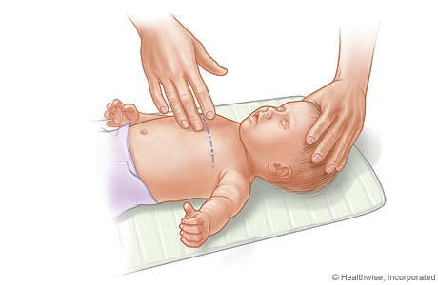
INFANT SITE

Slide 22
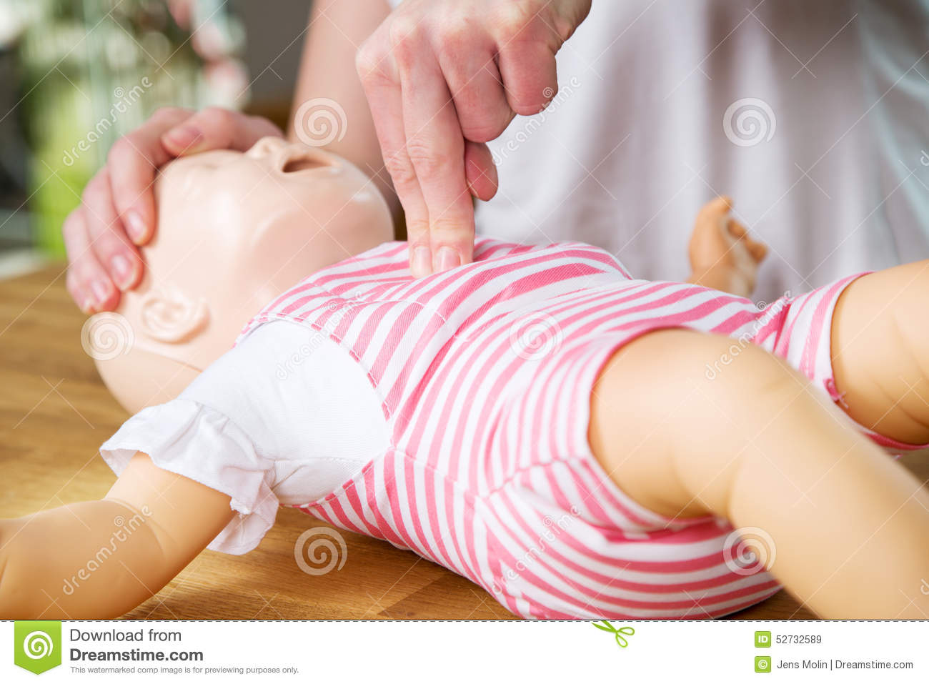

Slide 23
ADVANCED CARDIAC LIFE SUPPORT
Advanced cardiac life support or advanced cardiovascular life support (ACLS) refers to a set of clinical interventions for the urgent treatment of cardiac arrest, stroke and other life-threatening medical emergencies, as well as the knowledge and skills to deploy those interve.ntions

Slide 24
IMPORTANCE
ACLS is built heavily upon the foundation of BLS

Slide 25
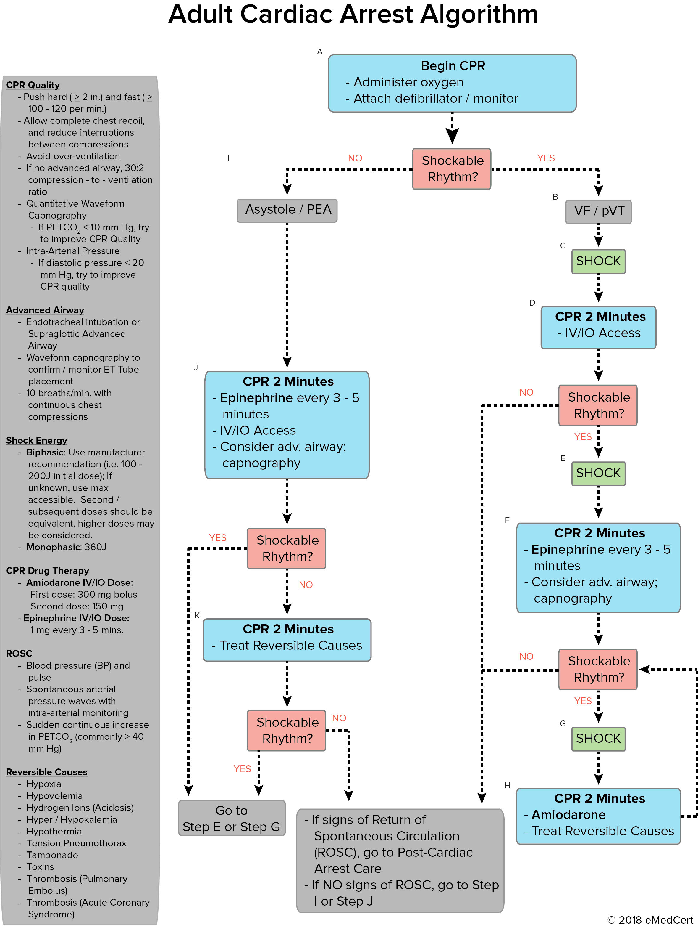

Slide 26
FIRST LINE DRUGS
1. INJ.ADRENALINE 1ml
Adrenaline is also known as Epinephrine which is a hormone, neurotransmitter
and a medicine.
Epinephrine is normally produced by both the adrenal glands and certain neurons.

Slide 27
It plays an important role in the fight-or-flight response by increasing blood flow to muscles, output of the heart, pupil dilation, and blood sugar.
It does this by binding to alpha and beta receptors.
It is found in many animals and some single cell organisms.

Slide 28
Mechanism of action:
Is a direct-acting sympathomimetic drug that acts as an agonist at alpha and beta-adrenergic receptors.
It produces vasoconstriction to counteract the vasodilation and resulting hypotension associated with anaphylaxis.

Slide 29
The bronchodilator effects of epinephrine and its ability to reduce mucosal edema relieve bronchoconstriction and improve respiratory effort.
Epinephrine also down-regulates the release of histamine, tryptase, and other inflammatory mediators from mast cells and basophils, improving respiratory function and reducing the pruritus, urticaria, angioedema, and gastrointestinal symptoms which occur after allergen exposure.

Slide 30
CODARONE (Amiodarone)
Class: Antiarrhythmic Agent
Class III Indications: Management of life-threatening recurrent ventricular fibrillation (VF) or hemodynamically-unstable ventricular tachycardia (VT) refractory to other antiarrhythmic agents or in patients intolerant of other agents used for these conditions.

Slide 31
CLASS III ANTIARRHYTHMIC AGENT, WHICH INHIBITS ADRENERGIC STIMULATION; AFFECTS SODIUM, POTASSIUM, AND CALCIUM CHANNELS; MARKEDLY PROLONGS ACTION POTENTIAL AND REPOLARIZATION; DECREASES AV CONDUCTION AND SINUS NODE FUNCTION.

Slide 32
NURSES ROLE IN CARDIO PULMONARY RESUCITATION

Slide 33
NURSING TEAM LEADER (USUALLY SENIOR WARD NURSE
Identifies self as Nursing Team Leader, responsible for coordinating and directing emergent nursing care of the patient.
Checks appropriate emergency call has been placed
Starts timer as soon as the Emergency trolley arrives.
Delegates available staff to roles appropriate to their level of practice: Airway,
Compression, Monitor & Medications and Runner to collect or remove extra equipment, supplies, labs etc.

Slide 34
Establishes the patient’s weight and delegates someone to print out an Emergency Drug Worksheet (Icon on desktop of clinical computers).
Ensures that the patient is placed on CPR back board.
Reassigns nursing staff once the PICU nurse and additional staff arrive as required.
Ensure someone is assigned to support family members.
Documents initial and ongoing vital signs and cardiac rhythm, medication administration, procedures and patient’s response to interventions on the CPR.

Slide 35
AIRWAY NURSE
Summons help and initiates CPR as required until initial assistance arrives and then assumes responsibility for airway management.
Maintains airway patency with use of airway adjuncts as required (suction, high flow oxygen, via Hudson mask, blob mask with O2 or bag valve mask ventilation).
This role becomes the responsibility of the Emergency nurse on their arrival.
Assist with intubation and securing of ETT

Slide 36
Inserts gastric tube and/or facilitates gastric decompression post intubation as required.
Assists with ongoing management of airway patency and adequate ventilation
Supports less experienced staff by coaching/guidance e.g. drug preparation

Slide 37
COMPRESSION NURSE
If CPR in progress, assume responsibility for cardiac compressions (this includes ensuring that staff doing compressions are changed at regular intervals (eg every 2 minutes) to avoid fatigue resulting in inadequate compressions being delivered)
Assess pulses (including pulse volume) and capillary refill as required Monitor and Medication Nurse Placement of monitors: ECG, O2 saturation and BP .

Slide 38
If a shock able rhythm is present (VF/VT) ensure AED or manual defibrillator pads are applied and connected.
If CPR is in progress, prepare and independently double check and label 3 doses of adrenaline
Prepare appropriate medications as per Team Leader request
Prepare and administer IV fluids as per Team Leader request
Announce medications to the Team leader as they are being administered.
Document medications administered (including time)

Slide 39
DUTY MANAGER
SUPPORTS LESS EXPERIENCED STAFF IN THE ABOVE ROLES AS REQUIRED.
COMMUNICATES WITH ALL APPROPRIATE SERVICES WHEN REQUESTED.
ENSURES OTHER PATIENTS ON THE WARD ARE ADEQUATELY CARED FOR AND IDENTIFIES AND AMENDS DEPARTMENTS STAFFING REQUIREMENTS.
ENSURES BREAKS FOR STAFF FOLLOWING LARGE RESUSCITATIONS

Slide 40
CONCLUSION
CARDIOPULMONARY RESUSCITATION (CPR) IS AN EMERGENCY PROCEDURE THAT COMBINES CHEST COMPRESSIONS OFTEN WITH ARTIFICIAL VENTILATION IN AN EFFORT TO MANUALLY PRESERVE INTACT BRAIN FUNCTION UNTIL FURTHER MEASURES ARE TAKEN TO RESTORE SPONTANEOUS BLOOD CIRCULATION AND BREATHING IN A PERSON WHO IS IN CARDIAC ARREST. IT IS RECOMMENDED IN THOSE WHO ARE UNRESPONSIVE WITH NO BREATHING OR ABNORMAL BREATHING, FOR EXAMPLE, AGONAL RESPIRATIONS.

Slide 41
Reference
Brunner A. Suddarth's Medical-Surgical Nursing. Suma Psicológica. 2004;13(1):15-31.
Heitkemper MM, Dirksen SR, Lewis SM, Bucher L, Harding M. Medical-surgical nursing: assessment and management of clinical problems.
Ignatavicius DD, Workman ML. Medical-Surgical Nursing-E-Book: Patient-Centered Collaborative Care. Elsevier Health Sciences; 2015 Jan 30.

Slide 42


