Slide 1


Slide 2
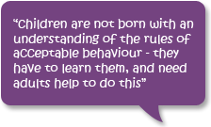

Slide 3
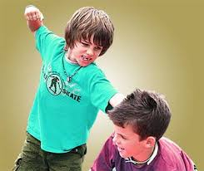
COMMON BEHAVIOURAL AND SOCIAL DISORDERS IN CHILDREN
BY
Mrs. AKHILA.C.
(M.Sc. CHILD HEALTH NURSING)
ASSISTANT PROFESSOR
JUBILEE MISSION COLLEGE OF NURSING
THRISSUR

Slide 4
CENTRAL OBJECTIVE
At the end of the class students will acquire knowledge regarding “Common Behavioral and Social Disorders in Children” and develop desirable attitude and skills towards the topic and in future practice.

Slide 5
SPECIFIC OBJECTIVES
At the end of the class Students will be able to,
define behavioral disorders
enlist the causes of behavioral disorders
enumerate the classifications of behavioral disorders
describe the behavioral problems of infancy
discuss the behavioral problems of childhood
explain the behavioral problems of adolescence
describe the nursing responsibilities in behavioral disorders

Slide 6
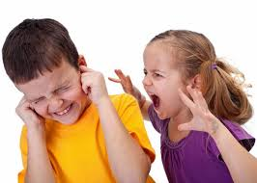
OVERVIEW
INTRODUCTION
DEFINITION
CAUSES
CLASSIFICATION
BEHAVIOURAL PROBLEMS OF INFANCY
BEHAVIOURAL PROBLEMS OF CHILDHOOD
BEHAVIOURAL PROBLEMS OF ADOLESCENCE
NURSING RESPONSIBILITIES

Slide 7
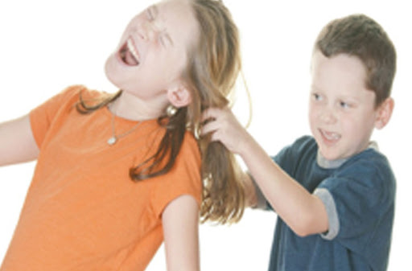
INTRODUCTION
BEHAVIORAL PROBLEMS ARE MAINLY DUE TO FAILURE IN ADJUSTMENT TO EXTERNAL ENVIRONMENT AND PRESENCE OF INTERNAL CONFLICT.
IT IS ALWAYS REQUIRE
SPECIAL ATTENTION.

Slide 8

DEFINITION
A CHILD IS SAID TO HAVE A BEHAVIORAL DISORDER WHEN HE OR SHE DEMONSTRATES BEHAVIOUR THAT IS NOTICEABLY DIFFERENT FROM THAT EXPECTED IN THE SCHOOL OR COMMUNITY.

Slide 9
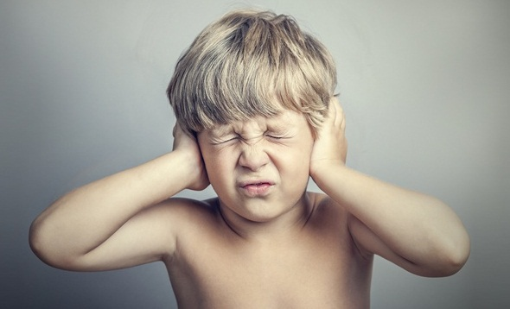
CAUSES OF BEHAVIOURAL DISORDERS
FAULTY PARENTAL ATTITUDE
INADEQUTE FAMILY ENVIRONMENT
HANDICAPPED CONDITIONS
INFLUENCE OF SOCIAL RELATIONSHIP
INFLUENCE OF MASS MEDIA
INFLUENCE OF SOCIAL CHANGE

Slide 10
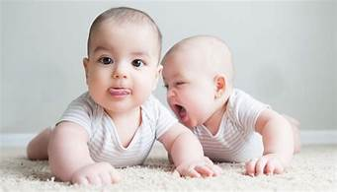
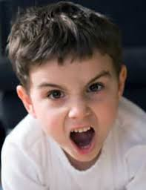
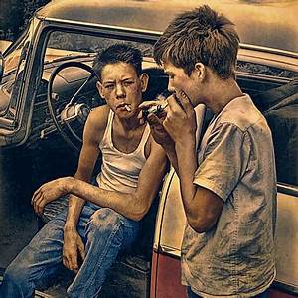
CLASSIFICATION
SOME BEHAVIORAL PROBLEMS ARE SPECIFIC TO PARTICULAR AGE GROUP. SO ACCORDING TO AGE IT IS DIVIDED IN TO 3 GROUPS.
BEHAVIOURAL PROBLEMS OF INFANCY
BEHAVIOURAL PROBLEMS OF CHILDHOOD
BEHAVIOURAL PROBLEMS OF ADOLESCENCE

Slide 11
BEHAVIOURAL PROBLEMS OF INFANCY

Slide 12
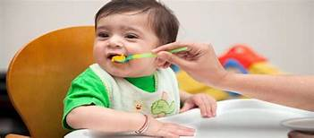
RESISTANCE TO FEEDING OR IMPAIRED APPETITE
INFANT MAY REFUSE NEW FOODS DUE TO DISLIKE OF TASTE OR DUE TO SEPARATION ANXIETY FROM MOTHER.
AVOID SEPARATION OF PARENTS, CHANGE OF FOOD ITEMS, PROVIDE TENDER LOVING CARE

Slide 13
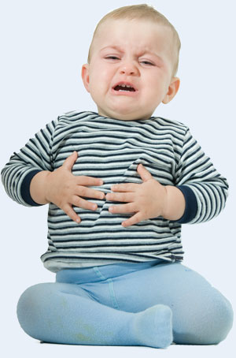
2. ABDOMINAL COLIC
IT IS A CONDITION CHARACTERIZED BY INTENSE CRAMPING OR COLICKY PAIN, WHICH MAY BE ACCOMPANIED BY NAUSEA AND VOMITING
PLACE BABY ON UPRIGHT POSITION, BURPING, FREQUENT FEEDING,ANTISPASMODIC DRUGS

Slide 14
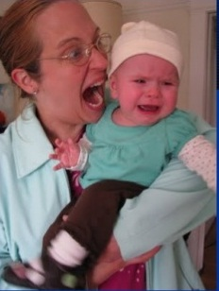
3. SEPARATION ANXIETY (STRANGER ANXIETY)
IT IS THE NORMAL FEAR EXPRESSED BY INFANTS WHEN REMOVED FROM THEIR MOTHERS OR APPROACHED BY STRANGERS.
IT MAY CONTINUE UP TO 13-15 MONTHS OF AGE.
GRADUAL APPROACH AND LOVING CONCERN OF THE STRANGER.

Slide 15
B. BEHAVIOURAL PROBLEMS OF CHILDHOOD

Slide 16
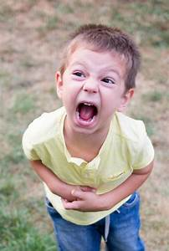
1. TEMPER TANTRUMS
IT IS A SUDDEN OUTBURST OR VIOLENT DISPLAY OF ANGER.
USUALLY PRESENT IN BOYS AND SINGLE CHILD
PROFESSIONAL HELP FROM CGC, CALM & LOVING APPROACH OF PARENTS, PHYSICAL ACTIVITIES FOR DIVERSION, PROTECT FROM SELF INJURY

Slide 17
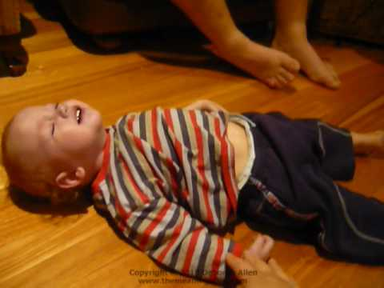
2. BREATH-HOLDING SPELL
IT IS OBSERVED IN RESPONSE TO ANGER AND FRUSTRATION.
FOUND WITH VIOLENT CRYING,HYPERVENTILATION AND SUDDEN CESSATION OF BREATHING, CYANOSIS RIGIDITY, AND SLOW HR.
OCCURS BETWEEN 6 MONTHS TO 5 YEARS OF AGE.
PUNISHMENT IS NOT APPROPRIATE, IDENTIFICATION &CORRECTION OF REASONS ARE ESSENTIAL APPROACH.

Slide 18
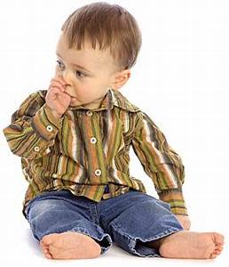
3. THUMB SUCKING
HABIT DISORDER DUE TO FEELING OF INSECURITY AND POOR BREASTFEEDING
BEYOND 4 YEARS LEADS TO GI INFECTIONS, THUMB DEFORMITY, MALALIGNMENT OF TEETH AND SPEECH DIFFICULTIES (D&T)
AFTER 7-8 YEARS INDICATES SIGNS OF STRESS
KEEP HANDS BUSY BY DISTRACTION, SHOULD NOT SCOLD THE CHILD, FOLLOW HYGIENIC MEASURES, CONSULTATION WITH DENTIST & SPEECH THERAPIST

Slide 19

4. NAIL BITING
IT IS A SIGN OF TENSION, INSECURITY AND SELF PUNISHMENT OR MAY OCCUR AS IMITATING THE PARENT
FOUND IN SCHOOL AGE BEYOND 4 YEARS
IDENTIFY THE CAUSE WITH THE HELP OF A CLINICAL PSYCHOLOGIST, AVOID PUNISHMENT, KEEP CHILD’S HAND BUSY,DEVELOP SELF CONFIDENCE

Slide 20
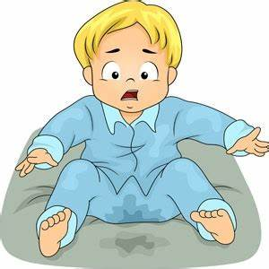
5. ENURESIS OR BED WETTING
REPITITIVE INVOLUNTARY PASSGE OF URINE AT INAPPROPRIATE PLACE BEYOND THE AGE OF 4-5 YEARS
CAUSES ARE SMALL BLADDE CAPACITY, INAPPROPRIATE TOILET TRAINING AND DEEP SLEEP
MANAGEMENT DEPENDS ON CAUSE.
ORGANIC CAUSES ARE MANAGED WITH SPECIFIC TREATMENT
NON-ORGANIC CAUSES TO BE MANAGED WITH EMOTIONAL SUPPORT & ENVIRONMENT MODIFICATION

Slide 21
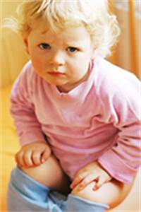
6. ENCOPRESIS
IT IS THE PASSAGE OF FECES INTO INAPPROPRIATE PLACES AFTER THE AGE OF 5 YEARS
CAUSED BY EMOTIONAL DISTURBANCES DUE TO STRESS, ANXIETY AND ANGER
MANAGEMENT IS BY PARENTAL SUPPORT, REASSUARANCE, COUNSELLING, TOILET TRAINING,etc

Slide 22
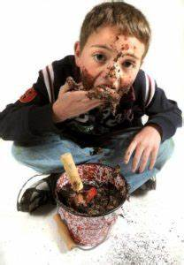
7. GEOPHAGIA OR PICA
IT IS A HABIT DISORDER OF EATING NON-EDIBLE SUBSTANCES LIKE CLAY, PAINT, CHALK, PENCIL, etc
IT IS NORMAL UP TO THE AGE OF 2 YEARS
CAUSED BY PARENTAL NEGLECT, POOR SOCIOECONOMIC STATUS, POOR ATTENTION OF CAREGIVERS
MANAGEMENT IS DONE WITH PSYCHOTHERAPY OF PARENTS AND THE CHILD

Slide 23

8. TICS OR HABIT SPASM
TICS ARE SUDDEN, ABNORMAL, REPITITIVE, RAPID, PURPOSELESS AND INVOLUNTARY MOVEMENTS MUSCLES LIKE EYE BLINKING, TONGUE PROTRUSION, etc.
IT IS DUE TO GENETIC DISORDER WITH ONSET AT 11 YEARS
MANAGEMENT IS BY BEHAVIOR THERAPY, DRUG THERAPY AND COUNSELLING

Slide 24

9. SPEECH PROBLEMS
IT INCLUDES,
STUTTERING OR STAMMERING (INTERRUPTION IN THE FLOW OF SPEECH)
CLUTTERING (UNCLEAR AND HURRIED SPEECH)
DELAYED SPEECH BEYOND 3 YEARS CAN BE CONSIDERED AS ORGANIC CAUSES LIKE MR AND AUTISM
DYSLALIA MEANS DIFFICULTY IN ARTICULATION DUE TO ABNORMLITIES OF TEETH, JAW OR PALATE
MANAGEMENT IS BY CORRECTION OF DEPRIVATION, MODIFICATION OF FAMILY ENVIRONMENT AND COUNSELLING

Slide 25
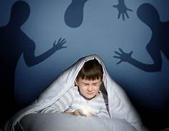
10. SLEEP DISORDERS
IT INCLUDES
DIFFICULTY TO FALL ASLEEP
NIGHT MARES (BAD DREAMS)
NIGHT TERRORS (SCREAMING DURING SLEEP)
SOMNAMBULISM (SLEEP WALKING)
SOMILILOQUY (SLEEP TALKING)
BRUXISM ( TEETH GRINDING DURING SLEEP)
COMMON IN CHILDREN WITH ANXIETY, TENSION AND OVERACTIVITY
MANAGEMENT IS BY LIGHT DIET IN DINNER,PLEASANT STORIES AT BED TIME, DOORS AND WINDOWS TO BE KEPT CLOSED,SPECIFIC DRUG THERAPY AND PSYCHOTHERAPY

Slide 26
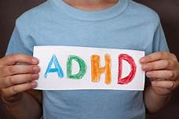
11. ATTENTION DEFICIT DISORDERS
THESE ARE LEARNING DISBILITIES RELATED TO CNS DYSFUNCTION OR HYPERACTIVITY
CHILD WILL MANIFEST WITH READING DISABILITY, IMPAIRED MEMORY, POOR SPEECH DEVELOPMENT, OVERACTIVE AND INATTENTIVE
MANAGEMENT INCLUDES BEHAVIOR MODIFICATION, COUNSELING, GUIDANCE OF PARENTS,AND DRUG THERAPY TO TREAT CNS DYSFUNCTION

Slide 27
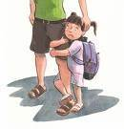
12. SCHOOL PHOBIA
IT IS THE ABNORMAL FEAR OF GOING TO SCHOOL
CAUSES INCLUDES ANXIETY OF MATERNAL SEPARATION, OVER PROTECTIVE MOTHER,TEASING BY OTHER STUDENTS, FEAR OF EXAMS AND TEACHERS, etc
IT CAN BE MANAGED BY HABIT FORMATION, PLAT SESSION, RECREATIONAL ACTIVITIES AT SCHOOL, AND FAMILY COUNSELLING TO RESOLVE ANXIETY OF MATERNAL SEPARATION

Slide 28
C. BEHAVIOURAL PROBLEMS OF ADOLESCENCE

Slide 29
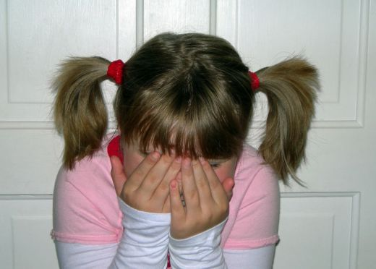
1. MASTURBATION
IT IS THE GENITAL STIMULATION BY HANDLING THE GENITALS GIVES PLEASURE TO THE CHILDREN
BOYS ARE MOSTLY ENGAGE WITH THIS PRACTICE
IT IS DUE TO ANXIETY AND SEXUAL EXCITEMENT
IN PUBESCENT PERIOD IT HAS A ROLE IN PHYSICAL AND EMOTIONAL DEVELOPMENT AND ALSO HELPS IN TENSION RELIEF
IN EXCESSIVE MASTURBATION CHILD NEEDS SPECIAL ATTENTION, RECREATION AND DIVERSION, SEX EDUCATION AND COUNSELING

Slide 30
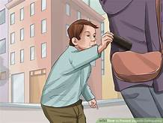

2. JUVENILE DELIQUENCY
IT MEANS INDULGENCE IN AN OFFENCE BY A CHILD IN THE FORM OF PURPOSEFUL AND UNLAWFUL CTIVITIES DONE HABITUALLY AND REPEATEDLY
THE MAIN CAUSES ARE POOR ECONOMY, LACK DISCIPLINE, INFLUENCE OF MASS MEDIA, LACK EDUCATION AND LIFE STYLES, etc.
DELIQUENT CHILDREN NEEDS SYMPATHETIC ATTITUDE WITH NECESSARY GUIDANCE, COUNSELING FOR MODIFICATION OF BEHAVIOR, HEALTHY RELATIONSHIP, PROVIDING EDUCATIONAL OPPORTUNITIES AND FULLFILLMENT OF BASIC NEED, etc.

Slide 31

3. SUBSTANCE ABUSE OR DRUG ABUSE
IT IS THE REPEATED INTAKE OF HABIT FORMING SUBSTANCES OR DRUGS LIKE TOBACOO, ALCOHOL, SLEEPING PILLS, COCAINE, CHARAS, GANJA, etc.
IT IS A THREATENING SOCIAL PROBLEMS OF SCHOOL GOING AND ADOLESCENCE AGE GROUP
REASONS INCLUDES POOR PARENTAL GUIDANCE, LACK OF EDUCATION, GANG ACTIVITIES, DISTURBED FAMILY, AND LACK OF RECRETION, etc.
MANAGEMENT IS BY PSYCHOTHERAPY, DEADDICTION SERVICES, REHABILITATION, PUBLIC AWARENESS, HEALTH EDUCATIONBAND PROPER GIDANCE, etc.

Slide 32

4. ANOREXIA NERVOSA
IT IS AN EATING DISORDER FOUND AS REFUSAL OF FOOD TO MAINTAIN NORMAL BODY WEIGHT BY REDUCING FOOD INTAKE ESPECIALLY FATS ANS CARBOHYDRTES
MOST OFTEN IN ADOLESCENT GIRLS
THERE IS NO SPECIFIC ORGANIC CAUSE
MANAGEMENT INCLUDES PSYCHOTHERAPY, BEHAVIOR MODIFICATION, NUTRITIONAL REHABILITATION, ANTIDEPRESSANT DRUGS AND COUNSELLING, etc.

Slide 33

NURSING RESPONSIBILITIES
ASSESSMENT OF PROBLEMS OF THE CHILD.
INFORMING THE PARENTS AND MAKING THEM AWARE.
ASSISTING PARENTS, TEACHERS AND FAMILY MEMBERS.
PROVIDE COUNSRLING SERVICES.
ENCOURAGING CHILD FOR BEHAVIOUR MODIFICATION.
PARTICIPATING IN MANAGEMENT AS A MEMBER OF HEALTH TEAM AND ORGANIZING CGC.
REFERRING THE CHILDREN TO BETTER HEALTH CARE FACILITIES, SOCIAL WELFARE AND SUPPORT AGENCIES.

Slide 34
REFERENCES
BOOK REFERENCES
“Dorothy R. Marlow, Barbara A Redding “ ” Textbook of paediatrics nursing,” 6th edition; Sounder’s publication; 2009; pg.no- 947-56
“ A Parthasarathy” “IAP textbook of pediatrics” 3rd edition; 2006; Jaypee publication pg no – 128
“Marliyn J Hockenberry, Wilson Winkelstein” “ Wong’s ‘Essentials of Pediatric nursing’”, 7th edition, elseveir publications pg no- 159,.231
Parul data, “Pediatric Nursing”, 2nd edition, elseveir publications pg. No-264.
Dutta p. Pediatric nursing 2nd ed. New Delhi: Japypee brothers, 2009. P-282 – 86.
Ghai P.O., Paul K.V, Bagg. A essential ;paediatrics. 7th ed. New Delhi: CBS publishers; 2010. Pg.no – 1302-08
NET REFERENCES
www.pediatric.com , indianpediatrics.net

Slide 35


Slide 36


