Slide 1
Alzheimer’ s disease
Ms. Anusha

Slide 2
definition
It’s a chronic, progressive, degenerative disease of the brain
It is the most common form of dementia
- a. Alzheimers disease ( most common form of dementia- 60% -80% of
dementia cases
- b. Vascular dementia
- c. Dementia with lewy bodies (alpha synuclein)
- d. Fronto temporal dementia
- e. Mixed dementia

Slide 3
incidence
More than 3 million Indians estimated to have dementia
It raise to 6 million by 2050
Men have higher incidence of vascular dementia
2/3 alzheimers disease are women

Slide 4
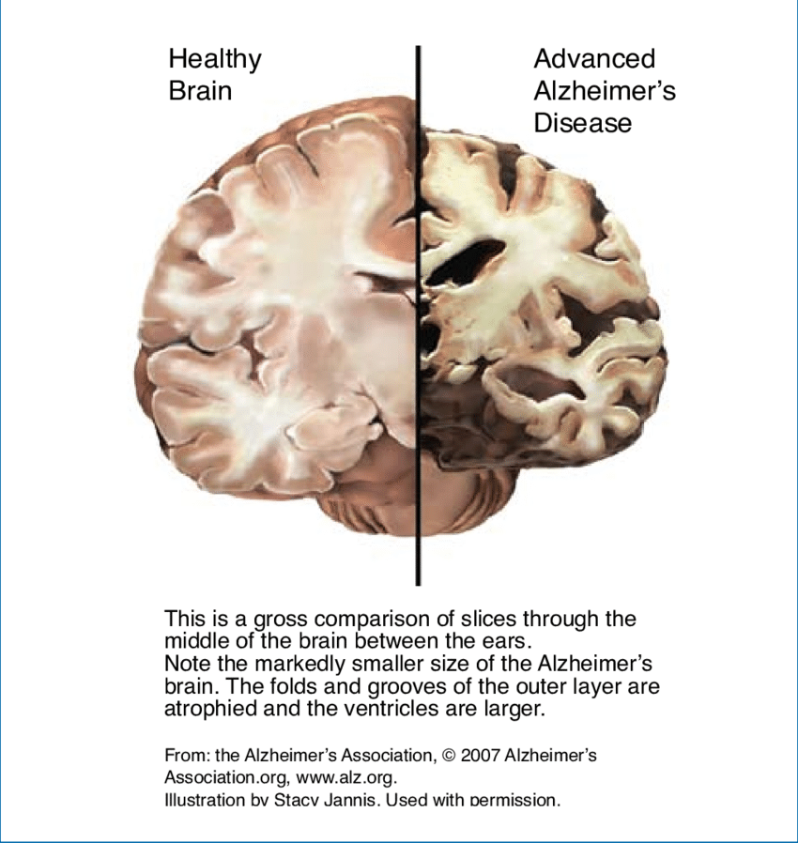

Slide 5
etiology
Unknown
Environmental factors
Age is the risk( but not a normal part of ageing process)
Genetic factors autosomal dominant disorder, mutations in 1,14,21 genes
Increased level of beta amyloid
First gene associated with AD was epsilon (E ) chromosome 19
Familial Alzheimers – inheritance within a family, early onset ( before 60)- presenilin 1, 2, APP gene mutation leads to over production of beta amyloid
Sporadic alzheimers- no familial connection. Late onset (above 60)

Slide 6
DM
Hypertension
Smoking
Hypercholesterolemia
Obesity
Trauma

Slide 7
pathophysiology
1. Amyloid plaques:
abnormal amount of beta amyloid cleaved from APP( amyloid precursor protein) and released into the circulation
beta amyloid fragments come together in clumps to form plaques and attach to neurons
Microglia react to the plague and cause inflammation

Slide 8
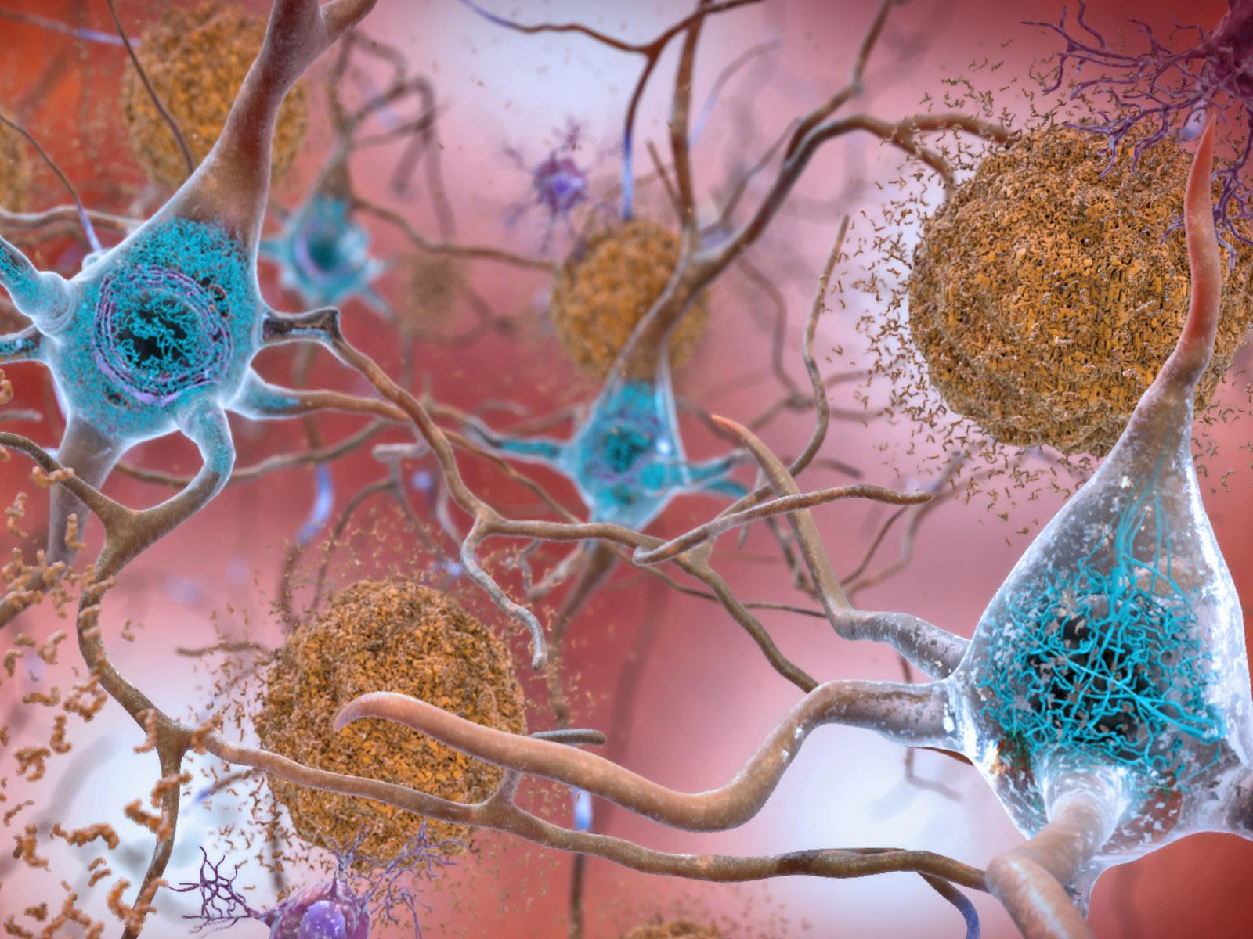

Slide 9
- plaques appear in certain part of the brain consisting of clusters of insoluble deposits of a protein called ß- amyloid, other protein remnants, microglia and astrocytes
- it develops in areas of brain used for memory, cognitive function and hippocampus (short term memory)
- eventually it attacks the cerebral cortex responsible for language and reasoning

Slide 10
2. Neurofibrillary tangles
- abnormal collection of twisted protein cells inside the nerve cells. The main component of these structures is a protein called Tau
- Tau protein in the CNS involved in providing support for the neuron microtubules
- chemical changes in the neuron produce structural changes in Tau proteins resulting in neurofibrillary tangles

Slide 11
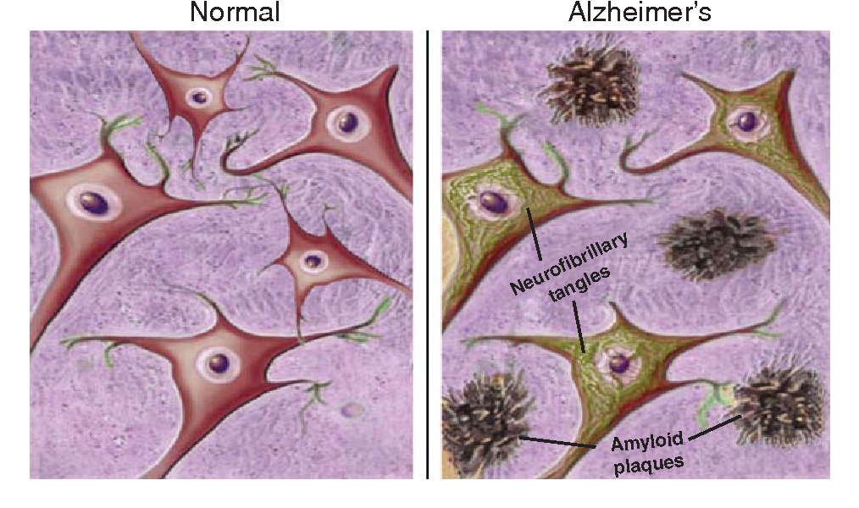

Slide 12
3. Loss of connections between neurons
- these process results in structural damage and the affected parts shrink ( brain atrophy)
4. Neuron death
- final stage brain tissue shrunk significantly and death of neirons

Slide 13
Clinical manifestations
Memory loss affect job skills
Difficulty performing familiar task
Language problems
Disorientation to time and place
Poor or decreased judgement
Misplacing things
Changes in mood and behaviour
Changes in personality
Los of initiative
Problems with abstract thinking

Slide 14
During initial stage
Changes in cognitive function
Memory loss
Mild disorientation
Trouble with words and numbers
As AD progresses
Personal hygiene deteriorates

Slide 15
Stages of Alzheimer’ s disease
Mild
Short term memory impairment
Loss of initiative and interest
Forget recent events
Small personality changes
Unable to solve simple maths
Slow in plan and organize

Slide 16
2. Moderate
Memory loss and confusion is more obvious
Trouble organizing and planning
Help for dress
Incontinence
Trouble recognize family members
Delusion, hallucination, behavioural problem

Slide 17
3. Severe
Severe cognitive impairment
Unable to perform self care activities
Needs help in daily needs
May not be able to talk
Cannot understand words
Difficulty eating and swallowing
Incontinence
immobility

Slide 18
Diagnostic evaluation
History and physical assessment
Neuro psychologic testing and MMSE
CSF analysis- level of tau protein
Brain imaging test- CT, MRI, PET ( brain atrophy, amyloid deposit)
CBC
ECG
Serum creatinine, creatinine, BUN
Thyroid function
Liven function
Screening for depression
Biomarkers- showing beta amyloid accumulation

Slide 19
Medial management
Decreased memory and cognition
- cholinesterase inhibitors- block cholinesterase responsible for breakdown of acetylcholine- donepezil, galantamine
- n methyl d aspartate receptors- protects brain nerve cells- memantine
Depression
- Selective Serotonin reuptake inhibitors- improve cognitive ability- fluvoxamine
Behavioural problems
- Antipsychotics- haloperidol
- benzodiazepines- clonazepam
Sleep disturbance- zolpidem

Slide 20
Nursing management
Maintain fuctional ability as long as possible
Maintained in safe environment
Meet personal care needs
Reduce care givers stresss
Maintain personal emotional and physical stress

Slide 21
Modifying the environment. Reducing clutter and noise can make it easier for someone with dementia to focus and function.
Hide objects that can threaten safety, such as knives and car keys. Monitoring systems can alert if the person with dementia wanders.
Simplifying tasks. Break tasks into easier steps and focus on success, not failure. Structure and routine also help reduce confusion in people with dementia.

Slide 22
Therapies
Several dementia symptoms and behavior problems might be treated initially using nondrug approaches, such as:
Occupational therapy. An occupational therapist can show you how to make the home safer and teach coping behaviors. The purpose is to prevent accidents, such as falls; manage behavior

Slide 23
Nursing management
Enhance communication. When talking with loved one, maintain eye contact. Speak slowly in simple sentences, and don't rush the response. Present one idea or instruction at a time. Use gestures and cues, such as pointing to objects.
Encourage exercise. The main benefits of exercise in people with dementia include improved strength, balance and cardiovascular health. Exercise may also be helpful in managing symptoms such as restlessness. Some research also shows that physical activity might slow the progression of impaired thinking in people with Alzheimer's disease, and it can lessen symptoms of depression.

Slide 24
Engage in activity. Plan activities the person with dementia enjoys and can do. Dancing, painting, gardening, cooking, singing and other activities can be fun, can help you connect with your loved one, and can help the loved one focus on what he or she can still do.
Establish a night time ritual. Behavior is often worse at night. Try to establish going-to-bed rituals that are calming and away from the noise of television, meal cleanup and active family members. Leave night lights on in the bedroom, hall and bathroom to prevent disorientation. Limiting caffeine, discouraging napping and offering opportunities for exercise during the day might ease nighttime restlessness.

Slide 25
Keep a calendar. A calendar might help your loved one remember upcoming events, daily activities and medication schedules. Consider sharing a calendar with your loved one.

Slide 26
prevention
Getting regular exercise
Avoid smoking habits
Avoiding harmful use of alcohol
Controlling weight
Eating a healthy diet
Maintaining healthy blood pressure, cholesterol and blood sugar levels,

