Slide 1
BANDAGES
SHIBI P GEORGE

Slide 5
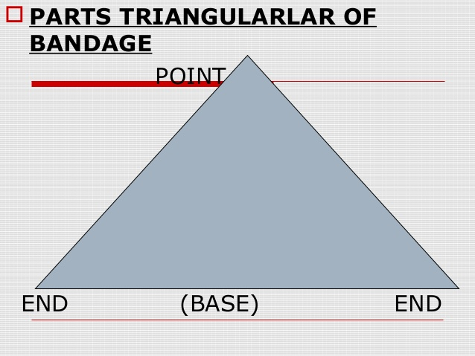

Slide 8
THANK YOU

